Slide 1
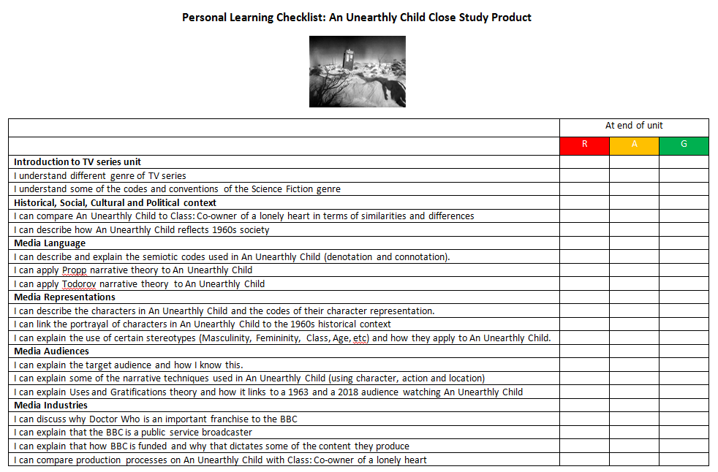
Representation │ Audiences │ Industries │ Language
Lesson 1: Introduction
Bell work
Collect your ‘An Unearthly Child’ Personal Learning Checklist and stick in your book – you must revisit this at the end of each lesson and again at the end of the unit.

Slide 2
TV Series – What is it?
Representation │ Audiences │ Industries │ Language
Lesson 1: Media Language
A TV series is a set of connected TV episodes that run under the same title eg Game of Thrones. They usually are structured in ‘seasons’ or ‘series’ and often end with a ‘season finale’. ‘Season’ is the US definition and in the UK we historically used the term ‘Series’ although over the last decade ‘Season’ has become a more generic global media term. For the purpose of this unit and GCSE, we will use the term series.
In your books, and in your own words:
Write down a definition of a TV series.
Make a list of ten popular series.

Slide 3
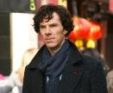
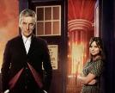
TV Series – What different genre of series exist?
Representation │ Audiences │ Industries │ Language
Lesson 1: Media Language
Genre is the term for any TV of film media product that has a chosen style that follows certain codes and conventions e.g. Comedy. Genres can change and there is increasingly a fashion to combine genres e.g. Romance and Comedy becomes a ‘RomCom’. What genre are the following TV series?
Sherlock
Doctor Who
Game of Thrones
Big Bang Theory
Peaky Blinders
In your books, and in your own words:
Write down a definition of genre.
For each of the above – list the genre you think it is.

Slide 4
TV Series – What different genre of series exist?
Representation │ Audiences │ Industries │ Language
Lesson 1: Media Language
Genre is the term for any TV of film media product that has a chosen style that follows certain codes and conventions e.g. Comedy. Genres can change and there is increasingly a fashion to combine genres e.g. Romance and Comedy becomes a ‘RomCom’. What genre are the following TV series?
Sherlock
Crime
Doctor Who
Science Fiction
Game of Thrones
Fantasy
Big Bang Theory
Comedy
Peaky Blinders
Gangster
Whilst all of these will have elements of multi-genre eg. Sherlock has elements of comedy written in it; the overriding genres are highlighted.

Slide 5
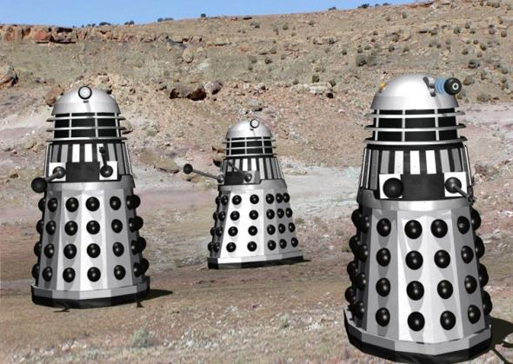
What genre is this and why?
Representation │ Audiences │ Industries │ Language
Lesson 1: Media Language
In your books, and in your own words:
What is the denotation?
What is the connotation?
What genre is it and why?
What other information might you need to know what genre it is?
Answer: N.I.C.S.

Slide 6
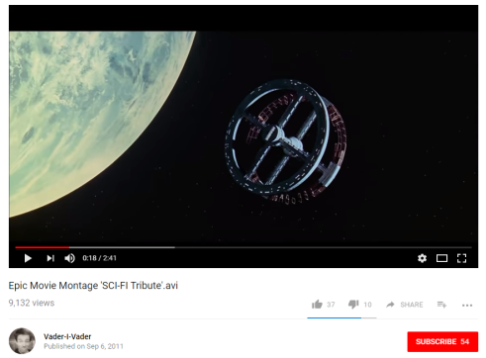
Defining Genre: Find out the NICS in Science Fiction
Representation │ Audiences │ Industries │ Language
Lesson 1: Media Language
Click image to view

Slide 7
Defining Genre: Find out the NICS
Representation │ Audiences │ Industries │ Language
Lesson 1: Media Language
To get clarity of a particular genre, being clear about the NICS will give you an accurate answer:
Narrative – is the typical stereotypes used. If it an action film, you will may expect to see Todorov style narrative structures [studied in Advertising unit]
Iconography – the mise-en-scene (the arrangement of the props, costumes, lighting, etc] to create a particular look. A horror movie may be particularly dark, bloody, bare props, etc.
Characters – the people who drive the story. Here you may see certain type of Propp roles in certain genres. In Fantasy there is often a hero, princess, helper, villain etc.
Setting – the locations or timescale used. In Western movies, you will often see it located in American or Mexican deserts around 1860s, for example.
Write a definition of NICS and how they help you identify a genre.
Define mise-en-scene [Keyword]
For Star Wars, state the NICS that tell you it is a Science Fiction movie.
In your books, and in your own words:

Slide 8
Defining Genre: Science Fiction NICS
Representation │ Audiences │ Industries │ Language
Lesson 1: Media Language
 | Description | Example from TV / Film
Narrative
Iconography
Characters
Setting
In your books, and in your own words:
Write a definition of NICS and how they help you identify the science fiction genre.
Define mise-en-scene [Keyword]

Slide 9
Defining Genre: Science Fiction NICS
Representation │ Audiences │ Industries │ Language
Lesson 1: Media Language
 | Description
Narrative | Alien invasion leading to taking over the Earth. Survivors battle to survive their dangerous worlds. Time-travel stories (Dr Who) involve travelling to past or future to change history. Development of new technology or species and the consequences of it. Psychological or biological changes brought onto characters due to scientific changes and over experimentation.
Iconography | High-tech gadgets (e.g. light saber) Holographic images Use of CGI/special effect/makeup Weapons of mass destruction Spaceships | Teleportation machines Laboratory Lab coats Robots High-tech/unique costumes (usually metal, shiny with unique design)
Characters | Maverick space adventurers (Han Solo) Heroes or heroines, forced by circumstance to fight for humanity’s survival (Luke Skywalker) Tyrannical rulers (Darth Vadar) Machines, Robots, Humanoids, Aliens, Mutants.
Setting | Earth or Alternative versions of the earth Futuristic setting Parallel universe | Space/planets – often barren wastelands [dystopian] Different dimension Spaceships

Slide 10
Representation │ Audiences │ Industries │ Language
Lesson 2: Dr Who context
Doctor Who: a cultural phenomenon
Long running BBC TV sci-fi series originally ran from 1963 to 1989
Listed in Guinness World Records as the longest-running science fiction television show in the world.
Successfully brought back in 2005, produced by BBC Wales in Cardiff.
839 Doctor Who episodes have been televised since 1963.
The Doctor explores the universe in a time-travelling space ship called the TARDIS [Time And Relative Dimension In Space]. The TARDIS has a vast interior but appears smaller on the outside.
The Doctor travels through space and time preventing evil aliens or people from harming innocent people or changing history.
The Doctor has gained numerous reoccurring enemies during his travels, including the Daleks, the Cybermen, and the Master, another renegade Time Lord.
Twelve actors have headlined the series as the Doctor. The transition from one actor to another is written into the plot of the show with the concept of regeneration into a new incarnation.

Slide 11
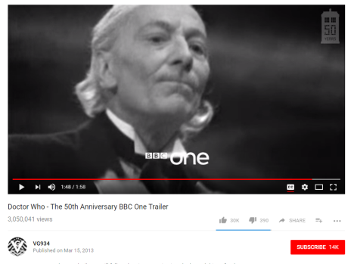
Representation │ Audiences │ Industries │ Language
Lesson 2: Dr Who context
Doctor Who: Factfile [Homework activity]
Who was Doctor Who?
What was the narrative in the show?
When did the programme first start?
What genre is Doctor Who?
What are the NICS in Doctor Who?
Name some of the actors who have played Doctor Who?
Click image to view
Introduction to Doctor Who

Slide 12
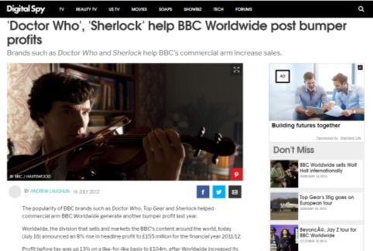
Representation │ Audiences │ Industries │ Language
Lesson 2: Dr Who context
Doctor Who: Importance to BBC
Doctor Who is one of the most iconic franchises that the BBC has. It has been launched all over the world through BBC Worldwide and generates huge income.
In 2014, a BBC Worldwide Report stated Sherlock and Doctor Who as now the BBC’s biggest exports of the past year. That worldwide simulcast of “The Day of the Doctor” in 2013 saw this episode air at the same time in 98 countries on six continents.
BBC Worldwide's top-selling brands featured all the usual suspects, including Doctor Who were sold in over 100 markets.
The five core BBC brands - Top Gear, Doctor Who, Lonely Planet, Dancing with the Stars (the international version of Strictly Come Dancing) and BBC Earth - accounted for 30% of Worldwide's headline sales.
It is vital to the BBC that it is seen as a global player in producing high-demand content to a global audience.
In your books, and in your own words:
Why is the Doctor Who franchise so important to the BBC?

Slide 13
The licence fee allows the BBC's UK services to remain free of advertisements and independent of shareholder and political interest.
Representation │ Audiences │ Industries │ Language
Lesson 3: The BBC and Doctor Who
Industry study: The BBC – what is the BBC and how is it funded?
http://www.bbc.co.uk/corporate2/insidethebbc/whoweare
The BBC (British Broadcasting Corporation) is a public service organisation and the oldest national broadcaster and the biggest in terms of employees [over 20,000]. It is different from other TV broadcasters in that funding comes from us all as BBC licence fee payers. Other channels rely on advertising and sponsorship. The BBC has 5 key purposes:
To provide impartial news and information to help people understand and engage with the world around them
To support learning for people of all ages
To show the most creative, highest quality and distinctive output and services
To reflect, represent and serve the diverse communities of all of the United Kingdom’s nations and regions and, in doing so, support the creative economy across the United Kingdom
To reflect the United Kingdom, its culture and values to the world
The licence fee costs every household £147 each year and pays for a wide range of TV, radio and online content. Such a licence is required to legally receive broadcast television across the UK. The licence fee is classified as a tax, and its evasion is a criminal offence. According to the BBC's 2013/14 Annual Report, its total income was £5 billion.
“The licence fee allows the BBC's UK services to remain free of advertisements and independent of shareholder and political interest.” BBC website
In your books, and in your own words:
What is the BBC and what does it stand for?
Make a list of ten BBC services or channels.
How is the BBC funded? Why does this make the BBC different in the content it provides?

Slide 14
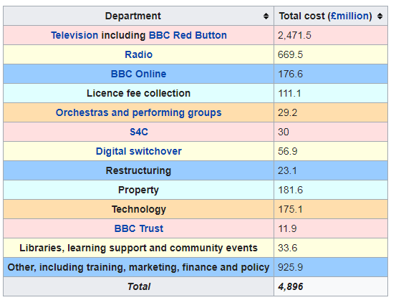
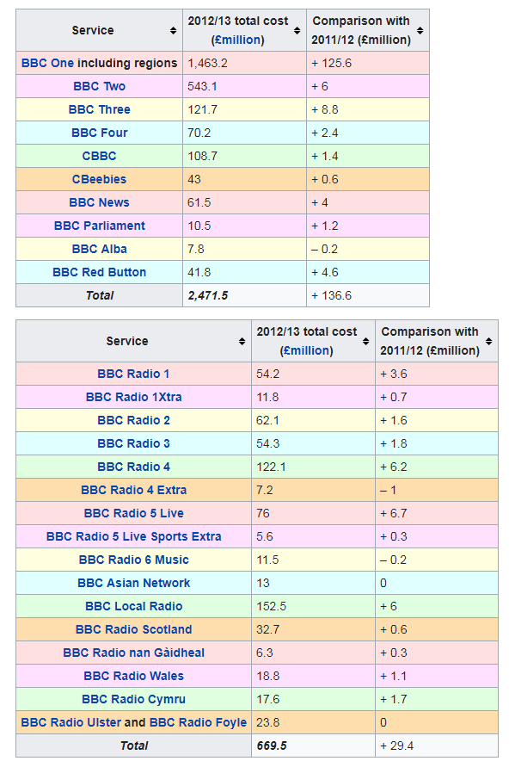
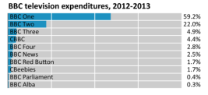
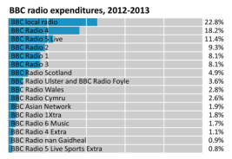
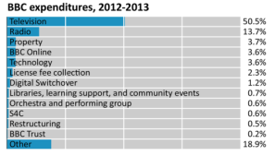
The licence fee allows the BBC's UK services to remain free of advertisements and independent of shareholder and political interest.
Representation │ Audiences │ Industries │ Language
Lesson 3: The BBC and Doctor Who
Industry study: The BBC – channels and services
Source: https://en.wikipedia.org/wiki/BBC

Slide 15
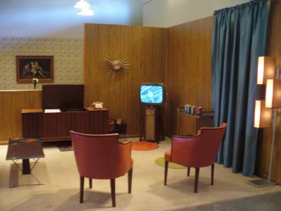
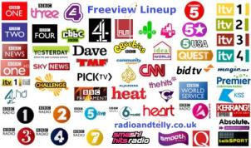
The licence fee allows the BBC's UK services to remain free of advertisements and independent of shareholder and political interest.
Representation │ Audiences │ Industries │ Language
Lesson 3: The BBC and Doctor Who
Industry study: The BBC – what did it look like in 1963?
Here is your standard 1963 living room. A small black and white television and large record player/radio.
The only BBC TV content then was:
BBC1 BBC2
Radio: BBC Light Programme (became Radio 2)
BBC Home Service (became Radio 4)
BBC Third Programme (became Radio 3)
THERE WAS ONLY ONE OTHER TV CHANNEL (ITV)
How does this TV environment of 1963 (3 channels only on at certain times of the day compare with the multi-channel, multi-format, (TV, web, etc) of today?
In your books, and in your own words:
Make a list of how TV was different in 1963.

Slide 16
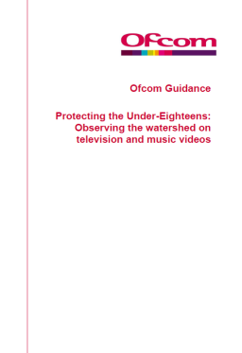
Representation │ Audiences │ Industries │ Language
Lesson 3: The BBC and Doctor Who
Industry study: The BBC – what is the BBC and how is it regulated?
http://www.bbc.co.uk/corporate2/insidethebbc/whoweare
The BBC (British Broadcasting Corporation) has a board of governing members and is independent of government intervention. This means that it can produce content free impartially.
The BBC is regulated by OfCOM (the Office of Communications). OfCOM oversees all media channels and produces a code of conduct that all media channels must follow or have their licence to make content removed and/or be fined heavily. This includes suitable programmes before the 9pm watershed and various other quality standards.
In your books, and in your own words:
What does OfCOM stand for?
OfCOM ‘regulate’ broadcasters like the BBC. What does this mean?

Slide 17
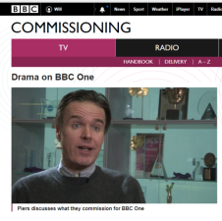
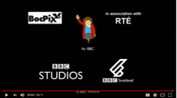
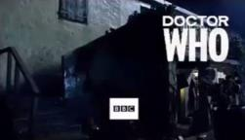
Representation │ Audiences │ Industries │ Language
Lesson 3: The BBC and Doctor Who
Industry study: How are programmes commissioned by the BBC?
The BBC commissions programmes from external companies as well as producing their own programmes.
Look at the end of many programmes and you will see a logo for a production company who have made the programme (paid for by the BBC).
Click image to view video
Not Going Out (Avalon)
Mrs Browns Boys
(BocPix)
People Just Do Nothing
(RoughCut)
In your books, and in your own words:
What is commissioning?
How does commissioning work?
Why does the BBC not commission Doctor Who from an external production company?
Doctor Who, on the other hand, is produced exclusively by the BBC as it such a flagship programme for the Corporation. They want and need to retain ownership, editorial and merchandising control.

Slide 18
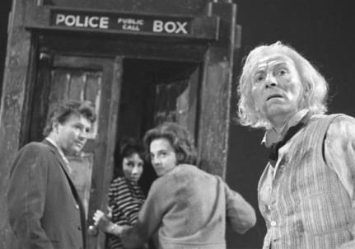
Representation │ Audiences │ Industries │ Language
Lesson 4: An Unearthly Child
Introduction to the episode
An Unearthly Child (sometimes referred to as 100,000 BC) is the first serial in the British science fiction television series Doctor Who. It was first broadcast on BBC TV in four weekly parts from 23 November to 14 December 1963. Scripted by the Australian writer Anthony Coburn, it introduces William Hartnell as the First Doctor and original companions; Carole Ann Ford as the Doctor's granddaughter Susan Foreman, with Jacqueline Hill and William Russell as school teachers Barbara Wright and Ian Chesterton. The first episode deals with Ian and Barbara's discovery of the Doctor and his time-space ship TARDIS in a junkyard in contemporary London.

Slide 19
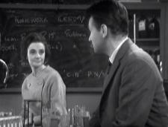
Representation │ Audiences │ Industries │ Language
Lesson 4: An Unearthly Child
Watch the episode
For rights reasons, the video cannot be shared on this resource. You can purchase a copy here:
https://www.amazon.co.uk/Doctor-Who-Beginning-Unearthly-Destruction/dp/B000C6EMTC/ref=sr_1_1?ie=UTF8&qid=1513156737&sr=8-1&keywords=an+unearthly+child

Slide 20
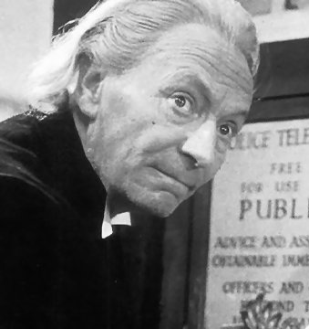
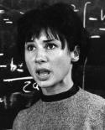
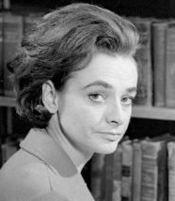
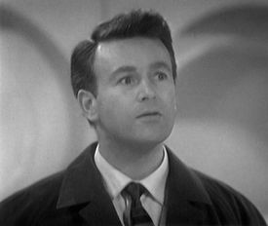
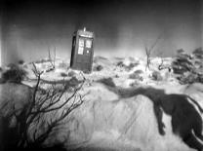
Representation │ Audiences │ Industries │ Language
Lesson 5: An Unearthly Child Analysis
Narrative structure
Is Propp’s narrative theory (taught in Galaxy CSP) helpful in analysing the episode?
Doctor Who
Grandfather
Susan Foreman
Student / Granddaughter
Barbara Wright
Teacher
Ian Chesterton
Teacher
Alien?
 | Who would this be? | How do you know?
Hero
Princess
Villain
Helper
Is Propp useful? Remember, you can be flexible when classifying characters into these types. Some characters fulfill more than one of the type. If you don’t think Propp fits in this first episode, why not? Do you think it may be deliberate? If so, why?

Slide 21
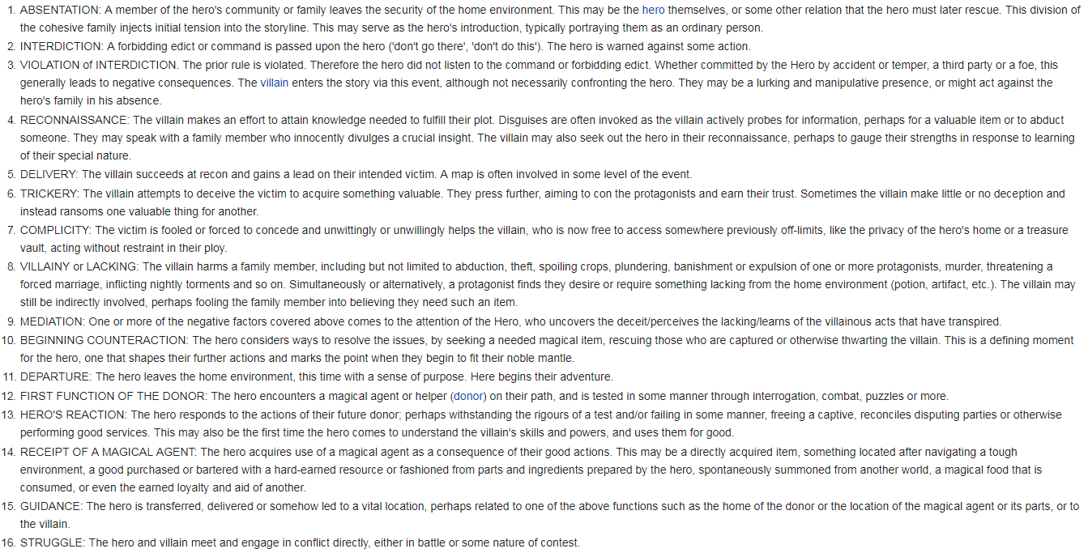
Representation │ Audiences │ Industries │ Language
Lesson 5: An Unearthly Child Analysis
Narrative structure
How else might Propp be useful in analysing the ‘Unearthly Child’ narrative?
Propp analysed Russian fairy-tales and believed that stories took 31 functions. How many of these does this episode cover?
Page 1 of 2

Slide 22
Representation │ Audiences │ Industries │ Language
Lesson 5: An Unearthly Child Analysis
Narrative structure
How else might Propp be useful in analysing the ‘Unearthly Child’ narrative?
Propp analysed Russian fairy-tales and believed that stories took 31 functions. How many of these does this episode cover?
From https://en.wikipedia.org/wiki/Vladimir_Propp
In your books, and in your own words:
Explain how some of Propp’s ideas link with some of the narratives in Doctor Who.
Page 2 of 2

Slide 23
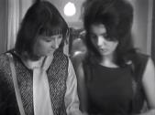
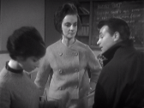
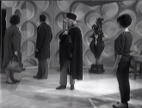
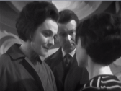
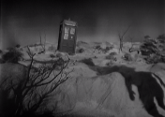
Representation │ Audiences │ Industries │ Language
Lesson 5: An Unearthly Child Analysis
Narrative structure
Is Todorov’s narrative theory (taught in Galaxy CSP) helpful in analysing the episode?
 | What happens in the narrative that makes you think this?
Equilibrium
Disruption
Recognition
Reparation
New equilibrium

Slide 24
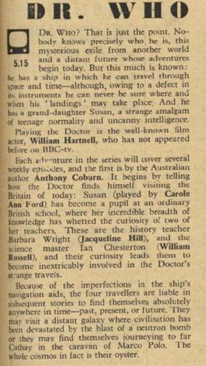
Representation │ Audiences │ Industries │ Language
Lesson 6: An Unearthly Child Analysis
Episode Genre and Semiotic Codes
Narrative: An Unearthly Child
Taken from: http://www.bbc.co.uk/archive/doctorwho/6404.shtml
Opposite you can see the Radio Times article outlining the basic narrative of Doctor Who.
Text:
Dr. Who In this series of adventures in space and time, the title-role will be played by William Hartnell.
DR. WHO? That is just the point. Nobody knows precisely who he is, this mysterious exile from another world and a distant future whose adventures begin today. But this much is known: he has a ship in which he can travel through space and time - although, owing to a defect in its instruments he can never be sure where and when his 'landings' may take place. And he has a grand-daughter Susan, a strange amalgam of teenage normality and uncanny intelligence.
Playing the Doctor is the well-known film actor, William Hartnell, who has not appeared before on BBC-tv.
Each adventure in the series will cover several weekly episodes, and the first is by the Australian author Anthony Coburn. It begins by telling how the Doctor finds himself visiting the Britain of today: Susan (played by Carole Ann Ford) has become a pupil at an ordinary British school, where her incredible breadth of knowledge has whetted the curiosity of two of her teachers. These are the history teacher Barbara Wright (Jacqueline Hill), and the science master Ian Chesterton (William Russell), and their curiosity leads them to become inextricably involved in the Doctor's strange travels.
Because of the imperfections in the ship's navigation aids, the four travellers are liable in subsequent stories to find themselves absolutely anywhere in time - past, present, or future. They may visit a distant galaxy where civilisation has been devastated by the blast of a neutron bomb or they may find themselves journeying to far Cathay in the caravan of Marco Polo. The whole cosmos in fact is their oyster.
In your books, and in your own words:
Describe the story – use the Radio Times article to help you (or the storyboard on the next slide).

Slide 25
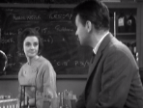
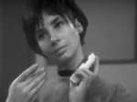
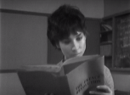
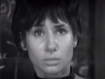
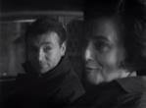
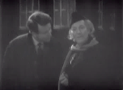
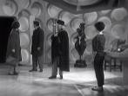
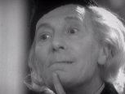
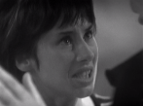
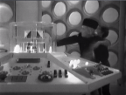
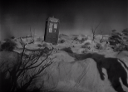
Representation │ Audiences │ Industries │ Language
Lesson 6: An Unearthly Child Analysis
Episode Genre and Semiotic Codes
Narrative: An Unearthly Child
1. Discussing gifted (if strange) student, Susan.
2. Strange facial expression when introduced to Susan ‘Alien?’
3. Pointers to time travel:
‘That’s not right – French Revolution’
‘The decimal system hasn’t started yet’
4. Pointers to space:
‘’What’s the 5th dimension?’ ‘Space’.
5. Barbara and Ian go to investigate the address that doesn’t exist. They are mirroring our desires as the audience.
6. Meet the enigmatic Grandfather who denies all knowledge of Susan.
7. Force their way into the TARDIS (which is much bigger inside than out).
8. Share narrative that they are travellers. Exiles. ‘My civilisation.’ Wanderers in the 4th dimension.
9. Susan wants to stay on Earth.
10. The Doctor sets off the TARDIS for a new destination.
In your books, and in your own words:
The narrative technique of flashback is used. Why is this manipulation of time useful in developing this non-linear narrative?
A TV series links narrative over a series of episodes. Describe how the use of cliffhanger helps this episode to do this.
Define each of the words in bold italics.
11. The TARDIS travels through time and space.
12. The TARDIS lands on another planet and ends of a ‘cliff-hanger.’

Slide 26
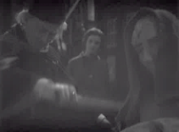
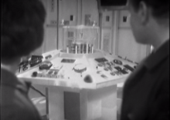
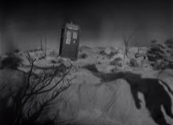
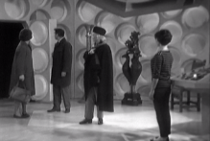
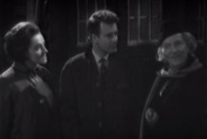
Representation │ Audiences │ Industries │ Language
Lesson 6: An Unearthly Child Analysis
Episode Genre and Semiotic Codes
Iconography: An Unearthly Child
Eerie interior of house. Strange dummies and props. ‘Other-worldliness”
Tardis control:
Electrical and futuristic – classic SciFi mise-en-scene.
Tardis exterior:
Teleportation machine. Classic Sci-Fi device. Familiar feature to 1960s audiences.
Use of TV effects (this time travel technique is an early version of CGI). Classic Sci-Fi device.
Tardis interior: metallic, futuristic walls.
Dr. Who costume: always eccentric and idiosyncratic.
In your books, and in your own words:
Describe the iconography used in An Unearthly Child.
Using the Internet, find some examples from future Doctor Who series where this iconography is continued.

Slide 27
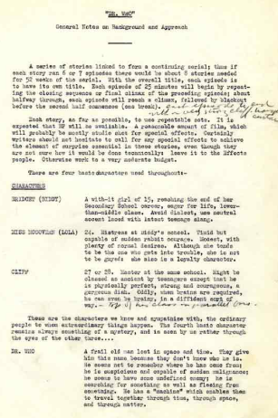
Representation │ Audiences │ Industries │ Language
Lesson 7: An Unearthly Child Analysis
Episode Genre and Semiotic Codes
Taken from: http://www.bbc.co.uk/archive/doctorwho/6403.shtml?page=1
Opposite you can see the original background notes on characters created by the writer, CE Webber, and BBC Head of Drama, Sydney Newman. Text below:
A series of stories linked to form a continuing serial; thus if each story ran 6 or 7 episodes there would be about 8 stories needed for 52 weeks of the serial. With the overall title, each episode is to have its own title. Each episode of 25 minutes will begin by repeating the closing sequence or final climax of the preceding episode; about halfway through, each episode will reach a climax, followed by blackout before the second half commences (one break).
[Handwritten note from Sydney Newman: "Each episode to end with a very strong cliff-hanger."]
Each story, as far as possible, to use repeatable sets. It is expected that BP [abbreviation for 'back projection'] will be available. A reasonable amount of film, which will probably be mostly studio shot for special effects. Certainly writers should not hesitate to call for any special effects to achieve the element of surprise essential in these stories, even though they are not sure how it would be done technically: leave it to the Effects people. Otherwise work to a very moderate budget.
There are four basic characters used throughout:-
CHARACTERS [clearly some names were changed prior to final production]
BRIDGET (BIDDY) A with-it girl of 15, reaching the end of her Secondary School career, eager for life, lower-than-middle class. Avoid dialect, use neutral accent laced with latest teenage slang.
MISS McGOVERN (LOLA) 24. Mistress at Biddy's school. Timid but capable of sudden rabbit courage. Modest, with plenty of normal desires. Although she tends to be the one who gets into trouble, she is not to be guyed: she also is a loyalty character.
CLIFF 27 or 28. Master at the same school. Might be classed as ancient by teenagers except that he is physically perfect, strong and courageous, a gorgeous dish. Oddly, when brains are required, he can even be brainy, in a diffident sort of way. [Handwritten note from Sydney Newman: "Top of his class in the parallel bars."]
These are the characters we know and sympathise with, the ordinary people to whom extraordinary things happen. The fourth basic character remains always something of a mystery, and is seen by us rather through the eyes of the other three....
DR. WHO A frail old man lost in space and time. They give him this name because they don't know who he is. He seems not to remember where he has come from; he is suspicious and capable of sudden malignance; he seems to have some undefined enemy; he is searching for something as well as fleeing from something. He has a "machine" which enables them to travel together through time, through space, and through matter.
Characters: An Unearthly Child

Slide 28
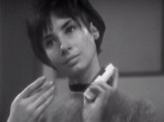
Representation │ Audiences │ Industries │ Language
Lesson 7: An Unearthly Child Analysis
Episode Genre and Semiotic Codes
Doctor Who
The Doctor represents the new age of technology and science that was emerging in the 1960s. The ‘space race’ was underway and the world was fascinated with all things space travel and linked to other planets. He represents this new world of discovery.
He is a Time Lord from the planet Gallifrey and he explores the universe with usually human companions who serve as audience surrogate characters to ask
Characters: An Unearthly Child
In your books, and in your own words:
Describe keyword exposition.
For each character, describe the semiotic character codes that they represent.
questions which allow the Doctor to provide relevant exposition. He is often eccentric, distracted and dark in mood. Some commentators have said he symbolises the struggle between good and evil, some have said he is a symbol of a God-like presence who wanders through time and space trying to change history for the better.
Susan Foreman
Barbara Wright and Ian Chesterton
Susan Foreman is the first of a long-standing tradition of Doctor Who companions. It was felt improper in 1963 for an older man, such as the Doctor, to be travelling through space with a young 15 year old girl; so she was written as his Granddaughter. She is a strong link to the young target audience and will often react in ways that the audience might in future episodes [e.g. screaming at aliens]. Classically relatable.
Barbara and Ian represent traditional human values and are classically middle class. They are the people the Doctor explains everything to, so that the audience understands as well. This is known as exposition.
They are also Science and History teachers so often offer advice and opinions to the Doctor on matters of space and time. They also have very clearly defined gender roles in the series.
She also provides a link between the chaotic alien madness of the Doctor and the human confusion embodied by Barbara and Ian (and the audience). She is therefore a translator of the more Sci-Fi elements of the story to a naïve 1960s audience. She can often be seen explaining some of the Doctor’s stranger outbursts to the humans Barbara and Ian. Another example of exposition.
Barbara and Ian also play the narrative role of mother and father to Susan who is very naïve and who has not had that paternal guidance from the Doctor. They are very traditional in their gender roles. Ian is very physical when there is fighting or physical work to be done. Barbara is represented in a more homely, caring role in the series. These were stereotypical gender roles in the early 60s – but times were changing. Ian and Barbara are bonded by their human characteristics in their Space adventures. They represent the caring, empathetic part of the human condition in how they look after Susan and, in later episodes, the Doctor himself.

Slide 29
Representation │ Audiences │ Industries │ Language
Lesson 7: An Unearthly Child Analysis
Episode Genre and Semiotic Codes
Setting: An Unearthly Child
The setting a TV series uses is important in establishing a sense of place that is familiar to the audience. In Doctor Who: An Unearthly Child, there are many features that are familiar to the audience (so quickly establish a sense of place and understanding of conventions eg. A school) and some that are very unfamiliar (eg. Another planet; although it is quickly recognisable as another planet). It is vital that the settings are believable to the audience. Look at the settings used in this episode:
‘Foggy’ London scene. Creates mystery and suspense
School setting. Creates familiarity for target audience.
Eerie interior of house. Strange dummies and props.
Tardis interior:
Electrical and futuristic – classic Sci-Fi mise-en-scene.
Alien planet:
Instantly recognised as other-wordly
In your books, and in your own words:
Why is setting important?
What settings does An Unearthly Child use and why?

Slide 30
Representation │ Audiences │ Industries │ Language
Lesson 8: An Unearthly Child Analysis
Representations of stereotypes
As we have seen in the advertising unit, stereotypes are used to quickly anchor certain representations of characters with the audience. Which stereotypes are used in this episode?
 | How is it portrayed in the episode and why? | Give an example
Place | Eg: London is the location for the episode. This would be instantly recognisable to the audience and is further reinforced with the Police Officer and the London fog. | The scene where the police officer is outside the Doctor’s house.
Education | Prompts: All well-educated? Does this link with target audience?
Masculinity | Prompts: Issues around control.
Femininity | Prompts: caring, sensitive.
Class | Prompts: All ABCs. Does this link with target audience?
Age | Prompts: Range of ages. Susan and Ian/Barbara may link to target audiences. Why is the Doctor so old?
In your books, and in your own words:
Complete this table in your books.
Why are other stereotypes not included? Link to target audience.

Slide 31
Representation │ Audiences │ Industries │ Language
Lesson 8: An Unearthly Child Analysis
The Audience for Unearthly Child
Who is the audience for this episode?
In your books, and in your own words:
Brainstorm a list of stereotypical audience members for this 1963 episode.
Remember that it was shown at 5.15 on a Saturday evening and was Sci-Fi.
Learn your ABCs – the ABC of audience classifications.
Look at who the studio audience was made up of at the original recording in 1963. This will give you a clue about the target audience in 1963.
 | Who would this be? | Examples of careers
A | Upper middle class and higher | Managerial / Executive
B | Middle class | Lower management.
C1 | Lower middle class | Supervisory / Clerical work
C2 | Skilled working class | Skilled manual workers
D | Working class | Semi or unskilled workers
E | Those at the lowest levels of subsistence | Pensioners of low paid workers
Note: There are no Ds and Es in the audience. Why not?

Slide 32
Representation │ Audiences │ Industries │ Language
Lesson 8: An Unearthly Child Analysis
The Audience for Unearthly Child
Why do we watch any media products? Find out about Uses and Gratification Theory.
In 1974, Blumler and Katz suggested that media audiences make active choices about what media to consume in order to meet certain needs. They were:
Background notes from the original series proposal. Note that Head of Drama says “It doesn't get across the basis of teaching of educational experience - drama based upon and stemming from factual material and scientific phenomena and actual social history of past and future.”
The need to be INFORMED and EDUCATED about the world in which we live.
The need to IDENTIFY personally with characters and situations in order to learn more about themselves.
The needs to be ENTERTAINED
The need to use the media as a talking point for SOCIAL INTERACTION
The need to ESCAPE from their daily grind into other worlds and situations.
Available at: http://www.bbc.co.uk/archive/doctorwho/6403.shtml?page=4
Clearly, it has been designed to educate. What other parts of Uses and Gratification Theory did it hit? Would it be the same today?
In your books, and in your own words:
Describe Uses and Gratification Theory.
What Uses and Gratification would this episode provide to a 1963 audience?
What Uses and Gratification would this episode provide to a 2018 audience?

Slide 33
Representation │ Audiences │ Industries │ Language
Lesson 8: An Unearthly Child Analysis
This concludes the Unearthly Child Close Study Product.
You will be required to use some comparison skills when you have completed the next CSP on a Doctor Who spin-off series
Class: Co-owner of a lonely heart

