Slide 1
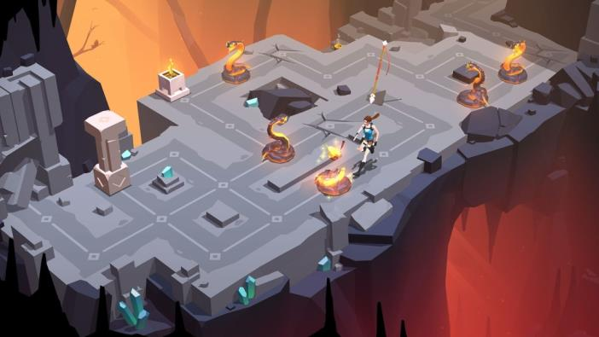
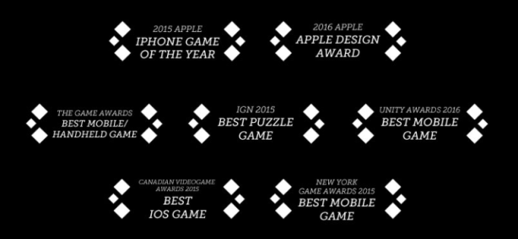
Online, Social and Participatory Media Close Study Product: Video Game - Lara Croft Go
Representation │ Audiences │ Industries │ Language
https://upload.wikimedia.org/wikipedia/commons/5/55/News-media-standards.jpg

Slide 2
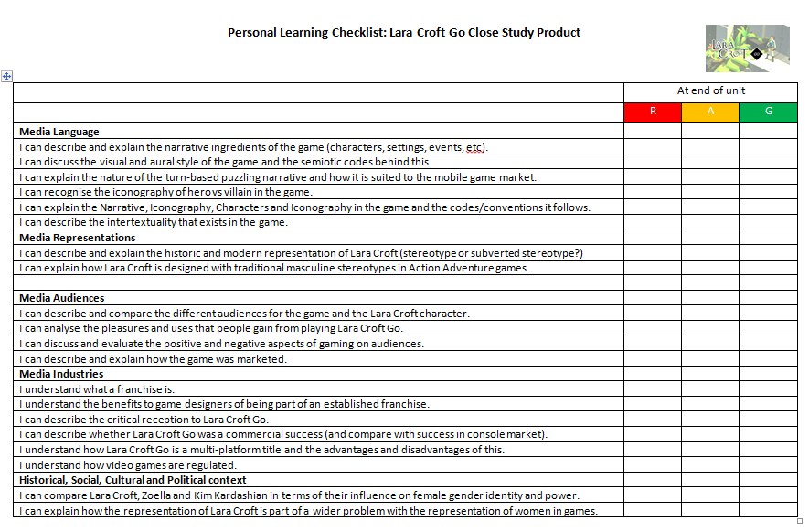
Complete the initial Personal Learning Checklist for the Lara Croft Go CSP as a starting point for your assessment
Representation │ Audiences │ Industries │ Language
https://upload.wikimedia.org/wikipedia/commons/5/55/News-media-standards.jpg

Slide 3
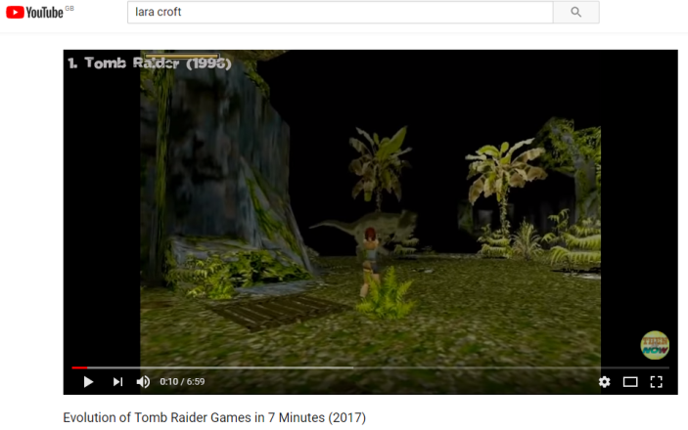
Representation │ Audiences │ Industries │ Language
https://upload.wikimedia.org/wikipedia/commons/5/55/News-media-standards.jpg
Lesson 1: The game
Media Representation: Who is Lara Croft?
Lara Croft was the central character (or protagonist] in the Tomb Raider games [and subsequent films and TV series].
The first Tomb Raider was designed in 1996 and was Action Adventure in genre.
Lara Croft is an iconic game and cultural figure and has variously been linked to:
Female lead characters in games.
Redefining gender in gaming.
Bringing sex appeal to gaming.
IGN credited a rise in PlayStation sales in part to Croft's debut on the PSOne.
Click image to view video
In your books, and in your own words:
After watching the video above, write a short description analysis of Lara Croft as a game character [i.e. what does she do?]
What genre were the original Tomb Raider games?
Why is she such an important figure in computer gaming history?

Slide 4
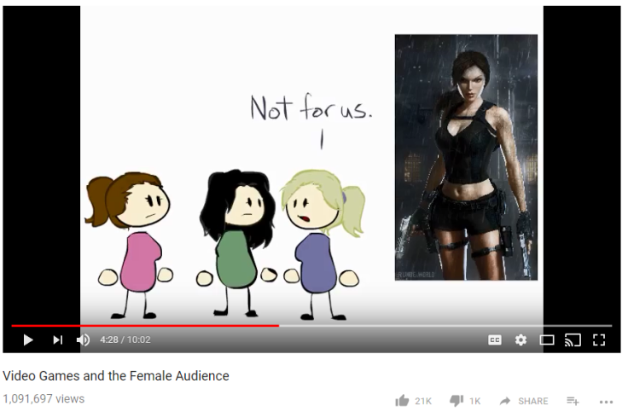
Representation │ Audiences │ Industries │ Language
Lesson 1: Women in Gaming
https://upload.wikimedia.org/wikipedia/commons/5/55/News-media-standards.jpg
Media Representation: Representation of women (and Lara Croft) in Gaming
Click image to view video
(First 5 minutes only)
In your books, and in your own words:
Why does the representation of women possibly stop women getting involved in gaming.
What was Lara Croft originally designed to represent?

Slide 5
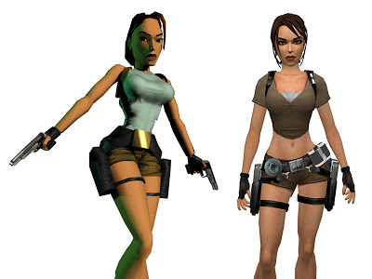
Representation │ Audiences │ Industries │ Language
Lesson 1: Women in Gaming
https://upload.wikimedia.org/wikipedia/commons/5/55/News-media-standards.jpg
Media Representation: Is Lara Croft a stereotypically female role in gaming?
Yes (traditional stereotype):
Object of sexual desire. Her body features were particularly exaggerated in early versions of games.
Scantily-clad designed for male audience. Would a male character be designed like this? Is Lara Croft is designed to be attractive to the male audience as she basically acquires all the features that some men would describe as perfect.
No (subverted stereotype):
She is an action hero – traditionally a male stereotype in gaming.
She is empowered female heroine – rare in gaming industry at the time. “The heroine, Lara Croft, is an intelligent, butt-kicking, gun-wielding, sexpot, ready to take on whatever comes her way.” Katherine Walker, Portrayal of Women in Media (Video Games)
Video link: How Lara Croft became a game changer
http://www.bbc.co.uk/news/uk-england-derbyshire-37619114
In your books, and in your own words:
How does Lara Croft conform to traditional representations of women and women and yet also subvert this stereotype?

Slide 6
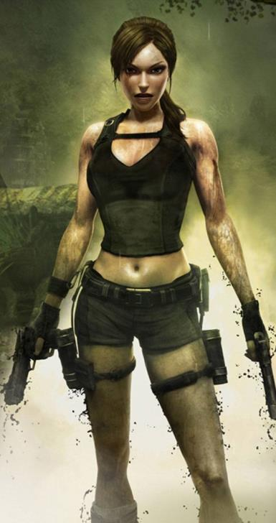
Representation │ Audiences │ Industries │ Language
Lesson 2: Lara Croft Design
https://upload.wikimedia.org/wikipedia/commons/5/55/News-media-standards.jpg
Media Representation: Is Lara Croft masculinised?
“Not just men and not just women were allowed to enjoy playing as Lara Croft -- Kennedy implies that the company Sony realized they could appeal to both audiences in one go - by creating an attractive hyper feminized (as in boobs) body with the ability to act out scenarios and activities previously only available to the male body. Lara is able to go into a male game-space, dungeons, tombs, jungles - the explorer's quest-- as no female avatar had done in the same way before.
That is not to say she is not still a problematic character as a representation to females. She is playable because she has been made masculine. She has little in the way of a romantic love interest and, like most female avatars, lacks a male body to gaze at (in the same way the female love interests of male avatars are).”
- Lex Vex, The Fullscape Blog
In your books, and in your own words:
How, in terms of her appearance and behaviour does she adopt characteristics of masculine gender identity? What characteristics are they?
Why would the game designers Square Enix do this? Who does she appeal to?

Slide 7
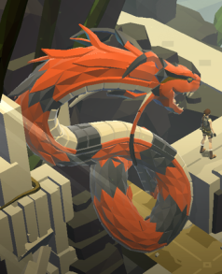
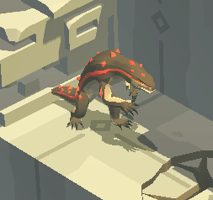
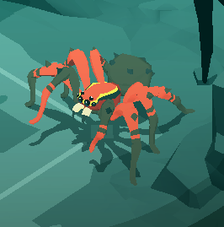
Representation │ Audiences │ Industries │ Language
“We really liked how the first Tomb Raider games were about Lara versus a hostile environment. It became clear that Lara wouldn’t be up against faceless henchmen, rather, she would be fighting to survive against dangerous creatures and escape deadly traps.”
https://upload.wikimedia.org/wikipedia/commons/5/55/News-media-standards.jpg
- Square Enix
Media Representation: Good vs Evil
Like many games, Lara Croft has the idea of Good versus Evil. Good is portrayed through the character of Lara and Evil through the following characters:
The Queen of Venom was the guardian (and boss character) of the Atlas of Beyond. She chased Lara Croft all over the mazes, once almost killing her. But Lara Croft used traps to hurt her, and when she retreated to her lair, Lara killed her with a spear throw to the throat.
Salamanders are enemies in Lara Croft GO. They mimic Lara's movements, and they must be over-smarted.
Spiders are enemies that appear in Tomb Raider II: Starring Lara Croft and Lara Croft Tomb Raider: Underworld.
Snakes are the most common enemy for Lara.
Lesson 2: Good vs Evil Design
In your books, and in your own words:
Why have these animals been chosen as a representation of evil (think scary, intertextuality in other media forms, etc).
Compare the representation of the good (Lara) vs the bad.

Slide 8
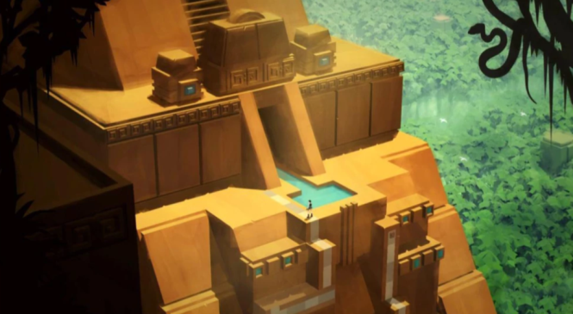
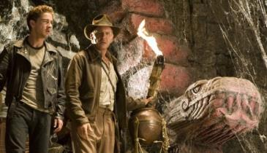
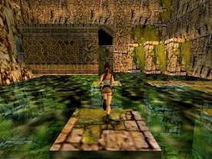
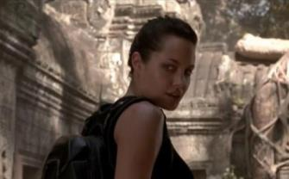
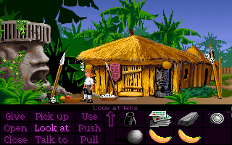
Representation │ Audiences │ Industries │ Language
“We were building an ancient world, unexplored and mysterious, strongly influenced by our memories of the first Tomb Raider.” - Square Enix
https://upload.wikimedia.org/wikipedia/commons/5/55/News-media-standards.jpg
Media Representation: Time and Place
Lesson 2: Game location
Lara Croft Go explores the ruins of an ancient civilization in the Amazon Jungle while fighting menacing enemies, overcome dangerous obstacles and traps, and ultimately, uncover the myth of the Queen of Venom. There is no specific timescale – but is modern-day in Lara’s weaponry.
This concept of action adventure exploring and uncovering relics from ancient civilisations is not new and there is some intertextuality here:
Indiana Jones movie
Original Tomb Raider games
Tomb Raider movie
Retro puzzle game, ‘Secret of Monkey Island’
In your books, and in your own words:
Why have these settings (ancient landscapes, jungle, etc) been chosen in the game?
What intertextuality exists here and why do you think that they have designed the game like this?

Slide 9
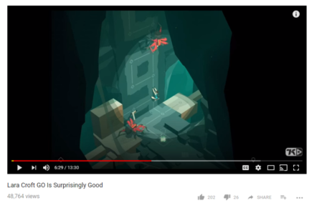
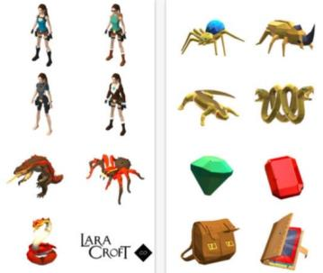
Representation │ Audiences │ Industries │ Language
Lesson 3: Narrative Structure
https://upload.wikimedia.org/wikipedia/commons/5/55/News-media-standards.jpg
Media Language: What are the features of the Lara Croft Go game?
Watch this 15 minute video review of the game.
In many ways, there are traditional Action Adventure elements to this game (she moves, she shoots, she avoids hazards). However, this game is a ‘turn-based puzzle’ which involves by-passing enemies and unlocking paths in a sequential manner which suits the ‘short timespan’ that people can sometimes commit to mobile gaming. It faithfully preserves element of original Tomb Raider game and brings the original adventure up to date.
Click image to view video
The game also involves collecting items that unlock special powers and tools that help your progress through the game. On the image to the left you can see many of the opponents that Lara comes across (Lizards, Snakes, Spiders) and some of the collectables. There are not many different enemies as memory size is key and given the transient nature of mobile gaming, immediate recognition/anchorage is important. The three act narrative structure proceeds from an orientation stage through various complications and blockages to a simple resolution.
In your books, and in your own words:
What features of the game follow the Action Adventure genre?
What features follow the turn-based puzzle genre? Why is this so suited to mobile gaming?
Describe the iconography used in the game (think Lara’s costume, think the ‘jungle-themed’).

Slide 10
Representation │ Audiences │ Industries │ Language
Lesson 3: Narrative structure and codes and conventions
https://upload.wikimedia.org/wikipedia/commons/5/55/News-media-standards.jpg
Media Language: NICs analysis of Lara Croft
 | Description
Narrative
Iconography
Characters
Setting
In your books, and in your own words:
After watching the video from the previous slide, you should be able to complete this NICs table to analyse the narrative devices used.

Slide 11
Representation │ Audiences │ Industries │ Language
Lesson 3: Narrative structure and codes and conventions
https://upload.wikimedia.org/wikipedia/commons/5/55/News-media-standards.jpg
Media Language: NICs analysis of Lara Croft (possible response)
 | Description
Narrative | Lara is explorer / adventurer on mission to unearth ancient secret. Narrative is built on explore model through ancient jungle landscape. There are puzzles to solve to progress through each level. Puzzles are based on timing certain moves, attacks and pressing switches to unlock doors and move objects. Enemies in the form of snakes, spiders and salamanders are placed in the way. Each enemy type has a specific movement pattern. Single-use items, such as spears, can be collected on levels and then used to dispatch enemies from a distance. Other mechanics include obstacles such as boulders, saw blades, and traps to avoid. The player can activate levers, which shift walls and platforms to open paths through the level. There are a range of limited collectibles for Lara to find on the way.
Iconography | The iconography follows the template laid down in previous Lara games and movies. The landscape is rainforest, the enemies are classically sinister/scary rainforest creatures, buildings are ancient. Lara wears her classic attire and there is instant anchorage in that imagery for loyal Tomb Raider fans.
Characters | The characters are Lara as heroine. Enemies are snakes, spiders and salamanders. There is a Boss character at the end of the game (the Queen of Venom). A boss character is a powerful end of game or level enemy that it is particularly difficult to beat.
Setting | The setting is Rainforest – although not specific where. This chimes with previous Tomb Raider outings and some of the established iconography in the Indiana Jones franchise. These mysterious settings are a regular trope - ‘a recurrent theme’

Slide 12
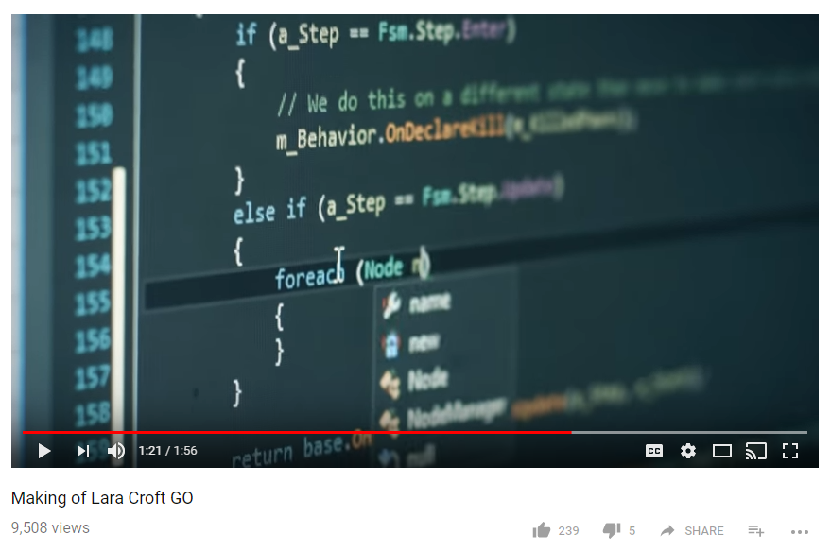
Representation │ Audiences │ Industries │ Language
Lesson 4: Visual and Aural codes
https://upload.wikimedia.org/wikipedia/commons/5/55/News-media-standards.jpg
Media Language: The thinking behind the game design of Lara Croft Go
Watch this 2 minute clip from Square Enix on the making of Lara Croft Go
Click image to view video

Slide 13
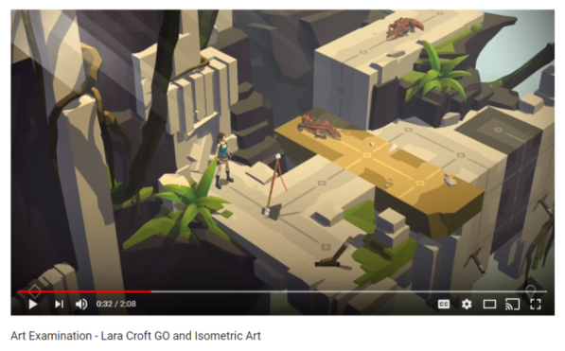
Representation │ Audiences │ Industries │ Language
“Acrobatics and platforming are key features of a Tomb Raider adventure, and we quickly realized that Lara had to be fully animated. Our animator did an amazing job of quickly producing a first batch of short animations for Lara, and immediately everything felt better. Again, we looked back at Lara’s classic animations from the first Tomb Raider and they fit right in with our turn-based game.” – Square Enix
https://upload.wikimedia.org/wikipedia/commons/5/55/News-media-standards.jpg
Lesson 4: Visual and Aural codes
Media Language: What is the visual appeal of the game
Watch this 2 minute analysis of the visual style of the game.
Use of isometric view – adds 3D mechanic to gameplay and puzzle solving.
Use of dark and light – at key points in game provides focus on the key action (remember, this was initially a mobile game so screen size was small)
Use of colour – to differentiate between levels and intensity of action.
Quality of animation – whilst the background graphics seem ‘blocky’ the key characters are animated fluidly.
Click image to view video
“We worked to define our own take on low-poly, finding the proper ratio between hard and soft edges, balancing flat surfaces versus geometric details, and establishing a framework for scene composition. The addition of foreground silhouettes and foggy backgrounds were key in crafting the final look of the game. Touch by touch, we honed in on an art direction that captured the essence of the old Tomb Raider but with a modern touch.” Square Enix
In your books, and in your own words:
Use the headings above (in bold) to describe and assess the visuals used in the game and why they have been designed like this.

Slide 14
Representation │ Audiences │ Industries │ Language
Lesson 4: Visual and Aural codes
https://upload.wikimedia.org/wikipedia/commons/5/55/News-media-standards.jpg
Media Language: How does the use of sound impact on the game experience?
“We see Lara Croft GO as an experience. Visuals are important but audio is just as essential, and this was a great medium to give a different take on what you might expect from a Lara Croft game.
Also, because this is a puzzle game, we knew we wanted something more atmospheric that wouldn’t impede your capacity to think.
With all these constraints in mind, we worked hard with Pixel Audio, a small studio in Montréal… and I think we found a mix that works pretty well!”
- Antoine Routon, Lara Croft GO's lead engineer
In your books, and in your own words:
Lara Croft Go does not overwhelm the player with sound effects. Why?

Slide 15
Representation │ Audiences │ Industries │ Language
Lesson 5: Target Audience
https://upload.wikimedia.org/wikipedia/commons/5/55/News-media-standards.jpg
Media Audiences: Lara Croft Go target audience
Who are the target audience for Tomb Raider / Lara Croft games? They fall into various groups and may be a mixture of all three:
Those interested in the quality of the innovative gameplay.
Those with brand loyalty based on the feminine empowerment displayed.
Those with brand loyalty based on sexualisation of Lara (especially if they played older Croft games when at a formative age)
This may not be as significant with the graphics in Lara Croft Go. Why? Think about how the representation of Lara has changed and become less ‘sexualised’ over the decades.
Remember that audiences consume media products for a variety of reasons (from Blumler and Katz Uses and Gratification Theory)
The need to be INFORMED and EDUCATED about the world in which we live.
The need to IDENTIFY personally with characters and situations in order to learn more about themselves.
The needs to be ENTERTAINED
The need to use the media as a talking point for SOCIAL INTERACTION
The need to ESCAPE from their daily grind into other worlds and situations.
In your books, and in your own words:
Who is the target audience for Lara Croft Go and why?
How is the target audience for Lara Croft different from Tomb Raider and why?
What pleasures and uses does playing Lara Croft Go offer?

Slide 16
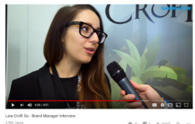
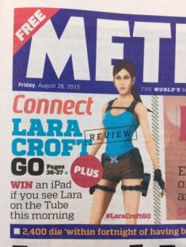
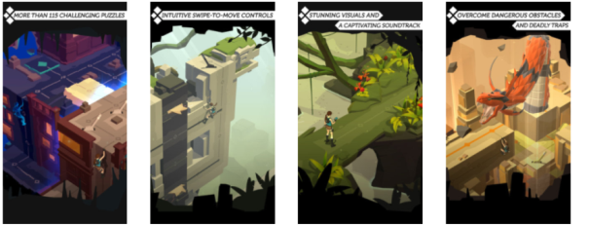
Representation │ Audiences │ Industries │ Language
Lesson 5: Advertising and Marketing the game
https://upload.wikimedia.org/wikipedia/commons/5/55/News-media-standards.jpg
Media Audiences: How was the game advertised and marketed?
Look how the advertising of the early Tomb Raider games differs from Lara Croft Go
1990s / 2000s
2015
Serious interviews on social media.
Screenshots on App store and Google Play etc.
Competitions on the Tube to stress mobile nature of game
Less ‘sexualised’ as they game is no longer designed like that.
Sexualised.
Aimed at ‘teen’ or ‘laddish’ audience.
In your books
Describe how the way Lara Croft Go was advertised and why.
What does the advertising tell us about the changing audience for Lara Croft Go and mobile gamers.
Why is the advertising budget different in mobile and console gaming?

Slide 17
Representation │ Audiences │ Industries │ Language
Lesson 5: Gaming – good or bad?
https://upload.wikimedia.org/wikipedia/commons/5/55/News-media-standards.jpg
Media Audiences: The positive and negative impact of gaming
Some critics point to the negative impact of gaming. What are the good and bad aspects of this art form?
Positive impacts | Negative impacts
Problem solving and logic. | Some research shows violent games can make people more violent.
Hand-eye coordination, fine motor and spatial skills. | Research has shown that playing some games may harm the brain.
Quick thinking, making fast analysis and decisions. | Too much video game playing socially isolates people.
Perseverance | Too much gaming means no time for other enriching life activities.
Mapping and memory. | Some video games can teach people the wrong values.
How to respond to challenges and frustrations. | Games can confuse reality and fantasy
Teamwork and cooperation when played with others | Games can be addictive and harm other areas of life (eg academic achievement)
Simulation, real world skills | Video games may also have bad effects on health (obesity, RSI)
Certain games encourage brain growth | Video games can make you less empathetic
Can you think of any more?
In your books, and in your own words:
Design your own Positive/Negative table.
Homework task: “With the growth of mobile gaming, the more we play games the more we damage society” To what extent do you agree or disagree with this statement?

Slide 18
Representation │ Audiences │ Industries │ Language
Lesson 6: Tomb Raiser franchise
https://upload.wikimedia.org/wikipedia/commons/5/55/News-media-standards.jpg
Media Industries: The Tomb Raider (and Lara Croft) franchise
“Tomb Raider is a media franchise that originated with an action-adventure video game series created by British gaming company Core Design. Formerly owned by Eidos Interactive, then by Square Enix after their acquisition of Eidos in 2009, the franchise focuses on a fictional English archaeologist Lara Croft, who travels around the world searching for lost artefacts and infiltrating dangerous tombs and ruins. The gameplay generally focuses around action-adventure exploration of environments, solving puzzles, navigating hostile environments filled with traps, and fighting numerous enemies. Additional media has grown up around the theme in the form of film adaptations, comics and novels. Tomb Raider games have sold over 58 million copies worldwide, becoming one of the best-selling video game franchises.” from https://en.wikipedia.org/wiki/Tomb_Raider
Click here to see the full list of Tomb Raider franchise media products: http://tvtropes.org/pmwiki/pmwiki.php/Franchise/TombRaider
In your books, and in your own words:
What is a media franchise?
When making a game, why is making a game for an existing franchise advantageous to a games producer when compared to developing a game for a brand-new character?

Slide 19
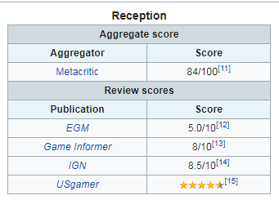
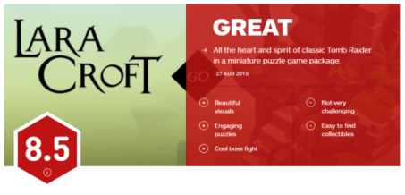
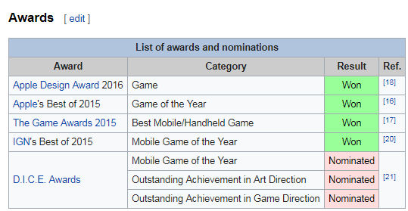
Representation │ Audiences │ Industries │ Language
Lesson 5: Critical and Commercial Reception
https://upload.wikimedia.org/wikipedia/commons/5/55/News-media-standards.jpg
Media Industries: Lara Croft Go critical reception
Tomb Raider Go was well received by critics. Metacritic (a site that collates reviews from across various media outlets) scored it 84/100
- US Gamer
- IGN
- Wired
In your books, and in your own words:
Looking at the information above, as Lara Croft Go a critical success?
Was it a commercial success? It had 11 million views initially and had been downloaded 280,000 times worldwide on iOS after a year at $5. This is a success. However, this is much less successful income than console game figures. Why are people less likely to pay for mobile games?
Notes:
https://www.tapsmart.com/news/insight-square-enix-on-why-it-wont-be-ditching-premium-mobile-titles-any-time-soon/
https://sensortower.com/blog/super-mario-run-25-million-downloads

Slide 20
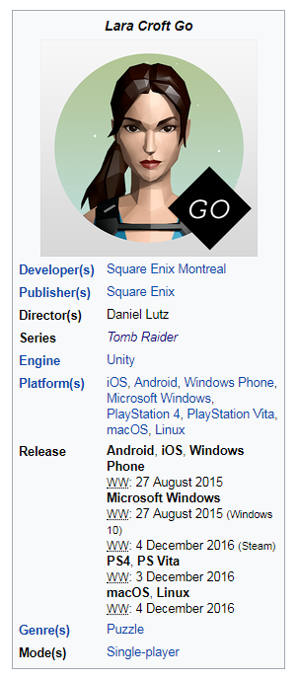
Representation │ Audiences │ Industries │ Language
Lesson 6: Critical and Commercial Reception
https://upload.wikimedia.org/wikipedia/commons/5/55/News-media-standards.jpg
Media Industries: Multi-platform sales
Look at the image on the left; Lara Croft Go is a multi-platform title. Many years ago, titles tended to be single platform as focusing on one system allows them to tailor the game to that hardware’s advantages leading to quicker turnaround times and a more polished final product. However, with increasing development costs, more and more developers are going multiplatform with their games in order to squeeze ever last drop of income out of a new release. While logically it would seem that making a game available to more people would increase sales, this doesn’t always happen. We must also consider the huge increase in resource needs and increased costs involved in making a game multiplatform. Also, when some games are exclusive to one platform this creates an ‘exclusivity’ factor that makes the game and console more desirable e.g. Uncharted4 on PS4.
In your books, and in your own words:
Complete this table on the advantages and disadvantages of multi-platform sales
Advantages | Disadvantages
Choose from:
More expensive to make | Bigger audience | Longer to develop | Not ‘exclusive’
Only big studios can do it | Only certain ‘licenses’ can carry multi-platform eg FIFA | Generates a social buzz | Creates greater brand loyalty
Notes:
https://www.iwu.edu/economics/PPE18/5Sacranie.pdf

Slide 21
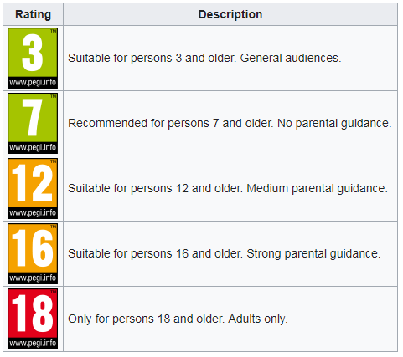
Representation │ Audiences │ Industries │ Language
Lesson 6: Game Regulation
https://upload.wikimedia.org/wikipedia/commons/5/55/News-media-standards.jpg
Media Industries: PEGI Game Ratings
PEGI stands for Pan European Game Information and is a European video game rating system established to help European consumers make informed decisions when buying video games or apps through the use of age recommendations and content descriptors.
It came into use in April 2003 and is now used in over 30 countries. It is designed to advise consumers on the suitability of the content in a game.
In your books and in your own words:
Define PEGI and state what it was designed for.
Why has the game industry felt it necessary to develop PEGI classifications. How has modern gameplay meant that this is required. Why would this not have been so required in the 1980s/1990s?

Slide 22
Representation │ Audiences │ Industries │ Language
Lesson 6: Comparing CSPs
https://upload.wikimedia.org/wikipedia/commons/5/55/News-media-standards.jpg
Historical, social and cultural context – comparing our CSPs
All of the CSPs in this section (Online, Social and Participatory Media) can be compared in terms of:
Gender identity – many see them all as strong representations of women who take control of their destiny and environment. Some women may feel that these are the representations of women (sexualised, obsessed with looks, etc) that reflects them.
Gender power – many see them all as women who have retained power and control. Kim and Zoella have clearly created a strong brand and are now in a position of great power and influence in the media world. Some people may argue that they have gained this power by reinforcing traditional stereotypes of women (in appearance and interests) and that this may be damaging to those who do not follow this stereotype. Equally, there may be an expectation that the way we look defines women in power.
 | Lara Croft | Kim Kardashian | Zoella
Gender Identity
Gender Power
Celebrity and followers
In your books and in your own words:
Draw this table in your books and complete.
Is the representation of women in games similar to the Lara Croft stereotype (sexualised, powerful, somewhat masculinised) or are there different representations? Is it a problem if women are represented this way in games industry? Explain why or why not?

Slide 23
Representation │ Audiences │ Industries │ Language
https://upload.wikimedia.org/wikipedia/commons/5/55/News-media-standards.jpg
This concludes the Lara Croft Go Close Study Product. Now complete your Personal Learning Checklist for this CSP.

