Slide 1
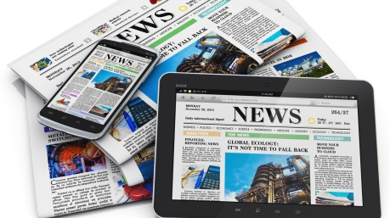
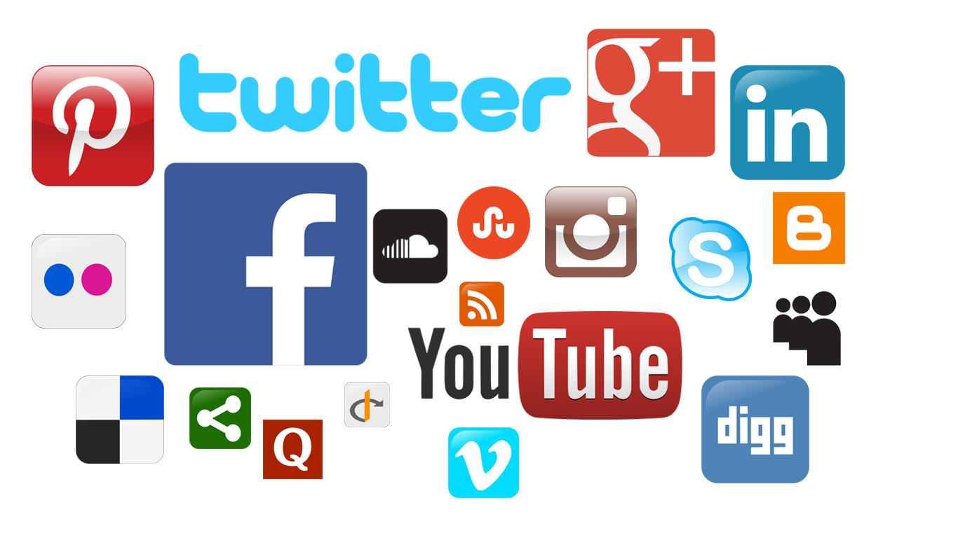
Online, Social and Participatory Media Close Study Product: Kardashian Hollywood App
Representation │ Audiences │ Industries │ Language
https://upload.wikimedia.org/wikipedia/commons/5/55/News-media-standards.jpg
Image source: https://upload.wikimedia.org/wikipedia/commons/b/bf/Socialmedia-pm.png

Slide 2
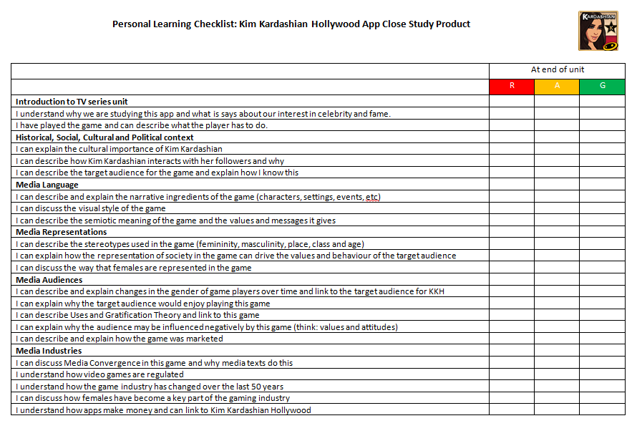
Online, Social and Participatory Media
Representation │ Audiences │ Industries │ Language
https://upload.wikimedia.org/wikipedia/commons/5/55/News-media-standards.jpg
Lesson 1
Bell work
Collect your Kim Kardashian Hollywood Learning Checklist and stick in your book – you must revisit this at the end of each lesson and again at the end of the unit.

Slide 3
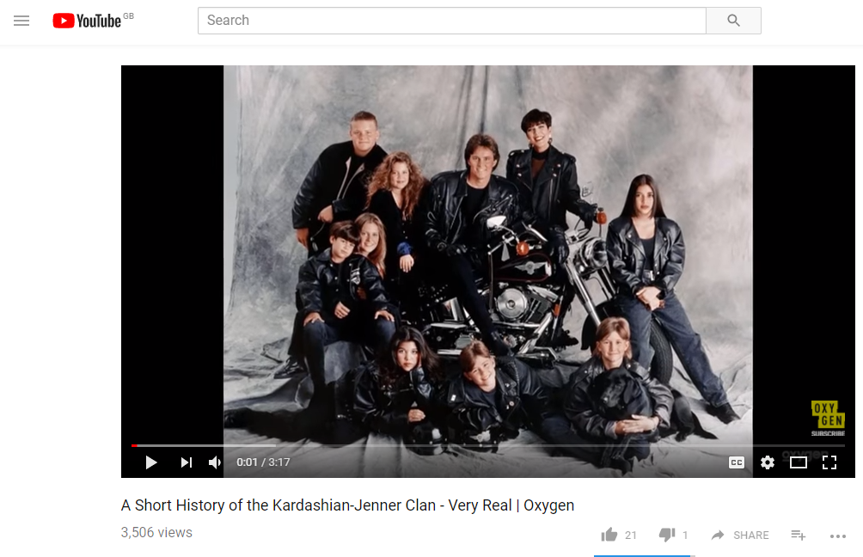
Online, Social and Participatory Media
Representation │ Audiences │ Industries │ Language
https://upload.wikimedia.org/wikipedia/commons/5/55/News-media-standards.jpg
Lesson 1: Kardashian intro
Close Study Product: Kardashian Hollywood App
The Kardashian Media phenomena is a study in the cultural significance of this group in society’s interest in fame and celebrity.
To find out more about the growth of the Kardashian phenomena, watch these videos:
https://www.youtube.com/watch?v=93TT8QMyNZc
https://www.youtube.com/watch?v=xPASdu5Keo8
Click to view
Homework opportunity:
Download the free app Kardashian Hollywood: be aware there is some in-app purchase. You do not need to do this for the course.

Slide 4
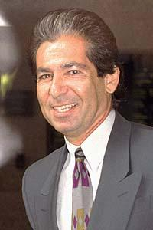
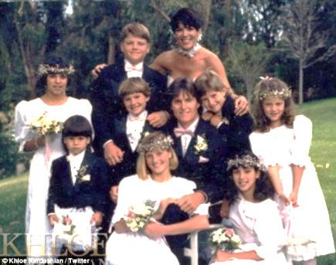
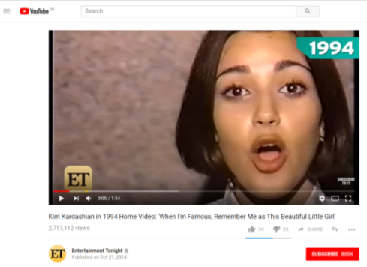
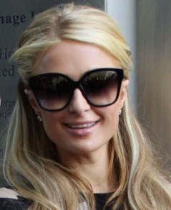
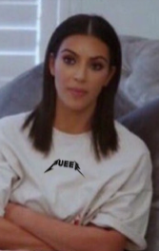
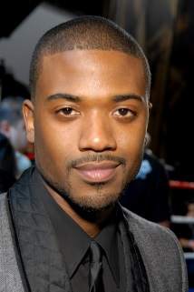
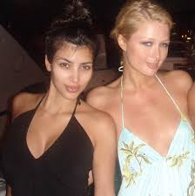
Online, Social and Participatory Media
Representation │ Audiences │ Industries │ Language
https://upload.wikimedia.org/wikipedia/commons/5/55/News-media-standards.jpg
Lesson 1: Kardashian intro
The Evolution of the Kardashian Brand – Part One
1. Robert Kardashian finds fame in OJ Simpson murder trial. He dies and leaves Kris a considerable inheritance.
2. Kris remarried: Bruce Jenner, former Olympian and Wheaties box star, who we now know as Caitlyn.
3. Even at a young age, Kim was determined to be a star (click image to see video).
4. The Reality TV phenomenon grows and Kim is famous for being friends with celebrity Paris Hilton [who made an infamous sex tape]
5. Kim becomes famous for a different leaked sex tape with singer Ray-J. There were rumours that Kris was allegedly instrumental in this happening to raise media profile.
6. The now infamous Kim joins Paris on Reality Show, ‘A Simple Life’. This raises their profile even more.
Kardashian brand continued

Slide 5
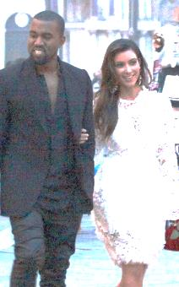
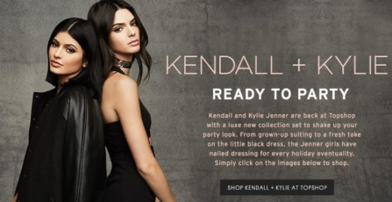
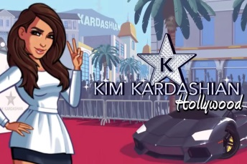
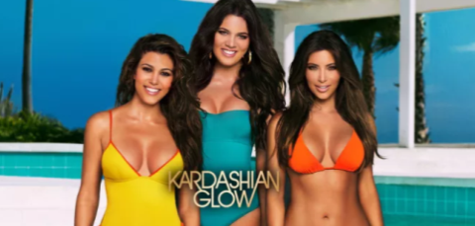
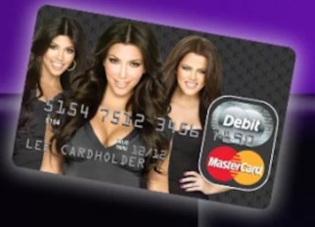
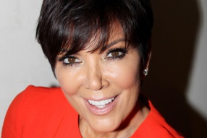
Online, Social and Participatory Media
Representation │ Audiences │ Industries │ Language
https://upload.wikimedia.org/wikipedia/commons/5/55/News-media-standards.jpg
Lesson 1: Kardashian intro
The Evolution of the Kardashian Brand – Part One
7. Keeping Up With The Kardashians was launched after Kris begged producers to develop it.
8. Kim starts to become famous away from the family by appearing on Dancing with the Stars [USA version of Strictly]
9. Kim married Kanye and their fame exploded. One picture ‘broke the internet’.
10. The Kardashian business empire has now grown so that they branches in clothing lines, cosmetics, apps, books, jewellery, credit cards, talk shows and a range of other reality TV shows.
"I started to look at our careers like pieces on a chessboard,” Kris revealed in her memoir, back in 2011. “Every day, I woke up and walked into my office and asked myself, ‘What move do you need to make today?’ It was very calculated. My business decisions and strategies were very intentional, definite and planned to the nth degree."
From http://www.refinery29.uk/2016/02/110357/how-the-kardashians-became-famous#slide-16

Slide 6
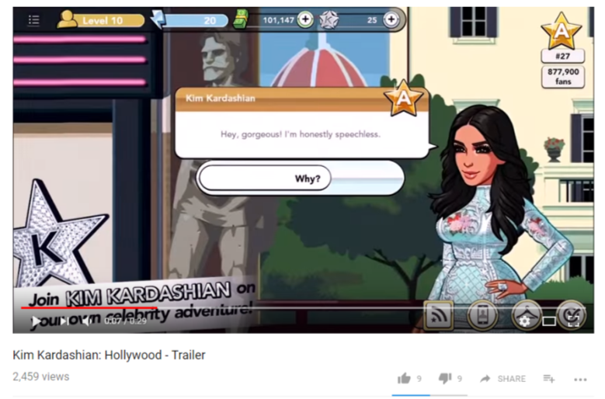
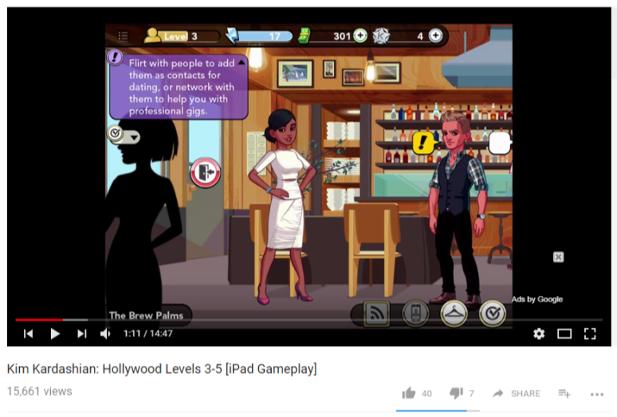
Online, Social and Participatory Media
Representation │ Audiences │ Industries │ Language
https://upload.wikimedia.org/wikipedia/commons/5/55/News-media-standards.jpg
Lesson 1: Kardashian intro
The app: aims of the game
The Kardashian Hollywood App is free to download to smartphones and tablets.
https://www.youtube.com/watch?v=HhizrsqMV8A
Users can spend money on virtual goods like private planes and on dressing and styling their avatars with virtual clothing and accessories made by designers like Balmain’s Olivier Rousteing.
In February 2017, the game had brought in $100 million since its launch in 2014.
The game’s goal is for players to push their avatars to fame by emulating the Kardashian lifestyle–including hanging out with Kardashian’s sisters, other celebrities, fashion elites, and designers like Lagerfeld and Anna Wintour.
It is an AQA study as it epitomises our society’s interest in fame and celebrity and the consumerist culture we live in.
Trailer
Click image to view video
Random Gameplay – flick through to get taste
Click image to view video

Slide 7
Online, Social and Participatory Media
Representation │ Audiences │ Industries │ Language
https://upload.wikimedia.org/wikipedia/commons/5/55/News-media-standards.jpg
Lesson 1: Kardashian intro
The app: task
In your books and in your own words:
What is the aim of the Kim Kardashian Hollywood App?
How does this relate to modern perceptions of celebrity and how to get famous?
Who is the intended audience for the Kim Kardashian Hollywood App? Why do you think this?
How do you download the Kim Kardashian Hollywood App?

Slide 8
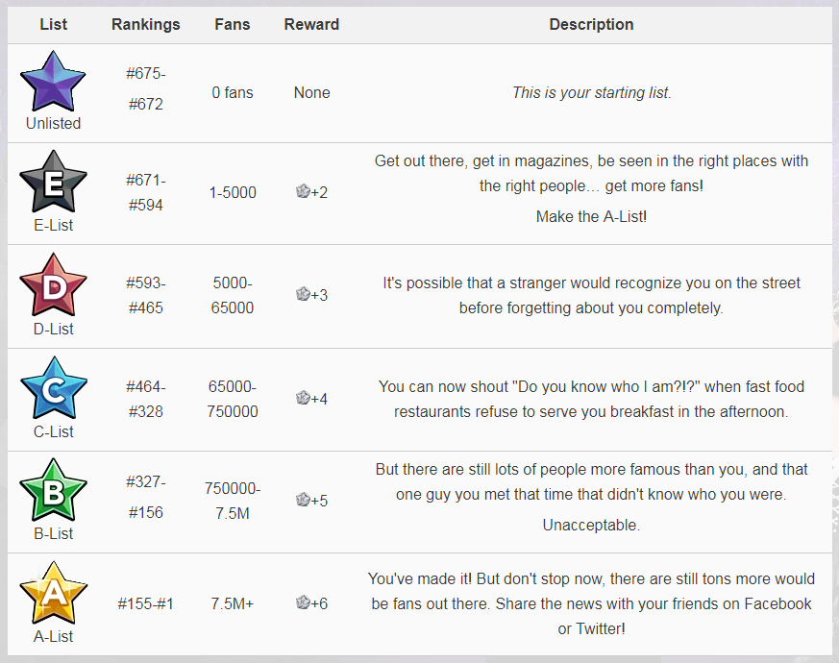
Online, Social and Participatory Media
Representation │ Audiences │ Industries │ Language
https://upload.wikimedia.org/wikipedia/commons/5/55/News-media-standards.jpg
Lesson 2: The Game
The app: narrative ingredients – THE AIM OF THE GAME
The aim of Kim Kardashian Hollywood is to work your way up the celebrity scale from Z-List to A-List. As you play you will interact with a range of real and fictional characters in the United States and around many of the world’s most glamourous and famous locations. As you progress, there are collectibles and missions that will allow you to develop the status of your customisable character. Your ranking is determined by your position on the Top Stars list in Hollywood. They are sorted into six different lists: Unlisted being the lowest rank to the A-list being the highest rank. You rise up in ranks by gaining fans. The goal of Kim Kardashian: Hollywood is to gain as many fans as possible by doing well on projects, getting attention from Starnews, and dating to get to the A-list.
In your books and in your own words:
What is the aim of the game and how does it relate to Kim Kardashian – the brand?
What is an A-list celebrity?
How does the aim of the game reflect modern ideas of celebrity and how to become one?

Slide 9
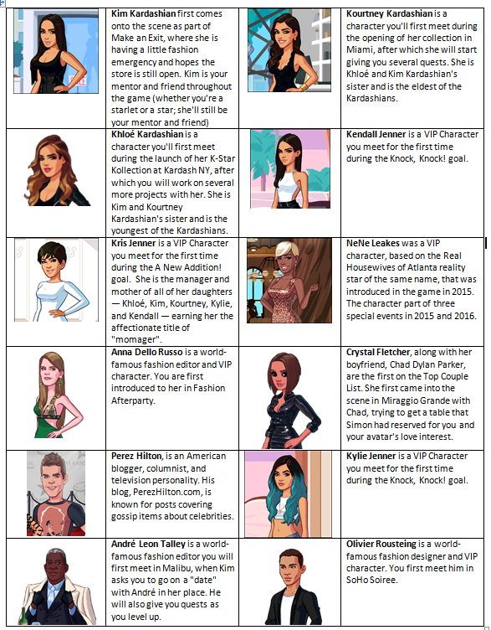
Online, Social and Participatory Media
Representation │ Audiences │ Industries │ Language
https://upload.wikimedia.org/wikipedia/commons/5/55/News-media-standards.jpg
Lesson 2: The Game
The app: narrative ingredients – CHARACTER TYPES
Characters are NPCs (Non-Playable Characters) that appear in goals or locations and the storyline as you progress in Kim Kardashian: Hollywood. These exclude NPCs you meet in the game that you can Date or Network with. These types of contacts are randomly generated according to each individual game.
The characters in Kim Kardashian Hollywood are a mixture of real VIP characters and fictional characters. There are 100s – you can see a few opposite.
In your pursuit to celebrity some of the fictional characters work with you and some actively try to ruin your journey by beating you to A-List.

Slide 10
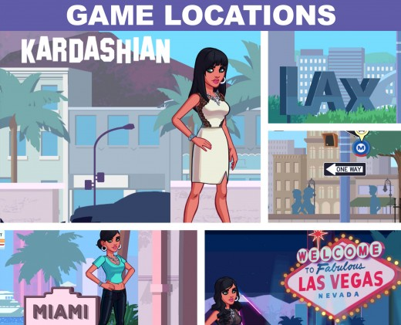
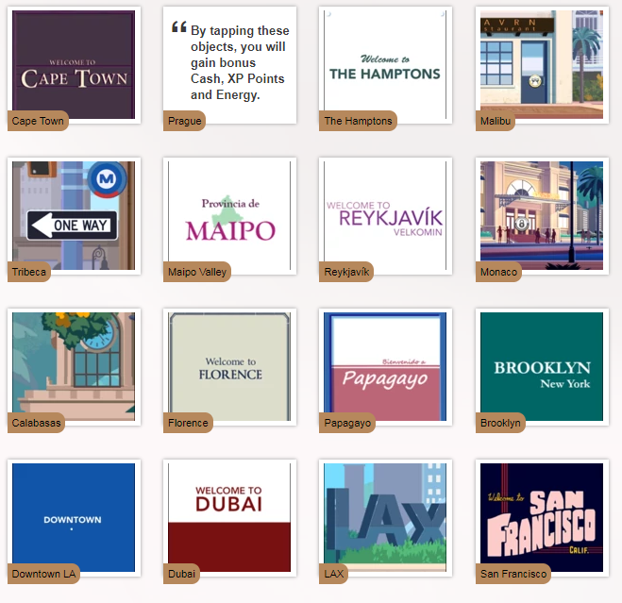
Online, Social and Participatory Media
Representation │ Audiences │ Industries │ Language
https://upload.wikimedia.org/wikipedia/commons/5/55/News-media-standards.jpg
Lesson 2: The Game
The app: narrative ingredients – SETTINGS
There are a range of locations in the game that try to mirror the stereotype of the celebrity lifestyle of an A-lister.
The settings on this page are just a select few.

Slide 11
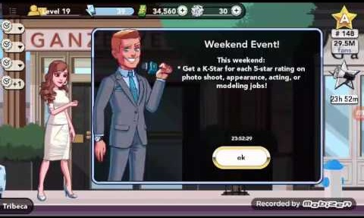
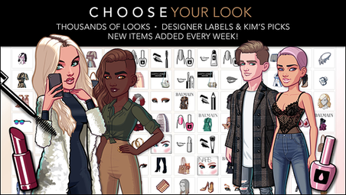
Online, Social and Participatory Media
Representation │ Audiences │ Industries │ Language
https://upload.wikimedia.org/wikipedia/commons/5/55/News-media-standards.jpg
Lesson 2: The Game
The app: narrative ingredients – EVENTS
Special Events are temporary goal arcs that are available only during Weekend Events in the game. By completing them, players can not only earn Cash Cash, XP XP, Energy Energy and Star Stars, but also Special Event stars. These regularly happen and keep the game fresh. It also means established players keep coming back to the game to see what the latest updated events are.
By collecting Special Event stars, players can unlock exclusive rewards and Kustomize items. The Kustomize screen, also known as your wardrobe, is the screen where you can customize your character to your liking. You can purchase tops, dresses, pants, skirts, shoes, hairstyles, facial features, nail colours and fashion accessories like bags, jewellery, and tattoos.
You can change your look whenever you like. Keep on top of current fashion to maximise your fans!

Slide 12
Online, Social and Participatory Media
Representation │ Audiences │ Industries │ Language
https://upload.wikimedia.org/wikipedia/commons/5/55/News-media-standards.jpg
Lesson 2: The Game
The Game: narrative ingredients
In your books and in your own words:
Complete this table.
Give examples when you can.
Aim of game:
Character types: What characters in the game? Why have they been chosen?
Settings: Where are the locations? Why have they been chosen?
Events: What happens in the game?
Visual styles: How is it designed and why?
Gameplay: What does the gamer do?

Slide 13
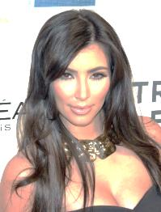
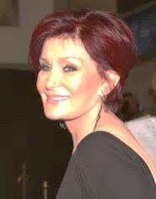
Online, Social and Participatory Media
Representation │ Audiences │ Industries │ Language
https://upload.wikimedia.org/wikipedia/commons/5/55/News-media-standards.jpg
Lesson 4: Gender and Power
Using the prompts and these quotes, what does the emergence of the Kardashian brand tell us about their cultural influence on gender identity and power.
“I said once before that I’m not really a feminist. But I feel I do a lot more than people that claim that they’re feminist. To clarify what I said before: I feel in my soul I’m a feminist. I just don’t need labels to make me feel or know what I am inside.”
- Kim Kardashian
“Whatever she does she’s showing her body, which shows she’s a strong, grounded woman and she’s not ashamed of her body. And that’s great, but people have been doing that since day one and people have been stripping and whatever since day one. It doesn’t make you a feminist, it makes you someone who is a strong person, and confident with their body and wants to show it. But, that’s not a feminist.”
- Sharon Osbourne
In your books and in your own words:
Do you think that Kim Kardashian is a strong female role model and why? Also, why may she not be thought of as that.
In the exam, you may be asked to compare Kim with Zoella (female YouTuber) and Lara Croft (strong female game character). How are they similar in the influence they have on gender identity and power.
What do you think would a feminist would think of the Kim Kardashian Hollywood app?

Slide 14
Online, Social and Participatory Media
Representation │ Audiences │ Industries │ Language
https://upload.wikimedia.org/wikipedia/commons/5/55/News-media-standards.jpg
Lesson 3: Marketing of the game
Watch the way that the game was marketed on TV by clicking the link below: https://www.bing.com/videos/search?q=official+tv+advert+Kim+Kardashian+hoywood+app&docid=607992229345234288&mid=88D4FDC8AD2835BF807088D4FDC8AD2835BF8070&view=detail&FORM=VIRE
https://www.bing.com/videos/search?q=official+tv+advert+Kim+Kardashian+hoywood+app&&view=detail&mid=C1DF18CC1084E66A41D6C1DF18CC1084E66A41D6&&FORM=VDRVSR
https://www.bing.com/videos/search?q=official+tv+advert+Kim+Kardashian+hoywood+app&&view=detail&mid=9D89D7FF757F94E8AA7E9D89D7FF757F94E8AA7E&rvsmid=88D4FDC8AD2835BF807088D4FDC8AD2835BF8070&FORM=VDQVAP
In your books and in your own words:
What is the semiotic analysis of the advertisement?
What does this tell us about the intended audience for Kim Kardashian Hollywood?
Link the design of this advert to Uses and Gratification Theory and Maslow’s hierarchy of need.

Slide 15
Online, Social and Participatory Media
Representation │ Audiences │ Industries │ Language
https://upload.wikimedia.org/wikipedia/commons/5/55/News-media-standards.jpg
Lesson 3: Representation of celebrity
The game uses a range of stereotypes.
What stereotypes are used?
Stereotype | How is it represented?
Masculinity
Femininity
Place
Class
Age
Look
Either classically ‘alpha male’, chiselled, gym-body
Beautiful, fashion-aware, all want to be celebrity, flirt to progress
Glamourous locations, famous buildings linked to ‘celebrity world’
All seem aspirationally middle or upper class.
Predominantly young (think target audience). Some VIPs older – e.g. Karl Lagerfeld
All image conscious, hair on-trend, etc. Image is everything!
In your books and in your own words:
What is a stereotype and why are they used in this character-filled game?
Draw the table in your books and describe the stereotypes used. Give examples.
Considering that the target audience for this game is predominantly young people, how does this representation of celebrity culture impact on their aspirations / lifestyle?
What social groups are not represented in the game. Why?

Slide 16
Online, Social and Participatory Media
Representation │ Audiences │ Industries │ Language
https://upload.wikimedia.org/wikipedia/commons/5/55/News-media-standards.jpg
Lesson 3: Uses and Gratification Theory
This game in incredibly popular. It has been downloaded over 50 million times and generated $100 million. Why does audiences like it. One way of understanding why audiences choose certain media texts is called the Uses and Gratification Theory.
Uses and Gratification Theory states that audiences consume media products/texts for at least one of the following reasons:
Diversion and escapism – escaping from normal life.
Personal relationships – fulfils their need for companionship. This is particularly true of social media products, online gaming and online communities.
Personal identity - find things out about themselves, reinforce their own identity, ‘finding themselves’.
Surveillance – using media to find out about the world around them.
Click here for a very detailed article as to why KKH is so successful.
In your books and in your own words:
Why do people like playing Kim Kardashian Hollywood?
What is Uses and Gratification Theory?
What parts of Uses and Gratification Theory does Kim Kardashian Hollywood satisfy? Explain your answer.
How does the game link with Maslow’s hierarchy of needs [from Advertising unit]?

Slide 17
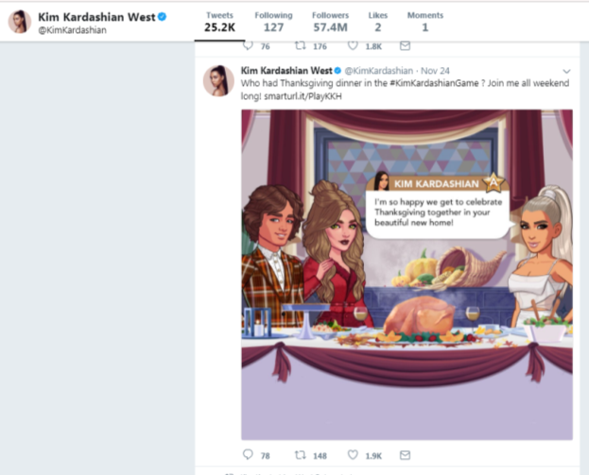
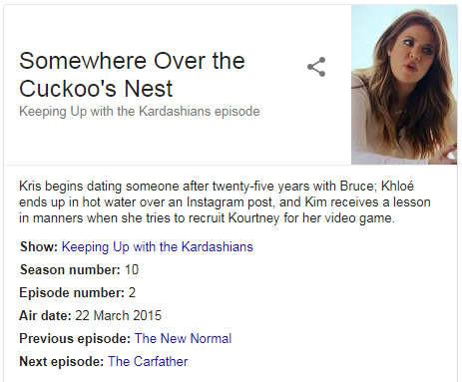
Online, Social and Participatory Media
Representation │ Audiences │ Industries │ Language
https://upload.wikimedia.org/wikipedia/commons/5/55/News-media-standards.jpg
Lesson 4: Media convergence
The game design means that there is a great deal of media convergence. Media convergence is the merging of different media texts. How does Kim Kardashian Hollywood involve media convergence?
1. Game
2. Social Media
3. TV Show
TV Show and social media channels are referenced in game. Player encouraged to engage online and gain bonus items for sharing on Facebook etc.
Game appears on Kim’s actual social media platforms. Also, need to tweet in game.
Game appears on Keeping Up with the Kardashians episodes. TV Show is also referenced in game.
In your books and in your own words:
What is media convergence?
Why do media institutions encourage convergence between their different media products?
How does Kim Kardashian Hollywood converge various parts of the Kardashian brand and why?

Slide 18
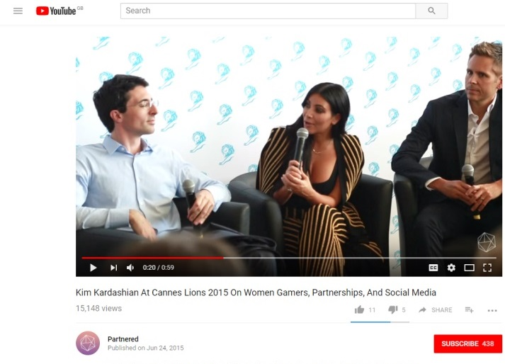
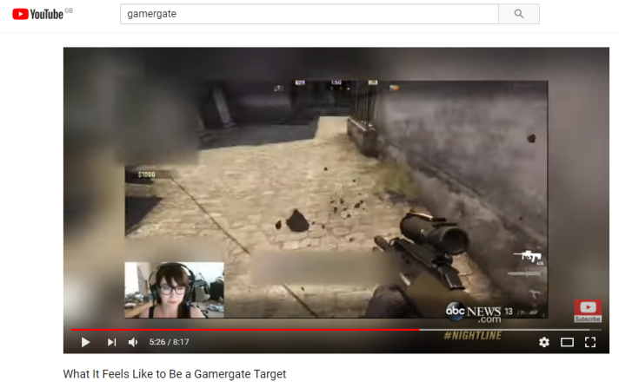
Online, Social and Participatory Media
Representation │ Audiences │ Industries │ Language
https://upload.wikimedia.org/wikipedia/commons/5/55/News-media-standards.jpg
Lesson 4: Gender and Gaming
Women in Gaming
Gaming is traditionally a very male-dominated industry. Kim Kardashian: Hollywood represents how modern smartphone and tablet technology has changed the demographics of gaming (more females gaming, older people gaming]. Apps have changed the pricing structure, accessibility and target audience for games. A survey in 2014 showed that 52% of gamers are women; this is a huge shift from gaming a generation before.
Kim being involved in the development and design of this game symbolises this cultural shift.
This has caused issues with the traditional male gaming audience in PC and console gaming. This has seen the #gamergate controversy which has split the gaming community. Particular issues are the sexual objectification of women in gaming and abuse of women in online gaming communities.
Kim on the game and female gaming
Click image to view video
In your books and in your own words:
Make a list of the ten well-known female game characters. How are they represented and what does this tell us about the representation of females in gaming.
What types of games are more popular with females than males (click here: link
Why have smartphones and tablets introduced more females to gaming?
How has the gameplay in KKH been designed for a multi-gender audience?
#Gamergate: gender abuse in gaming
Click image to view video
Notes:
Further reading: Gender representation in gaming - https://en.wikipedia.org/wiki/Gender_representation_in_video_games

Slide 19
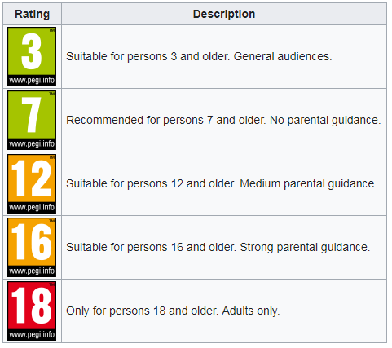
Online, Social and Participatory Media
Representation │ Audiences │ Industries │ Language
https://upload.wikimedia.org/wikipedia/commons/5/55/News-media-standards.jpg
Lesson 5: Gaming Ratings
PEGI Game Ratings
PEGI stands for Pan European Game Information and is a European video game rating system established to help European consumers make informed decisions when buying video games or apps through the use of age recommendations and content descriptors.
It came into use in April 2003 and is now used in over 30 countries. It is designed to advise consumers on the suitability of the content in a game.
In your books and in your own words:
Define PEGI and state what it was designed for.
Why has the game industry felt it necessary to develop PEGI classifications. How has modern gameplay meant that this is required. Why would this not have been so required in the 1980s/1990s?

Slide 20
Online, Social and Participatory Media
Representation │ Audiences │ Industries │ Language
https://upload.wikimedia.org/wikipedia/commons/5/55/News-media-standards.jpg
Lesson 5: Changing game industry
How has the gaming industry changed?
1970s – gaming was in infancy and mostly in arcades. Predominantly male dominated, expensive and niche. Some home machines like Atari.
1980s – games moved more into the home with home computers like Commodore 64, Sinclair Spectrum.
Late 1980s/90s – consoles arrived. Gaming became more popular – but still largely male-dominated.
2000s – online gaming begins. Gamers collaborate and compete online [links to KKH in online nature]
2005 – Nintendo Wii, with revolutionary motion-sensor controller, changes gaming culture by bringing gaming to wider family unit, out of the bedroom and into living room and more popular with females.
2007 – whilst mobile gaming on handheld consoles (Nintendo DS) and phones (who remembers Snake?) had been around for a while and popular. The introduction of high-quality games on mobile phones revolutionised the gaming industry. Games were often free or cheap (compared to console games), easily downloadable and were as equally popular with females and males. The idea of in-app purchase monetised the gaming industry [links to KKH in mobile and in-app purchase]
In your books and in your own words:
How has the gaming industry changed over the last 50 years?
How has Kim Kardashian Hollywood taken advantage of modern changes in the industry?

Slide 21
Online, Social and Participatory Media
Representation │ Audiences │ Industries │ Language
https://upload.wikimedia.org/wikipedia/commons/5/55/News-media-standards.jpg
Lesson 5: How do ‘free’ apps make money?
Download for free, but include in-app purchase
In Kim Kardashian Hollywood, you can customise your character (avatar). This can take time, but the process can be speeded-up by buying upgrades.
Certain missions or scenarios can only be played by buying them.
Many tasks require energy. The software ‘cunningly’ doesn’t give you enough at times; you have to either wait before playing again or pay for the ability to play immediately.
In-app advertising
Many apps have pop-up adverts from companies or other games that the user has to wait for. Companies pay for this advertising space. In Kim Kardashian Hollywood, you get bonus items for watching adverts for products. All of these adverts generate income. Also, in Kim Kardashian Hollywood some of the retailers you see in the game as you shop in various locations have paid the company to be included to raise their profile.
In your books and in your own words:
How do ‘free’ apps make money?
How does Kim Kardashian Hollywood make money?
Using the Internet, research how much income Kim Kardashian Hollywood has generated and how much Kim Kardashian has benefitted financially from this.

Slide 22
Online, Social and Participatory Media
Representation │ Audiences │ Industries │ Language
https://upload.wikimedia.org/wikipedia/commons/5/55/News-media-standards.jpg
Lesson 5: Review
This concludes the Kim Kardashian Hollywood Close Study Product. Now complete your Personal Learning Checklist for this CSP.

