Slide 1
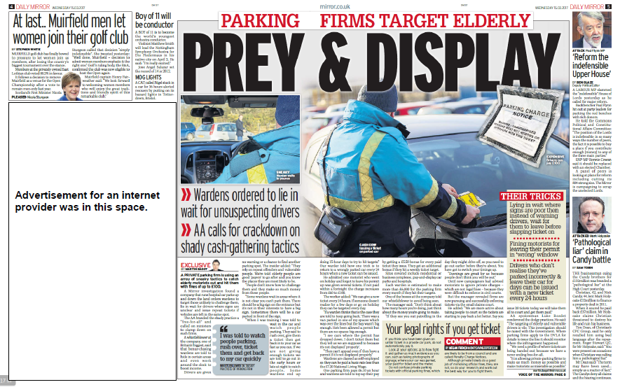
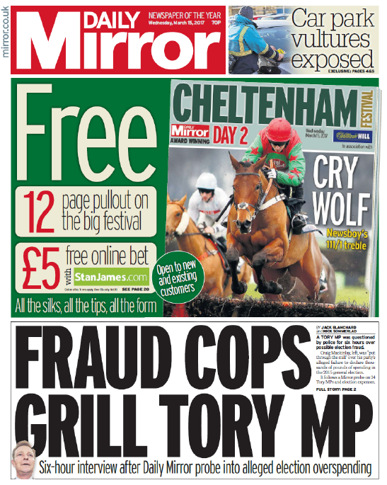
Close Study Product: Newspaper Daily Mirror
Representation │ Audiences │ Industries │ Language
https://upload.wikimedia.org/wikipedia/commons/5/55/News-media-standards.jpg
The Daily Mirror is a national daily tabloid newspaper that has social, cultural and political significance. Comparison is invited with The Times which targets a different audience demographic and has a different political and ideological viewpoint.

Slide 2
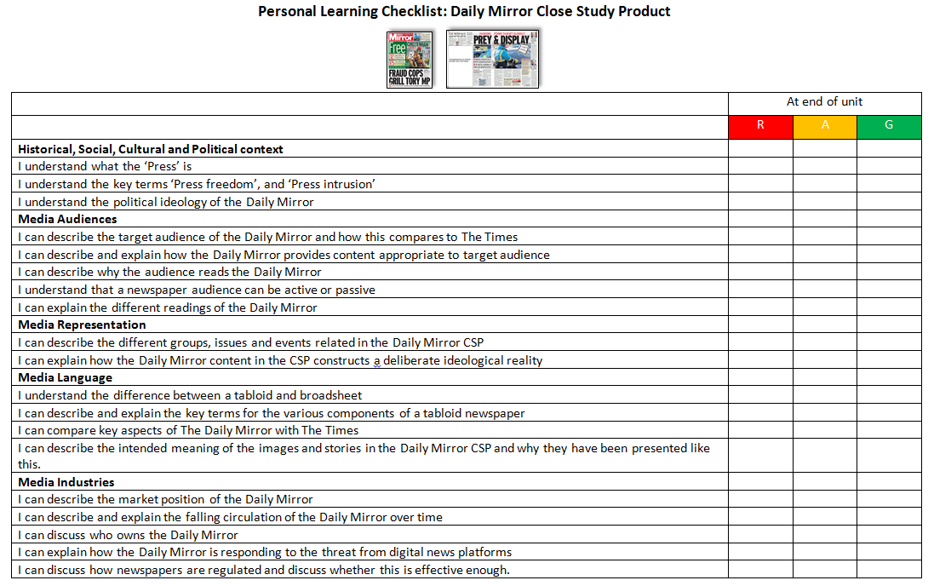
Complete the initial Personal Learning Checklist for Daily Mirror CSP as a starting point for your assessment
Representation │ Audiences │ Industries │ Language
https://upload.wikimedia.org/wikipedia/commons/5/55/News-media-standards.jpg

Slide 3
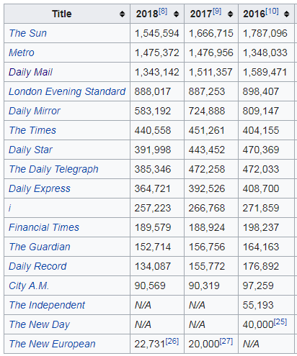
Representation │ Audiences │ Industries │ Language
Lesson 1: The ‘Press’
https://upload.wikimedia.org/wikipedia/commons/5/55/News-media-standards.jpg
Historical, Social and Cultural contexts: What is the ‘Press’ and what is its role?
The ‘Press’ is a collective term for the newspaper industry. The name is linked to the printing presses that were originally used to make the newspaper. Examples of newspapers in the UK are the Daily Mirror and The Times, which will be our CSPs.
Newspapers are still popular media products for audiences to get their news, be entertained and informed. There are a range of national (Daily Mail), regional (Birmingham Mail) and specialist newspapers (The Racing Post). Whilst still popular, since the 1950s, there has been a gradual decline in newspaper sales due to the rise of TV ownership (and news programmes) and, more recently, the growth of digital news through websites and social media.
Daily newspaper circulation figures 2016-2018
from https://en.wikipedia.org/wiki/List_of_newspapers_in_the_United_Kingdom_by_circulation
In your books, and in your own words:
What is the ‘Press’? Give examples. What is the purpose of the Press?
What has happened to newspaper sales and why?

Slide 4
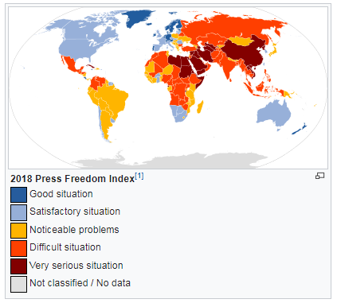
Representation │ Audiences │ Industries │ Language
Lesson 1: The ‘Press’
https://upload.wikimedia.org/wikipedia/commons/5/55/News-media-standards.jpg
Historical, Social and Cultural contexts: What is a free ‘Press’ and what is its Press intrusion?
A free press implies that journalists (those that write for newspapers) and newspaper editors can edit content free of intervention from Government influence. In more than a 3rd of a world’s population live in countries there is no press freedom. This causes a problem as in those countries journalists are often imprisoned if they disagree with the Government, social media channels are not allowed to operate, non-democratic countries often control access to information and employ state-run news organizations to promote the propaganda critical to maintaining an existing political power base.
In your books, and in your own words:
What is a free press and why is it important?
Why do some countries not want a free press?

Slide 5
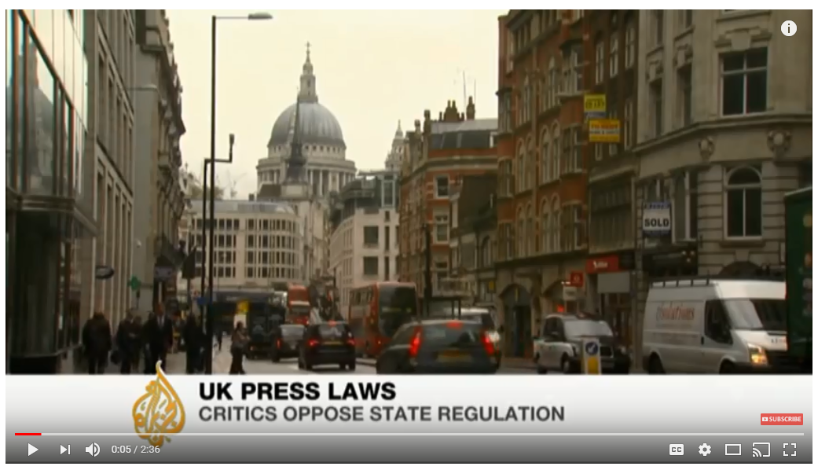
Representation │ Audiences │ Industries │ Language
Lesson 1: The ‘Press’
https://upload.wikimedia.org/wikipedia/commons/5/55/News-media-standards.jpg
Historical, Social and Cultural contexts: What is a free ‘Press’ and what is its Press intrusion?
Click image to view video

Slide 6
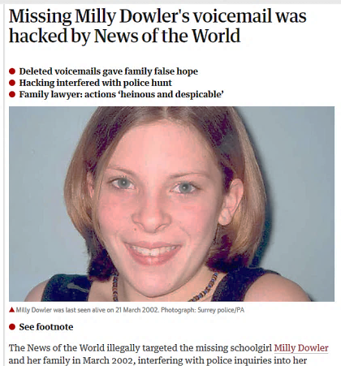
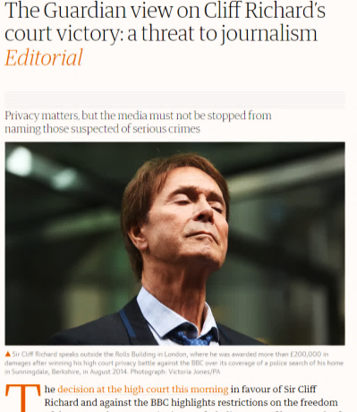
Representation │ Audiences │ Industries │ Language
Lesson 1: The ‘Press’
https://upload.wikimedia.org/wikipedia/commons/5/55/News-media-standards.jpg
Historical, Social and Cultural contexts: What is a free ‘Press’ and what is its Press intrusion?
Press intrusion is where press pry too closely into people’s lives to gather their stories. Newspapers may argue that they have to do this to get to the truth in the hunt for their stories. However, when news emerged in July 2011 that murdered schoolgirl Milly Dowler's phone had been hacked by the News of the World, Prime Minister David Cameron set up the Leveson inquiry into press ethics. Leveson proposed a new self-regulation body as newspapers were ignoring the Press Complaints Commission (PCC). The Prime Minister, David Cameron, rejected the idea as he was worried about government interference with the press.
vs
Too much press intrusion
Freedom of the Press
In your books, and in your own words:
What is press intrusion? What are the arguments for and against it?

Slide 7
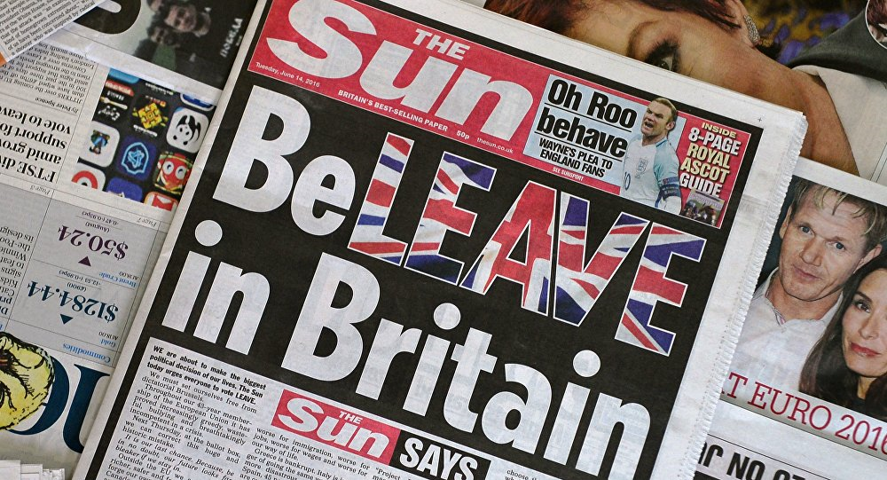
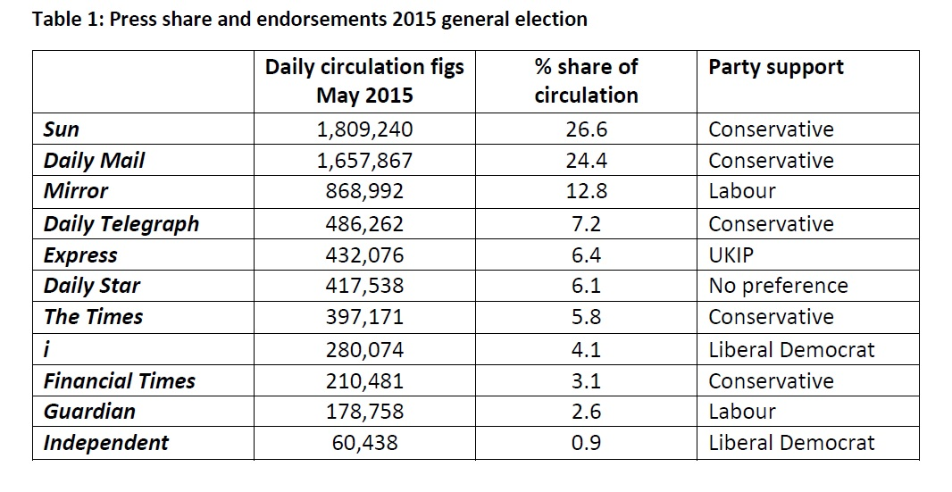
Representation │ Audiences │ Industries │ Language
Lesson 1: The politics of the ‘Press’
https://upload.wikimedia.org/wikipedia/commons/5/55/News-media-standards.jpg
Historical, Social and Cultural contexts: What are the political leanings of the ‘Press’
Most newspapers have some sort of political bias. This is based on their history and the demands of their target audience. The relevance of the bias is that it impacts on the way news is interpreted and can have significant influence on the audience and how they vote / think.
The Sun’s headline on the day of the Brexit vote was clearly political and may have influenced voting patterns.
The political leanings of the national press at the time of the 2015 General Election
From http://whorunsbritain.blogs.lincoln.ac.uk/2015/11/19/press-affiliation-and-the-2015-general-election/
In your books, and in your own words:
What are the political leanings of the Daily Mirror and The Times.
How does the politics of newspapers impact on content and audience?

Slide 8
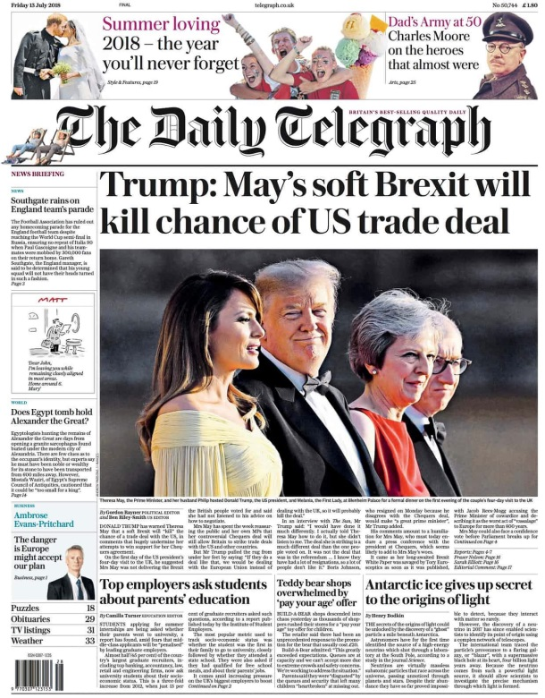
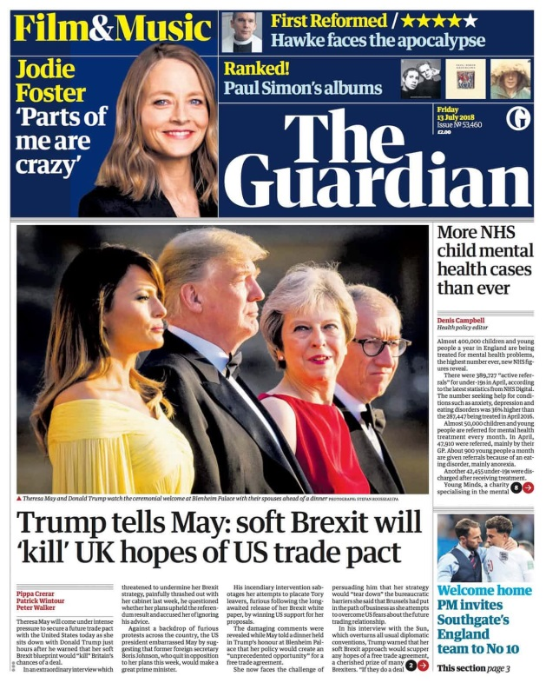
Representation │ Audiences │ Industries │ Language
Lesson 1: The politics of the ‘Press’
https://upload.wikimedia.org/wikipedia/commons/5/55/News-media-standards.jpg
Historical, Social and Cultural contexts: What are the political leanings of the ‘Press’
Look at the two front covers from two broadsheets – one Conservative (right-leaning) and one Labour (left-leaning).
In your books, and in your own words:
What is the connotation of each image chosen? How does this reflect the political bias of the newspaper and the underlying Conservative issues about Theresa May’s leadership?
How does the politics of newspapers impact on content and audience?

Slide 9
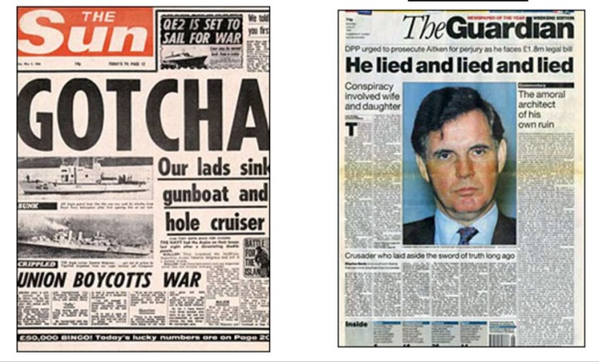
Representation │ Audiences │ Industries │ Language
Lesson 2: Tabloid vs Broadsheet
https://upload.wikimedia.org/wikipedia/commons/5/55/News-media-standards.jpg
Media Language: Comparing Tabloids and Broadsheets
There are generally two classifications of newspapers – tabloids and broadsheets.
Tabloids tend to be easier to read, shorter articles and include more photographs. They report on major news, but also include a lot of showbiz gossip, entertainment and sport. They tend to be the better sellers.
Broadsheet newspapers tend to be larger (printed on ‘broad sheets’) and typically are also folded horizontally in half to accommodate newsstand display space. They tend to be more serious, have smaller fonts, more advanced use of language and less photographs (although they have included more over the last 20 years to be more popular). They tend to have lower circulation figures than tabloids.
Tabloids: The Sun, The Mirror, The Star. These are called red tops because they have red mastheads. The Daily Mail and Daily Express are tabloids are sometimes called ‘middle market’ newspapers as they have a mixture of tabloid/broadsheet audience.
Broadsheets: The Daily Telegraph, The Times, Guardian and the Financial Times are all broadsheets although The Times has recently changed it’s size to make it more accessible (but it’s style is still very much broadsheet)

Slide 10
Representation │ Audiences │ Industries │ Language
Lesson 2: Tabloid vs Broadsheet
https://upload.wikimedia.org/wikipedia/commons/5/55/News-media-standards.jpg
Media Language: Comparing Tabloids and Broadsheets
In your books, and in your own words:
Compare tabloids and broadsheets by completing the table below:
 | Tabloid | Broadsheet
Size |  | Bigger in size.
Example |  | The Times.
Language/Grammar |  | More advanced language requiring higher reading age. Longer sentences and paragraphs. Less emotive language.
Key focus |  | News. Politics. International. Culture. Sport. All for information purposes – less for entertainment.
Image use |  | Less images.
Layout |  | Dominated by copy (text).
Audience |  | Targets a more ‘up-market’ audience.
Cost |  | More expensive. The Times is £1.60.

Slide 11
Representation │ Audiences │ Industries │ Language
Lesson 2: Tabloid conventions
https://upload.wikimedia.org/wikipedia/commons/5/55/News-media-standards.jpg
Media Language: The layout of a tabloid and key newspaper conventions
The layout of a newspaper is key part of grabbing the reader’s attention. Here are some key terms to learn:
Slogan
Masthead
Dateline
Kicker
Incentive
Pug
Byline
Splash Head
Leader
Strandfirst
Cross-reference
Strapline
In your books, and in your own words:
Write each key term and explain what the reason for it.

Slide 12
Representation │ Audiences │ Industries │ Language
Lesson 2: Tabloid conventions
https://upload.wikimedia.org/wikipedia/commons/5/55/News-media-standards.jpg
Media Language: The layout of a tabloid and key newspaper conventions
The layout of a newspaper is key part of grabbing the reader’s attention. Here are some key terms to learn:
Slogan
Key phrase to identify paper
Masthead
The title block of the newspaper
Dateline
The published date of the paper
Incentive
Encourages audience to buy a copy
Kicker
An article linked to a story inside. Sometimes called an ‘earpiece area’
Pug
Placed to grab attention
Byline
The reporter who writes the article
Splash Head
Main headline to leader
Strandfirst
Introductory paragraph, often in bold text
Leader
Lead story for front page
Cross-reference
Links to continued article inside paper
Strapline
Subheading below the splash headline

Slide 13
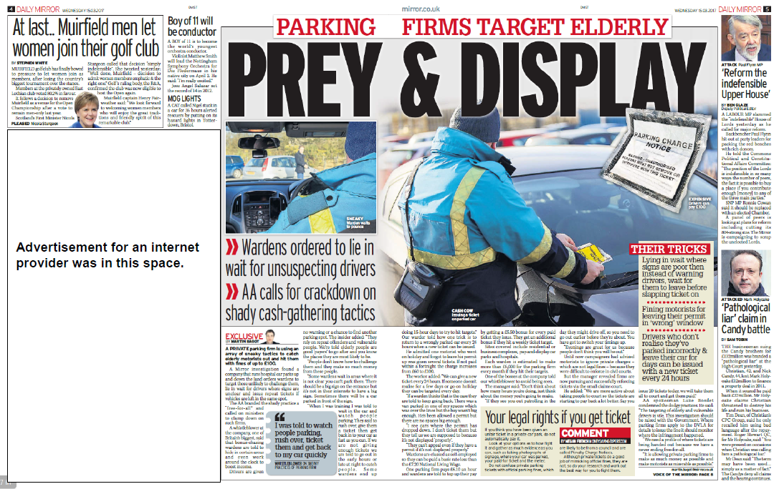
Representation │ Audiences │ Industries │ Language
Lesson 2: Tabloid conventions
https://upload.wikimedia.org/wikipedia/commons/5/55/News-media-standards.jpg
Media Language: The layout of a tabloid and key newspaper conventions
In your books, and in your own words:
Here is the inside part of the same Daily Mirror. Label the key terms from the previous slides on here.

Slide 14
Representation │ Audiences │ Industries │ Language
Lesson 3: Daily Mirror analysis
https://upload.wikimedia.org/wikipedia/commons/5/55/News-media-standards.jpg
Media Language: The layout of a tabloid and key newspaper conventions
In your books, and in your own words:
Answer the questions below when analysing the front cover of the Daily Mirror.
Kicker points to an article about ‘car park vultures’. How does the nature of the article and emotive language link to the political leaning of the newspaper and the impact of ‘big business’ on our lives.
Layout is dominated by Cheltenham festival promotion. How does this tie in with target audience?
Very dominant Splash Head. Look at the language and size of typography. What does this tell you about the political motivation of the newspaper and the intended impact on audience?

Slide 15
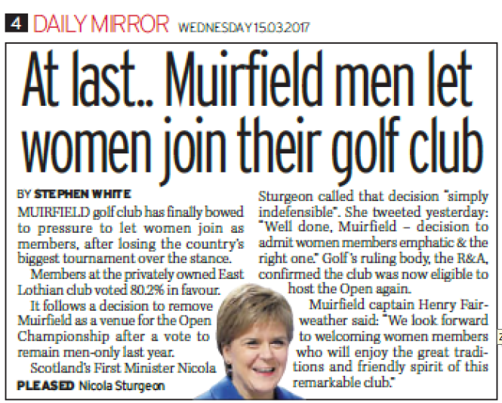
Representation │ Audiences │ Industries │ Language
Lesson 3: Daily Mirror analysis
https://upload.wikimedia.org/wikipedia/commons/5/55/News-media-standards.jpg
Media Language: The layout of a tabloid and key newspaper conventions
In your books, and in your own words:
Answer the questions below when analysing the inside pages of the Daily Mirror.
Muirfield article language implies that Muirfield ‘bowed to pressure’ to let women into their golf club. How does this link to a socialist agenda around the power of the masses and the overcoming the elitist elements of our society.
Nicola Sturgeon (Leader of SNP and First Minister of Scotland) is quoted. Why and how is this politically linked?
Write down example of the emotive language that is used to communicate messages about the unfairness and archaic nature of the women ban and explain why.
What is the narrative that is created in this article?
“their golf club”
“At last”
“bowed to pressure”
“privately-owned”
“indefensible”
“men let women”

Slide 16
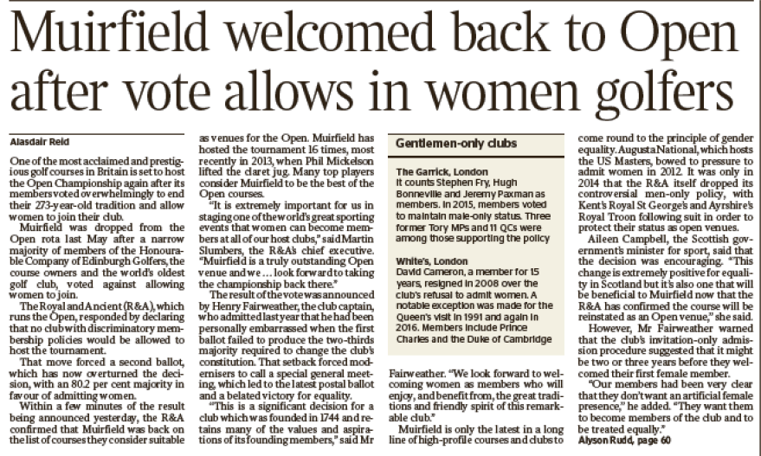
Representation │ Audiences │ Industries │ Language
Lesson 3: Daily Mirror analysis
https://upload.wikimedia.org/wikipedia/commons/5/55/News-media-standards.jpg
Media Language: Comparing Daily Mirror and The Times
In your books, and in your own words:
Read through this article and compare The Times narrative with the Daily Mirror (see next slide also)

Slide 17
Representation │ Audiences │ Industries │ Language
Lesson 3: Daily Mirror analysis
https://upload.wikimedia.org/wikipedia/commons/5/55/News-media-standards.jpg
Media Language: Comparing Daily Mirror and The Times
Examine the use of language and the narrative in the right-leaning Times newspaper.
“Vote allows in women golfers”
“members voted overwhelmingly to end their 273-year tradition”
“a narrow majority of members…voted against allowing women to join”
Look at the tone of the article. The headline and the quotes used suggest that it is good that the ban has been overturned as it means that they will be allowed to hold major golf tournaments again; not that is good for gender equality (although this does get mentioned at the end):
“Muirfield welcomed back to Open”
“The R&A confirmed that Muirfield was back on the list of courses they consider suitable”
“bowed to pressure to admit women”
“Our members…don’t want an artificial female presence… It might be two or three years”
In your books, and in your own words:
Read through this article and compare The Times narrative with the Daily Mirror.
Describe the emotive language used and why it is used.
Does The Times seem happy about the news? How might this reflect it’s intended audience and their political opinion.
Compare the level of language and detail in the Daily Mirror and The Times articles.

Slide 18
Representation │ Audiences │ Industries │ Language
Lesson 3: Daily Mirror analysis
https://upload.wikimedia.org/wikipedia/commons/5/55/News-media-standards.jpg
Media Language: Comparing Daily Mirror and The Times
What are the similarities and differences between the Daily Mirror and The Times front page and coverage of the Muirfield story?
Similarities | Differences
In your books, and in your own words:
Complete the table

Slide 19
Representation │ Audiences │ Industries │ Language
Lesson 4: Audience analysis
https://upload.wikimedia.org/wikipedia/commons/5/55/News-media-standards.jpg
Media Audiences: How are newspaper audiences classified?
The NRS social grades are a system of demographic classification used in the United Kingdom. They were originally developed by the National Readership Survey (NRS) to classify readers, but are now used by many other organisations for wider applications and have become a standard for market research. They were developed over 50 years ago and achieved widespread usage in 20th century Britain. The distinguishing feature of social grade is that it is based on peoples occupation.
YouGov profiles the nation’s newspaper readers [click to access]

Slide 20
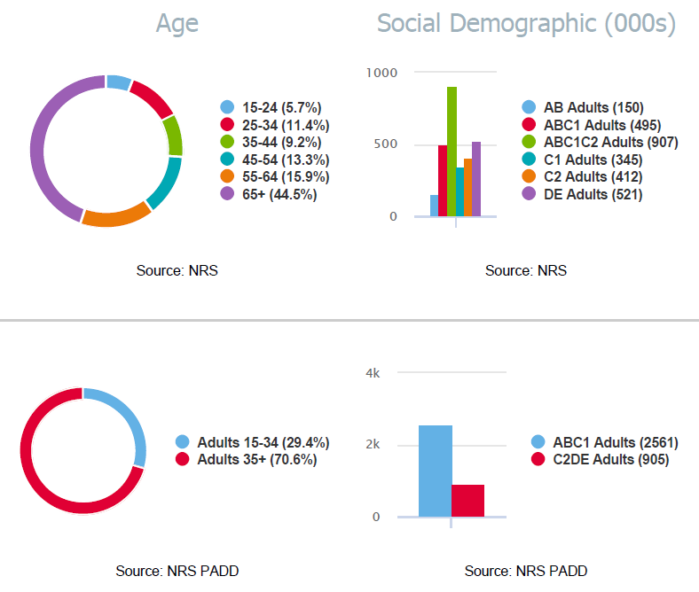
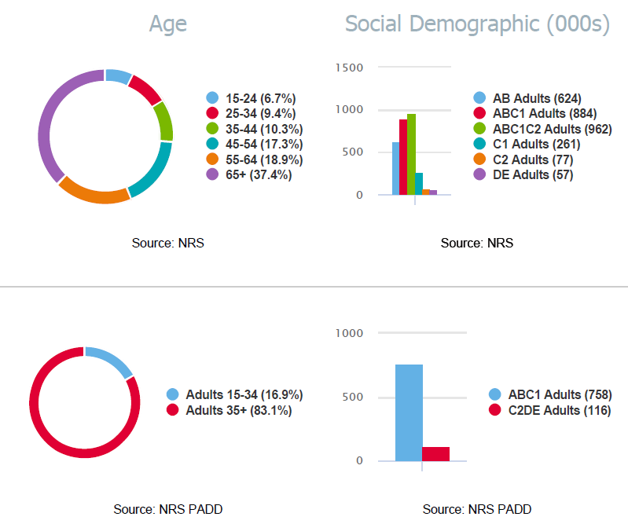
Representation │ Audiences │ Industries │ Language
Lesson 4: Audience analysis
https://upload.wikimedia.org/wikipedia/commons/5/55/News-media-standards.jpg
Media Audiences: What is the audience for the Daily Mirror and The Times
The Daily Mirror and The Times target very different audiences.
The Daily Mirror
The Times
In your books, and in your own words:
Compare the social demographic audience of The Daily Mirror and The Times (look particularly at the difference between AB Adults and C2 and DE adults.
Compare the age distribution of audiences of the two newspapers. In both cases, the largest audience demographic is 55+ C1-DE adults. Why?

Slide 21
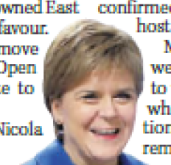
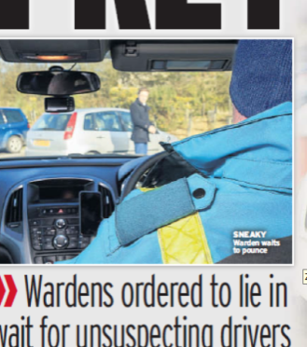
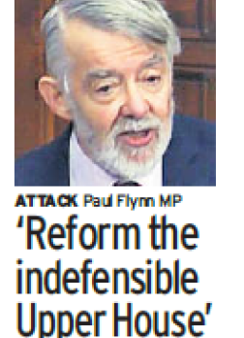
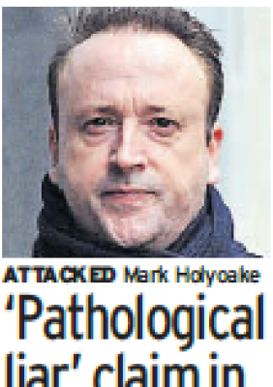
Representation │ Audiences │ Industries │ Language
Lesson 4: Media Representation
https://upload.wikimedia.org/wikipedia/commons/5/55/News-media-standards.jpg
Media Representation: How are different social groups, issues or events represented?
Examine the individuals or social groups that are represented in the Daily Mirror excerpts and what does their representation tell us:
Elitist golf clubs previously banning women.
Traffic Wardens preying on drivers, especially elderly, at hospital car parks.
Conservative MP being investigated for fraud by police.
Millionaire businessmen falling out over money.
The ‘broken’ Government system with unelected house
In your books, and in your own words:
Newspapers try to construct a reality to share with their audience. What is the reality that the Daily Mirror is construct here about the rich, elite, government and powerful business?
How does this constructed reality reflect the newspapers politics and ideology?
How does this help to attract its audience?

Slide 22
Representation │ Audiences │ Industries │ Language
Lesson 4: Targeting audience
https://upload.wikimedia.org/wikipedia/commons/5/55/News-media-standards.jpg
Media Audiences: How does the Daily Mirror target its audience?
Free pull-out incentive prioritised. Why?
Think target audience?
Free pull-out is sponsored by William Hill (a gambling website and one of Trinity Mirror’s clients). Why is a gambling offer attractive to the Daily Mirror’s audience?
Stan James offers a free bet (another bookmaker). Why is a free offer attractive to the Daily Mirror’s audience?
The Daily Mirror is cheaper than The Times broadsheet. Why is this targeted at intended audience?
In your books, and in your own words:
As well as the nature of the stories attracting its target audience [previous slide], how else does the Daily Mirror attract its audience? Answer the questions above.

Slide 23
Representation │ Audiences │ Industries │ Language
Lesson 5: Audience Pleasures
https://upload.wikimedia.org/wikipedia/commons/5/55/News-media-standards.jpg
Media Audience: What pleasures are offered to readers of the Daily Mirror?
Surveillance – the main reason we read newspapers is to find out what is going on in the world around us. We find out news, different opinions and catch up with the latest gossip and scandal.
Entertainment – One of the main reasons we read newspapers is for entertainment. Whether it’s enjoying reading the opinions of others, reading the cartoons or completing crosswords. We want to be entertained.
Personal Identity – the newspaper you read what type of person are. A Daily Mirror reader will probably think very differently from a Times reader. Even if a reader does not always agree with a viewpoint the newspaper puts forward, they may still be agreeing with the values being shared and thus reinforcing their own values.
Social interaction and integration – People will use many of the articles in the Daily Mirror as a focus of discussion with friends. It helps people feel that they are part of a common culture.
Becoming an active participant – increasingly newspapers, especially online editions, encourage audience input through comments and email. This is particularly important for some sections of the audience.
In your books, and in your own words:
Why do people read the Daily Mirror. Give examples from the CSP.

Slide 24
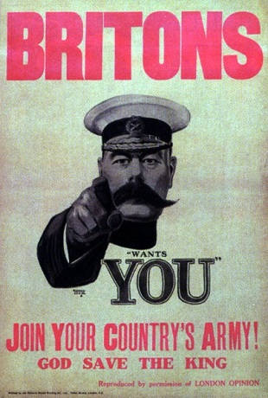
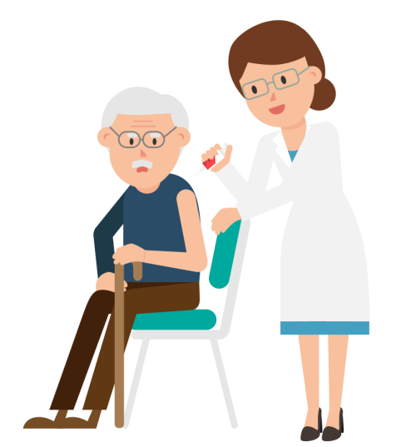
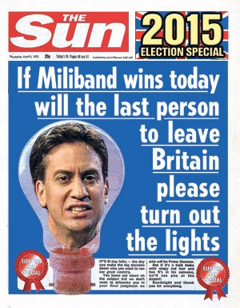
Representation │ Audiences │ Industries │ Language
Lesson 5: Targeting audience
https://upload.wikimedia.org/wikipedia/commons/5/55/News-media-standards.jpg
Media Audience: Does the Daily Mirror want its audience to be active or passive?
There are basically two different schools of thought concerning how audiences consume media texts like newspapers. There are those that believe that audiences are ‘passive’ and those who believe that audiences are ‘active’.
The Hypodermic Needle theory suggests The idea that the media ‘injects’ ideas and views directly into the brains of the audience like a hypodermic needle, therefore, controlling the way that people think and behave. The audience passively receives the information from the media text without any attempt to challenge this information. It was particularly powerful in World War Two. Is it still so relevant now in these times of fake news and social media echo chambers?
Audience Theory:
Hypodermic Needle
In your books, and in your own words:
What evidence is there that the Daily Mirror wants its audience to be passive and to ‘control’ the way the audience thinks and the ideology it shares.
Explain the hypothermic needle audience theory and how it relates to the Daily Mirror.

Slide 25
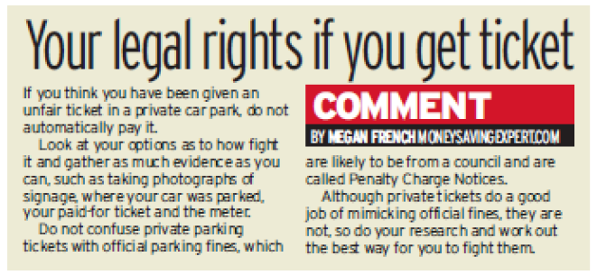
Representation │ Audiences │ Industries │ Language
Lesson 5: Targeting audience
https://upload.wikimedia.org/wikipedia/commons/5/55/News-media-standards.jpg
Media Audience: Does the Daily Mirror want its audience to be active or passive?
The active audience model suggest that audiences do not just receive information passively but are actively involved, often unconsciously, in making sense of the message within their personal and social contexts
The Daily Mirror in our CSP offers the audience opportunities to engage with the stories on a much more personal level. The newspaper is almost breaking through the normal codes and conventions of a news story to speak directly to the reader. This desire to interact with their
audience is through free offers and is further encouraged with journalist email addresses.
In your books, and in your own words:
Explain the Active Audience theory and how it related to the Daily Mirror.
What evidence is there that the Daily Mirror encourages the audience to be active.
Which do you think has more influence on a Daily Mirror audience; a passive ‘hypothermic needle’ approach or a more active, interactive approach?

Slide 26
Representation │ Audiences │ Industries │ Language
Lesson 5: Targeting audience
https://upload.wikimedia.org/wikipedia/commons/5/55/News-media-standards.jpg
Media Audience: Are there any opportunities for the audience to negotiate or reject the preferred reading?
Stuart Hall (1973) suggested that there were three main perspectives involved in the way in which an audience responds to a media product. This involves how the audience is positioned by the product and influences their response to it.
Preferred reading
This is where the audience responds to the product exactly as the producer intended. The Daily Mirror will hope that many of their stories will reflect the political and ideological position of the Daily Mirror.
Negotiated reading
This is where the audience accepts parts of the product and not others. In our modern media-aware world this is increasingly an issue in all newspapers from all but the most ‘loyal’ readers.
Oppositional or resistant readings
This can happen in newspapers as some members of the audience will consume the news from the Daily Mirror even though they may disagree with it’s political and ideological position.
In your books, and in your own words:
For one story in the Daily Mirror CSP, state how a reader may have a preferred reading, a negotiated position and an oppositional reading.

Slide 27
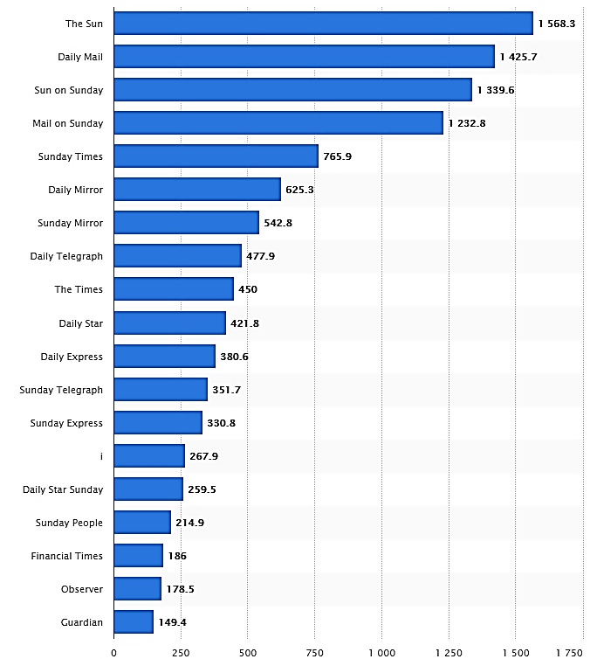
Representation │ Audiences │ Industries │ Language
Lesson 6: Market Position
https://upload.wikimedia.org/wikipedia/commons/5/55/News-media-standards.jpg
Media Industries: What is the market position of The Daily Mirror?
“A lot of people tend to put all the redtops in the same basket. We feel that we sit between the Daily Star, The Sun and the Daily Mail in a ‘mid-top’ kind of place.”
National newspapers in the UK can be split into:
popular red top/tabloids
midmarket
quality products.
Lloyd Embley
Editor-in-Chief
The term 'tabloid' is often used to describe the smaller-sized, downmarket, popular or red-top dailies (Sun, Daily Star). However, many newspapers have changed size so don’t be confused by the size issue. The Times adopted their format in 2004 (though they called it 'compact'). The Times would classify itself as a Quality Compact whereas the Daily Mirror would like to classify itself as a Midmarket tabloid. Some would argue that the Daily Mirror is a popular tabloid and The Times is moving midmarket. The Daily Mirror is one of the few labour-supporting newspapers (as well as The Guardian).
Circulation of newspapers in the United Kingdom (UK) in 2017 (in 1,000 copies)
From
https://www.statista.com/statistics/529060/uk-newspaper-market-by-circulation/
In your books, and in your own words:
What are the sales figures for the Daily Mirror? How does this compare to The Times?
What type of newspaper in the Daily Mirror?
What is the political affiliation of the Daily Mirror?

Slide 28
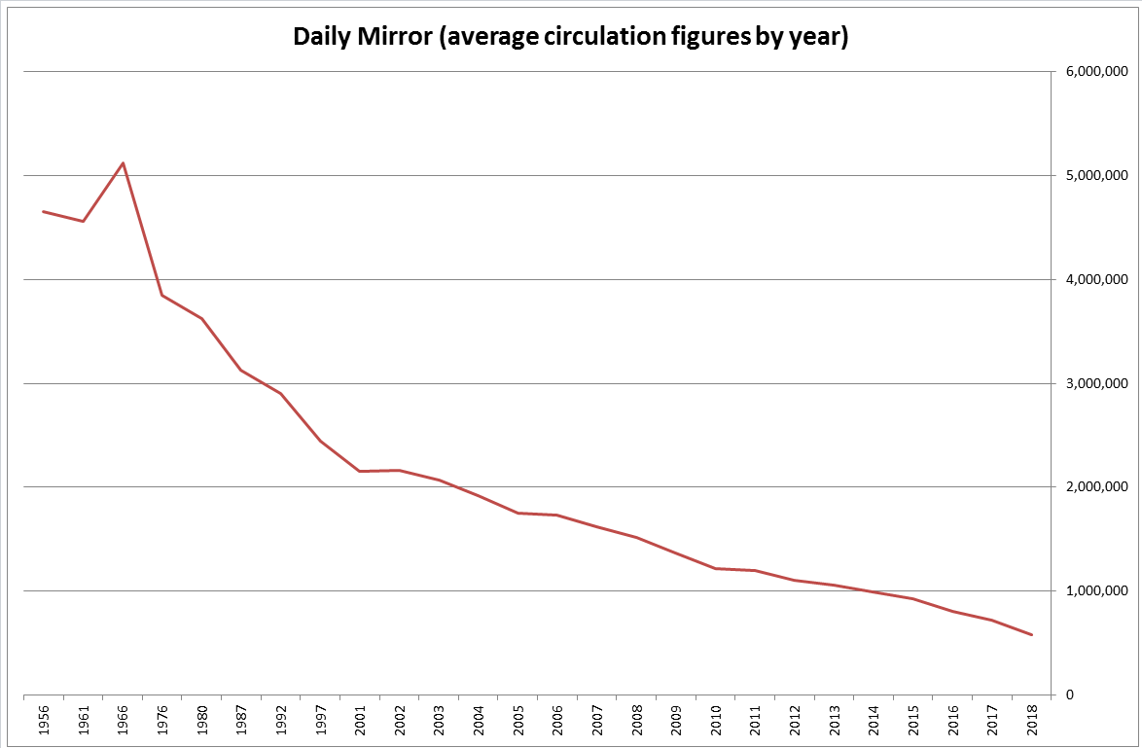
Representation │ Audiences │ Industries │ Language
Lesson 6: Circulation
https://upload.wikimedia.org/wikipedia/commons/5/55/News-media-standards.jpg
Media Industries: What are the Daily Mirror’s circulation figures and how have they changed?
The Daily Mirror was the largest-selling paper from the 1930s until the 1970s, when it was overtaken by Rupert Murdoch's Sun. The circulation figures for the Daily Mirror have been falling steadily for the last 50 years.
Notes:
Figures from https://en.wikipedia.org/wiki/List_of_newspapers_in_the_United_Kingdom_by_circulation

Slide 29
Representation │ Audiences │ Industries │ Language
Lesson 6: Circulation
https://upload.wikimedia.org/wikipedia/commons/5/55/News-media-standards.jpg
Media Industries: What are the Daily Mirror’s circulation figures and how have they changed?
There are a number of reasons why the circulation of newspapers has fallen over the last 50 years:
The growth of television as a major source of news (since the 1950s)
The growth of the Internet as a major source of news (since the 1990s). This has particularly impacted on advertising revenue for newspapers as we use the Internet (often free) for services when previously we would have looked at other companies.
People are accessing news freely through social media and other online outlets. Newspapers cannot compete with the speed and cost-free nature of this. Twitter has no printing costs, printing factories, distribution costs and journalist wages.
Previously we would go to small number of outlets for our news (BBC and other national broadcasters, national and some local newspapers). Now there are so many places we can access news (numerous TV channels, websites, social media accounts, blogs). This so-called narrowcasting has splintered audiences into smaller and smaller pieces for an increasing number of news organisations.
Critics of the newspaper as a medium also argue that while today's newspapers may appear visually different from their predecessors a century ago, in many respects they have changed little and have failed to keep pace with changes in society. The technology revolution has meant that readers accustomed to waiting for a daily newspaper can now receive up-to-the-minute updates from Web portals, bloggers and new services such as Twitter.
In your books, and in your own words:
Describe the pattern for the Daily Mirror’s circulation over the last 50/60 years.
Why has newspaper circulation fallen?
Notes:
Figures from https://en.wikipedia.org/wiki/List_of_newspapers_in_the_United_Kingdom_by_circulation

Slide 30
Representation │ Audiences │ Industries │ Language
Lesson 6: Market Position
https://upload.wikimedia.org/wikipedia/commons/5/55/News-media-standards.jpg
Media Industries: Who owns the Daily Mirror?
Reach plc (formerly known as Trinity Mirror between 1999 and 2018) is a British newspaper, magazine and digital publisher. It is one of Britain's biggest newspaper groups, publishing 240 regional papers in addition to the national Daily Mirror, Sunday Mirror, The People, as well as the Scottish Sunday Mail and Daily Record. In February 2018, the company completed the acquisition of the UK publishing assets of Northern & Shell, including the Daily Express, Sunday Express, Daily Star and OK!. Following completion, Trinity Mirror announced a plan to rebrand as Reach.
Newspaper groups | Titles owned | Daily market share in 2017 (2005)
News International (Rupert Murdoch) | Sun, Times, Sunday Times, Sun on Sunday (News of the World) | 34% (34%)
Daily Mail and General Trust | Mail, Mail on Sunday | 24% (21%)
Northern & Shell (Richard Desmond) | Express, Express on Sunday, Star | 14% (16%)
Reach – formerly Trinity Mirror plc | Mirror, Sunday Mirror, Sunday People, Daily Record | 11% (15%)
Telegraph Group (Barclay brothers) | Daily Telegraph, Sunday Telegraph, (The Business) | 8% (8%)
Guardian Media Group (Scott Trust) | Guardian, Observer | 3% (6%)
Nikkei (bought from Pearson) | Financial Times | 1% (1%)
In your books, and in your own words:
Who owns The Daily Mirror?
What newspapers does Reach PLC now own? What market share does it now have from February 2018?

Slide 31
Representation │ Audiences │ Industries │ Language
Lesson 7: Digital Platforms
https://upload.wikimedia.org/wikipedia/commons/5/55/News-media-standards.jpg
Media Industries: How is the Daily Mirror responding to the challenges to traditional newspapers from digital platforms?
With sales in printed newspapers falling and the associated loss of earnings from advertisers and sales, the Daily Mirror has been concentrating on digital sales, and advertising, in response to the growth of digital news platforms and social media. As they say, if you can’t beat them, join them! They have:
Moved towards a multi-platform landscape. This means that it publishes and synchronises across its print, desktop and mobile platforms. The Daily Mirror has provided this online content for free. Some newspapers (e.g. The Times) have a paywall on their online content. Free providers make money from advertising space online.
Created a social media strategy in collaboration with the digital team to drive growth of their Twitter and Facebook profiles.
Creating news based content that updates regularly, is shared on social media channels, includes a range of video content and encourages audience involvement. Printed newspapers cannot do this so effectively.
MailOnline remains the most popular online newspaper site with 29.3 million users ahead of the Daily Mirror’s 23.8 million.
In your books, and in your own words:

Slide 32
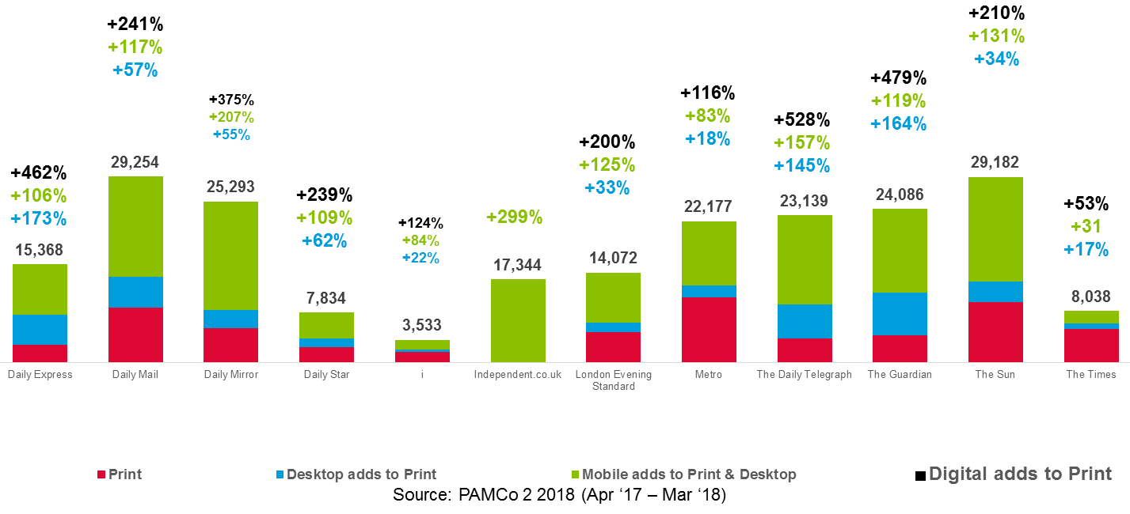
Representation │ Audiences │ Industries │ Language
Lesson 7: Multiplatform
https://upload.wikimedia.org/wikipedia/commons/5/55/News-media-standards.jpg
Media Industries: What trends are towards convergence of media platforms in the case of the Daily Mirror?
In your books, and in your own words:
Describe impact of digital to print for the Daily Mirror.
Compare the difference in media platform impact between the Daily Mirror and The Times.
Account for the difference in the digital impact between the two papers.
Notes:
From http://www2.newsworks.org.uk/multi-platform.pptx

Slide 33
Representation │ Audiences │ Industries │ Language
Lesson 7: Press regulation
https://upload.wikimedia.org/wikipedia/commons/5/55/News-media-standards.jpg
Media Industries: How and why are UK newspapers regulated?
The Press Complaints Commission (PCC) was a voluntary regulatory body for British printed newspapers and magazines, consisting of representatives of the major publishers. The PCC closed on Monday 8 September 2014 after criticism after the phone hacking affair. It was replaced by the Independent Press Standards Organisation (IPSO), chaired by Sir Alan Moses.
The role of IPSO is to:
Regulate 1500 print and 1100 online titles.
Listen to complaints about press behaviour.
Help with unwanted press attention.
Advise publication editors .
Provide information to the public.
Provide a journalist whistleblowing hotline.
Low-cost arbitration between complainants and publications.
In your books, and in your own words:
Why did David Cameron want the removal of the PCC?
What does IPSO stand for? What is the role of IPSO?

Slide 34
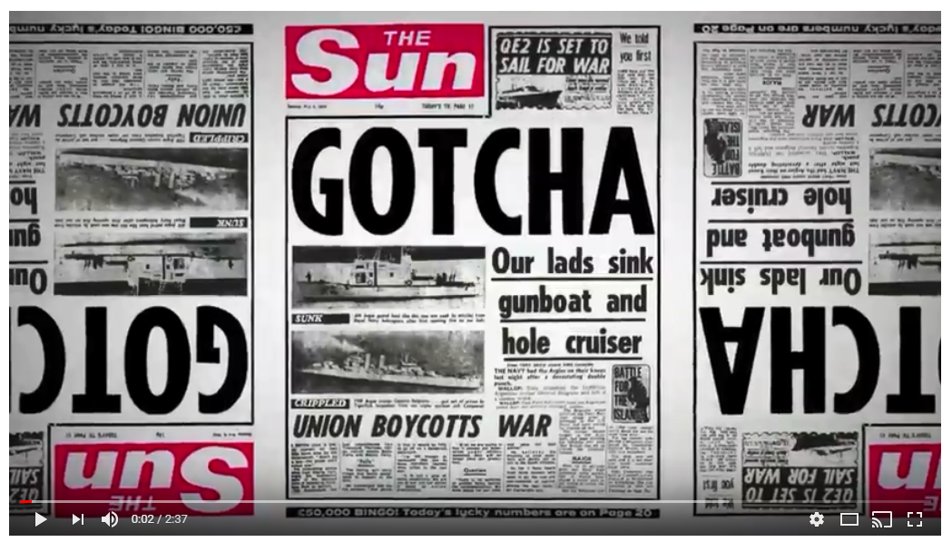
Representation │ Audiences │ Industries │ Language
Lesson 7: Press regulation
https://upload.wikimedia.org/wikipedia/commons/5/55/News-media-standards.jpg
Media Industries: How and why are British newspapers regulated?
Click image to view video
In your books, and in your own words:
Watch the video. Why do some organisations think that IPSO does not regulate newspapers rigorously enough?
How far do you agree that regulation stops freedom of speech in our newspapers?

Slide 35
Representation │ Audiences │ Industries │ Language
https://upload.wikimedia.org/wikipedia/commons/5/55/News-media-standards.jpg
This concludes Daily Mirror Close Study Product. Now complete your Personal Learning Checklist for this CSP.

