Slide 1
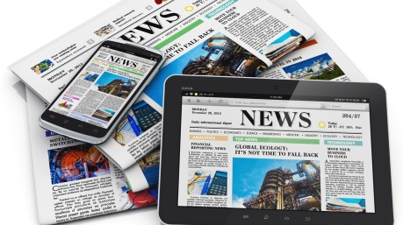
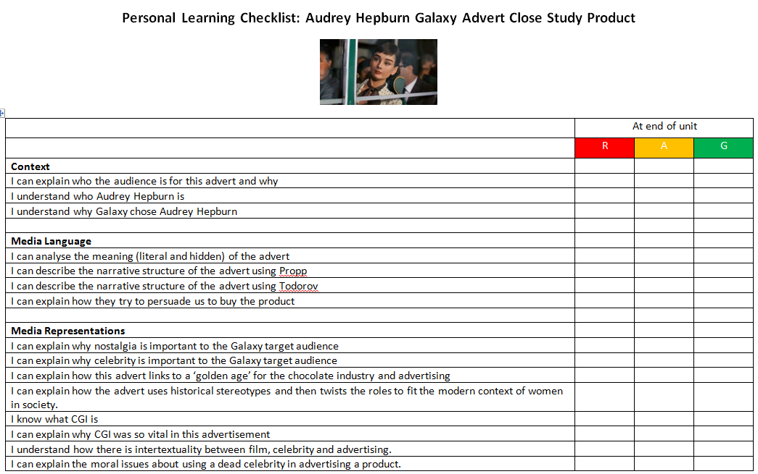
Representation │ Audiences │ Industries │ Language
Lesson 1: Advert context
https://upload.wikimedia.org/wikipedia/commons/5/55/News-media-standards.jpg
Bell work
Collect your Galaxy Audrey Hepburn Personal Learning Checklist and stick in your book – you must revisit this at the end of each lesson and again at the end of the unit.

Slide 2
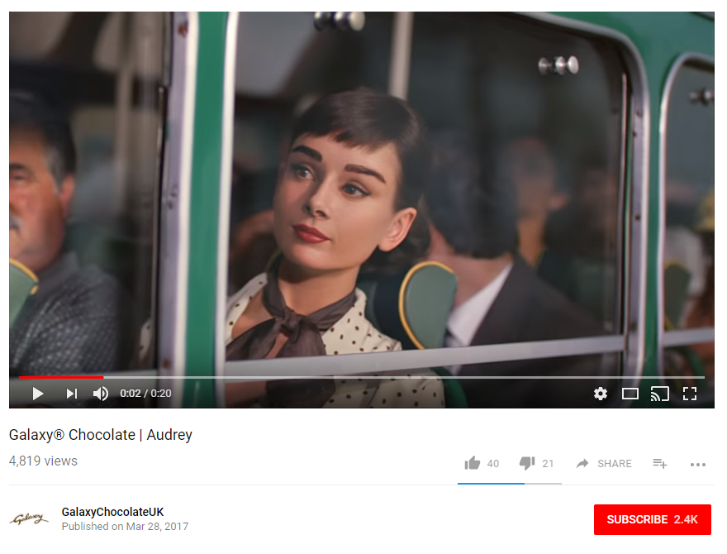
Advertising Galaxy Chocolate Advert featuring Audrey Hepburn https://youtu.be/QcgEqbhsCfU
Representation │ Audiences │ Industries │ Language
Lesson 1: Advert context
https://upload.wikimedia.org/wikipedia/commons/5/55/News-media-standards.jpg
Click to view

Slide 3
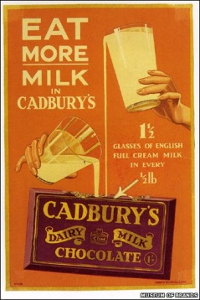
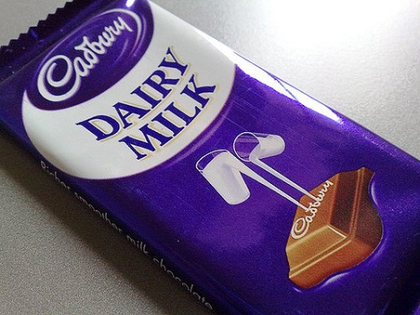
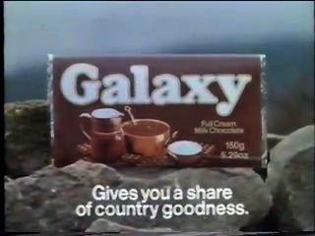
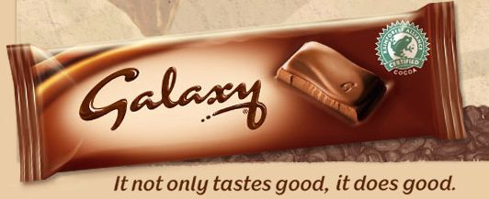
Representation │ Audiences │ Industries │ Language
Lesson 1: Advert context
https://upload.wikimedia.org/wikipedia/commons/5/55/News-media-standards.jpg
Historical context of confectionary advertising
Nostalgia, or a "yearning for yesterday," is a frequently used advertising tool. It is particularly common in the chocolate industry.
Packaging design points to nostalgia. Very traditional.
Whilst the font and image has changed with Galaxy, the key message about ‘Goodness’ has stayed consistent.
In your books and in your own words:
What is nostalgia?
Why does the chocolate industry seem to have a focus on nostalgia in their advertising campaign [think target audience / perceived as natural and wholesome products / desire for more ‘traditional’ times]?
Why do advertisers use images of ‘older’ times in their advertising?

Slide 4
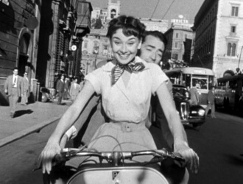
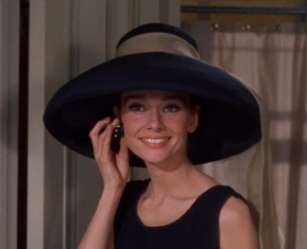
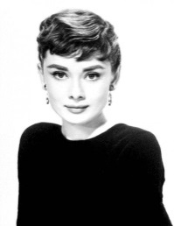
Representation │ Audiences │ Industries │ Language
Lesson 1: Advert context
https://upload.wikimedia.org/wikipedia/commons/5/55/News-media-standards.jpg
Use of CGI
How the advert was made
CLICK HERE
Audrey Hepburn was as a film and fashion icon and was famous during Hollywood's Golden Age. She was ranked by the American Film Institute as the third-greatest female screen legend and encapsulates the ‘Golden Age’ of Hollywood.
“Audrey represents heritage, classiness and elegance. So from a strategic and creative point of view, it made sense for Galaxy to communicate its “silk, not cotton” branding through these qualities. What was less clear, however, was just how we were meant to recreate an iconic and globally recognised face when the original footage exists at a resolution incompatible with today’s high standards.” The Guardian 08/10/14 How we resurrected Audrey Hepburn for the Galaxy chocolate ad
The advertising company received permission from the Audrey Hepburn estate [managed by her sons]. However, does this place moral and ethical questions about the use of dead celebrities or their work in selling a product? Would they have consented to this when they were alive?
In your books and in your own words:
What does CGI stand for?
Why are there moral issues related to the CGI use of a dead celebrity in an advertising campaign?

Slide 5
Representation │ Audiences │ Industries │ Language
Lesson 2: Media Language - Semiotics
https://upload.wikimedia.org/wikipedia/commons/5/55/News-media-standards.jpg
Semiotic Meaning of the advert
Semiotics are frequently used in advertising to convey meaning. There are clear codes and conventions used in advertising so that the viewer can quickly understand the key signals and meaning. Remember, adverts often do not have long to get their message across so rely on semiotic understanding.
Chocolate is partially seen. Symbol of luxury and pleasure.
Hepburn is a symbol of classic feminine beauty / nostalgia / ‘golden’ times. Here some ‘intertextuality’ is needed from the target audience. They need to know who Audrey is and what she represents. This assumes the target audience is quite mature in cultural references.
Visual
Cultural
The implied romance between the driver and Audrey will have more codes relevant to females [who may be more of the target audience]
The driver is in a luxury car. Links luxury product to luxury car. Driver looks like a chauffeur. Again, implies social standing and wealth.
Possible Semiotic Codes
Language
Gender
Clear signs that Audrey is in control. An empowered feminine lead.
“Why have cotton when you can have silk?” Again the connotation is that Galaxy is a luxury product. Silk being a superior product.
In your books and in your own words:
What does semiotic stand for?
Describe and explain the semiotic codes used in the advert

Slide 6
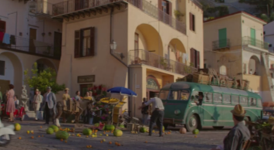
Representation │ Audiences │ Industries │ Language
Lesson 2: Media Language – Narrative structure
https://upload.wikimedia.org/wikipedia/commons/5/55/News-media-standards.jpg
Narrative Structure – what is the story or plot of the advert?
In your books and in your own words:
Watch the advert and try to storyboard and explain key scenes in it. If possible, pull out the semiotic codes used in the advert. You could use a template like this – first one done for you:
Scene | Image | Description and Meaning | Scene | Image | Description and Meaning
1 |  | Busy Italian market scene – links to 1953 film ‘Roman Holiday’. Bus journey disrupted by fallen food. Audrey is seen on bus. | 5
2 |  |  | 6
3 |  |  | 7
4 |  |  | 8

Slide 7
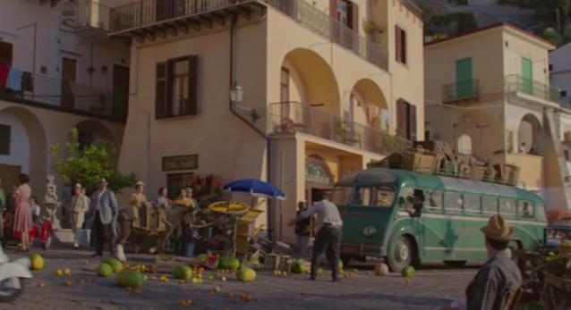
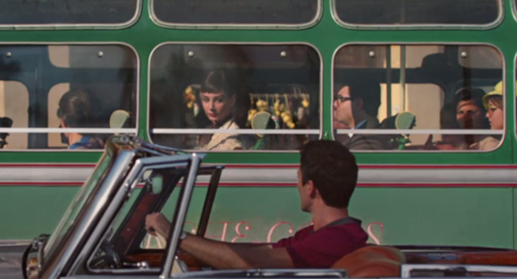
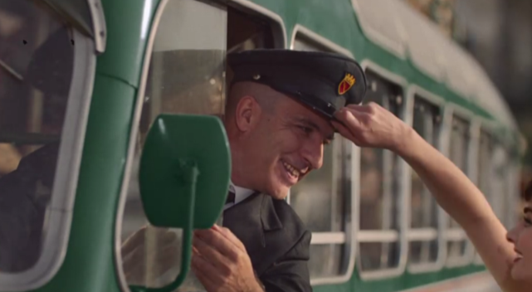
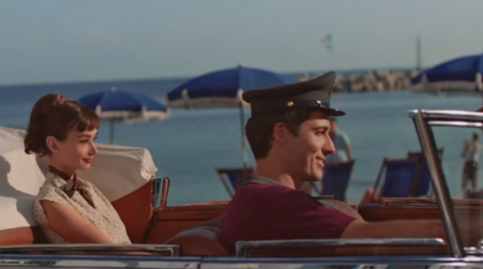
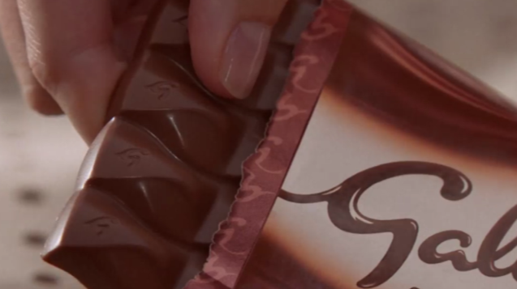
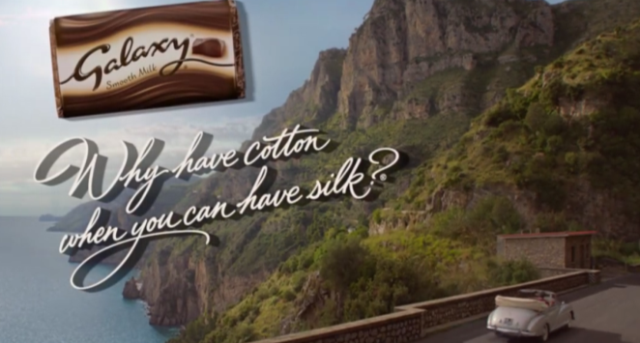
Representation │ Audiences │ Industries │ Language
Lesson 2: Media Language – Narrative structure
https://upload.wikimedia.org/wikipedia/commons/5/55/News-media-standards.jpg
Narrative Structure
Many media products have a narrative structure that makes sense to the audience. What is the narrative structure of this advert?
Busy Italian market scene – links to 1953 film ‘Roman Holiday’. Bus journey disrupted by fallen food. Audrey is seen on bus.
‘Hero’ driver comes along and signals to Audrey that she can come in the car.
Audrey borrows the bus drivers hat and puts it on the hero’s head. Semiotic links to control, here.
Audrey sits in the back of the car and ‘hero’ wears the hat now resembling a chauffeur.
Audrey relaxes in the car and eats Galaxy. Semiotic luxury. Note only eating a little (it’s a luxury). Also, reveal of text ‘smooth’.
Car drives along Amalfi coast with advertising slogan.

Slide 8
Representation │ Audiences │ Industries │ Language
Close Study Product: Galaxy Advertisement
https://upload.wikimedia.org/wikipedia/commons/5/55/News-media-standards.jpg

Slide 9
Representation │ Audiences │ Industries │ Language
Lesson 3: Media Language - Todorov
https://upload.wikimedia.org/wikipedia/commons/5/55/News-media-standards.jpg
Narrative Structure and Todorov’s Narrative Theory
Tzvetan Todorov studied classic fairy tales and stories and theorised that many stories follow the same narrative structure and involve transformation of character/story. Namely:
1. A state of equilibrium.
(balance/ calm)
2. An event that disrupts the equilibrium.
3. A recognition that this disruption has occurred.
4. An attempt to repair the damage of this disruption.
5. A new equilibrium or return to old state. Order is restored.
In your books and in your own words:
What is Todorov’s Narrative theory?
Describe each stage of Todorov’s Narrative Theory. Give an example for each stage from a film / book / TV series you have enjoyed.
For each stage, link Todorov to the Galaxy advert. Is it useful to do this?
Todorov’s Narrative Theory
Equilibrium | Bus is travelling through Italian village.
Disruption | Fruit stall stops bus and disrupts journey.
Recognition
Repair
New Equilibrium

Slide 10
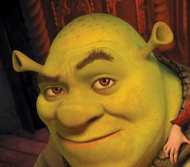
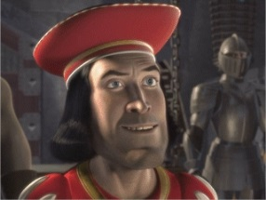
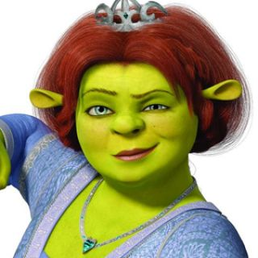
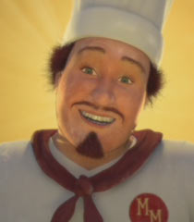
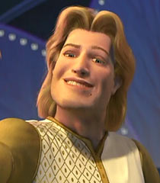
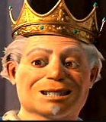
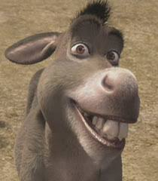
Representation │ Audiences │ Industries │ Language
Lesson 3: Media Language - Propp
https://upload.wikimedia.org/wikipedia/commons/5/55/News-media-standards.jpg
Narrative Structure and Propp’s Narrative Theory
Vladimir Propp stated that there were seven basic character functions when he analysed 100 fairy tales and that these were present in many media products. When analysing Shrek, let’s see if he’s right?
The Hero
Shrek is the hero who has his quest or mission throughout.
The Villain
Lord Farquaard is obviously the villain in Shrek. The villain tries to stop the hero.
The Princess
Fiona is a princess. She is rescued and falls in love with ‘The Hero’. A prize for the hero.
The Donor
The donor often gives the hero a special power to complete the quest. In Shrek, the Muffin Man helps Shrek.
In your books and in your own words:
What is Propp’s Narrative theory?
Describe each character type in Propp’s Narrative Theory.
Does Propp work with Galaxy? Which character-types do you recognise and which ones do you not?
The False Hero
The false hero tries to take the credit for the Hero’s actions and get the Princess. Prince Charming fulfils this role in Shrek.
The Princess’s Father
Often an authority figure who offers a reward to the Hero.
The Helper
The helper is the character who helps the hero achieve his/her quest. In Shrek, it’s the Donkey

Slide 11
Representation │ Audiences │ Industries │ Language
Close Study Product: Galaxy Advertisement
https://upload.wikimedia.org/wikipedia/commons/5/55/News-media-standards.jpg

Slide 12
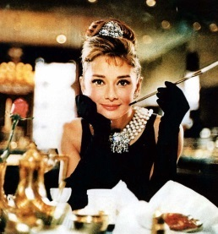
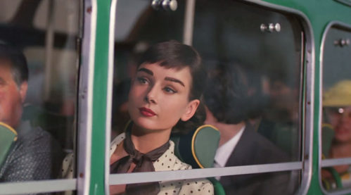
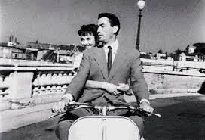
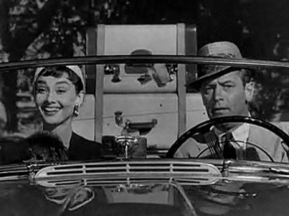
Representation │ Audiences │ Industries │ Language
Lesson 4: Media Language - Intertextuality
https://upload.wikimedia.org/wikipedia/commons/5/55/News-media-standards.jpg
Intertextuality in Media Products
Intertextuality is where one media product (e.g. Galaxy) makes reference to other Media Products (e.g. Audrey Hepburn movies) to interest and engage the audience. This is clearly done in this advert:
Audrey driven away in the advert and by Gregory Peck in ‘Roman Holiday’. The actor even looks like Peck.
Audrey always looking glamourous; in the advert and ‘Breakfast at Tiffany’s’.
Classic cars were very much a theme in Audrey Hepburn movies and she was often driven (as was the fashion) rather than driving.
In your books and in your own words:
What is Intertextuality?
Why do advertisers incorporate this?
Give examples from the Galaxy advert? Does it work for all audiences? If not, why not?

Slide 13
Representation │ Audiences │ Industries │ Language
Lesson 4: Media Representation
https://upload.wikimedia.org/wikipedia/commons/5/55/News-media-standards.jpg
Media Representations: Stereotypes vs Reality?
The TV advertisement for Galaxy uses a range of stereotypes. Stereotypes are used so that semiotic codes can be quickly messaged to the target audience. What stereotypes are used in this advert, why and how do they compare to reality?
 | Stereotype used | Reality
Place: Italy
Celebrity: Audrey Hepburn
Product: Galaxy chocolate
Time: 1950s
Masculinity and Femininity
Class
Age
In your books and in your own words:
Ensure you have these key points in your book: Stereotypes vs Reality
Why have each of these stereotypes been included and how do they impact on the target audience?

Slide 14
Representation │ Audiences │ Industries │ Language
Lesson 4: Media Representation
https://upload.wikimedia.org/wikipedia/commons/5/55/News-media-standards.jpg
Media Representations: Stereotypes vs Reality?
The TV advertisement for Galaxy uses a range of stereotypes. Stereotypes are used so that semiotic codes can be quickly messaged to the target audience. What stereotypes are used in this advert, why and how do they compare to reality?
 | Stereotype used | Reality
Place: Italy | Classic Mediterranean hilltop village setting. Sunny. Beautiful buildings. Chaotic. Disorganised. | Where are the poorer, less-glamourous locations. Why have these been excluded?
Celebrity: Audrey Hepburn | Immaculately presented. Cool. Charming. Loved by all people. | Audrey [you may be surprised to hear] was not always this immaculate! *she often was though!
Product: Galaxy chocolate | Luxury product. Induces calm, relaxation, etc. | Chocolate doesn’t always make you feel like this. Why have they felt the need to represent chocolate this way?
Time: 1950s | Friendly, slow-pace of life, simpler times. | This is clearly stereotypical, but some truth. 1950s were not always like this for everybody though.
Masculinity and Femininity | Women – feminine attire, flirtatious, Propp’s Princess’s, trusting. Men – working, Propp’s helpers and hero’s. | Many images of masculinity and feminine were changed after WW2. Are these stereotypes relevant today? Would you expect this to happen in a modern advert?
Class | No specific class present – seems very inclusive and friendly. | Why is the society so inclusive? What image of this society are they trying to represent?
Age | All ages represented, but central characters are young, good-looking and image-aware. | Think of the target audience. What age are they now? Why would this image resonate with them?
In your books and in your own words:
Ensure you have these key points in your book: Stereotypes vs Reality
Why have each of these stereotypes been included and how do they impact on the target audience?

Slide 15
Representation │ Audiences │ Industries │ Language
Lesson 4: Media Representation
https://upload.wikimedia.org/wikipedia/commons/5/55/News-media-standards.jpg
Media Representations: What factors will affect audience interpretation?
There are a number of factors that would impact on how an audience interprets this advert:
Views on nostalgic lifestyle and busy modern lifestyles
Cultural references regarding 1950s movie stars.
Age of audience – who are the buyers? How would older/younger audience respond?
Factors affecting audience interpretation
Personal identity with Audrey Hepburn and representations of class and femininity.
The belief that chocolate is good for you. This contradicts modern healthy lifestyle messages.
In your books and in your own words:
For each factor, explain why each of these could affect audience interpretation.

Slide 16
This concludes the TV Galaxy advert Close Study Product. Now complete your Personal Learning Checklist for this CSP.
Representation │ Audiences │ Industries │ Language
Lesson 4 : Media Representation
https://upload.wikimedia.org/wikipedia/commons/5/55/News-media-standards.jpg

