Slide 1

Home learning lesson 1:
Identifying values and aligning actions

Slide 2



  We are learning:
  About values and how these influence people’s actions.
  We will be able to:
  describe different types of values and how these affect people’s wellbeing.
  explain the connection between people’s values and their goals.

Slide 3
What do you think?
You overhear the conversation below. To what extent do you agree with each view?
Which do you agree with more and why?
The most important thing is winning awards for what you do, so that people know you’re the best at it.
Nah, I don’t really care about winning trophies or what other people think. I just do things I enjoy.
Write down your thoughts on a piece of paper.
You will return to this at the end of the session.

Slide 4





What are values?
In the overheard conversation on the previous slide, the people talking disagree because they hold different values.
A value is something that a person, or group of people, believes is important. Values can influence our behaviour and decisions.
Some examples include:
Valuing a feeling of connection to a community, healthy friendships or valuing the environment.
Valuing feeling healthy and having a sense of positive wellbeing, or a feeling of self-acceptance.
Valuing being wealthy, being popular or famous or feeling recognised by winning awards.

Slide 5
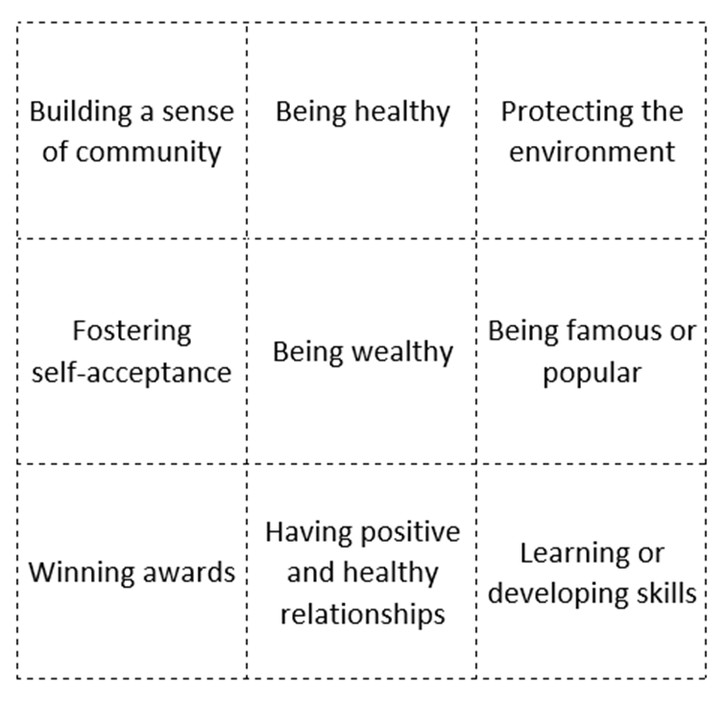


Slide 6
Values in daily life
Sort Resource 1 values cards into the categories below.
You might want to change the colour of each card without printing (for example to blue and orange as below) or you may want to print, cut out and sort the cards.
Values about supporting ourselves or others
Click here to reveal answers
Values about comparing a person to others
Click here to reveal answers
Building a sense of community
Being healthy
Protecting the environment
Fostering self-acceptance
Having positive and healthy relationships
Learning or developing skills
Being wealthy
Winning awards
Being famous or popular
Notes:
Values about supporting ourselves or others
Building a sense of community
Being healthy
Protecting the environment
Fostering self-acceptance
Having positive and healthy relationships
Learning or developing skills
Values about comparing a person to others
Being wealthy
Winning awards
Being famous or popular

Slide 7






Values in daily life
Values about supporting ourselves or others
Values about comparing an individual to others
These are called intrinsic values and they help us to fulfil our needs. For example, connecting with others in a community or healthy relationship, or developing our knowledge and skills.
They support our wellbeing and that of others by helping us to learn and grow, or connect with each other and our wider world.
These are called extrinsic values and they only have value when compared to something external, such as how much money someone has or what clothes they wear.
They often involve competition, and while a little competition can be healthy, too much focus on this can be less helpful to our wellbeing and even damage the environment.

Slide 8


Personal values
Different people consider different values to be more or less important.
Choose three values from Resource 1 value cards that you think would be of high importance to each of the characters on the next slide.
You may want to use the same value card more than once!

Slide 9
Click on each person to learn about them
Billy
Since having children, Billy has been more aware of the need to keep the planet safe for future generations.
Billy currently has a job mapping the oceans, but he has been offered a higher pay by an oil company which he could use to buy a bigger house.
Nicola is a fitness vlogger and often makes vlogs with other people who have similar interests. She is a popular person and enjoys working with others.
Nicola’s friend has just won an award for their vlogs. Nicola feels happy for her friend, but wonders if she should have an award too.
Nicola
Eli
Sabina
Eli has worked hard to get a job designing luxury cars. His family are very proud of him and he likes being able to donate to environmental charities.
Eli’s doing really well in his job. He wonders if he should continue doing what he’s good at, or if he should look for something more challenging.
Sabina volunteers in after school clubs with lots of sports and activities to help children who have moved to the UK make new friends.
Sabina can’t decide on her next step, should she start a research degree about migration or become a teacher?
Notes:
Billy
Since having children, Billy has been more aware of the need to keep the planet safe for future generations.
Billy currently has a job mapping the oceans, but he has been offered a higher pay by an oil company which he could use to buy a bigger house.
Eli
Eli has worked hard to get a job designing luxury cars. His family are very proud of him and he likes being able to donate to environmental charities.
Eli’s doing really well in his job. He wonders if he should continue doing what he’s good at, or if he should look for something more challenging.
Nicola
Nicola is a fitness vlogger and often makes vlogs with other people who have similar interests. She is a popular person and enjoys working with others.
Nicola’s friend has just won an award for their vlogs. Nicola feels happy for her friend, but wonders if she should have an award too.
Sabina
Sabina volunteers in after school clubs with lots of sports and activities to help children who have moved to the UK make new friends.
Sabina can’t decide on her next step, should she start a research degree about migration or become a teacher?

Slide 10
Personal values
You may have suggested that Billy prioritises protecting the environment or that Sabina prioritises building a sense of community.
If you are able to speak to your classmates, you may find you have different suggestions – there is no one correct answer in this case.
Are there any values that two or more of the characters have in common?
Sometimes people can hold similar values, but can act on these in different ways. They may act on these through their career choice, or through other actions in their daily lives.

Slide 11





Match the value to the action a person might take. (Then click each box to reveal the answer)
.
Building a sense of community
Pursuing knowledge
Protecting the environment
Fostering self-acceptance
Having high social status
Values
Starting an online course to learn a new skill.
Reducing single-use plastic bought and recycling at home.
Keeping a journal to log personal strengths and challenges.
Checking in on friends on the phone and asking how they are.
Buying new clothes every few weeks to follow the latest trends.
Actions
Notes:
Building a sense of community → Checking in on friends on the phone and asking how they are.
Pursuing knowledge → Starting an online course to learn a new skill.
Protecting the environment → Reducing single-use plastic bought and recycling at home.
Fostering self-acceptance → Keeping a journal to log personal strengths and challenges.
Having high social status → Buying new clothes every few weeks to follow the latest trends.

Slide 12

Personal reflection
Looking at the value cards we used earlier, what are your values?
What do you already do to act on these values in your life?
Set yourself one goal or action point that aligns with your values.

Slide 13
What do you think?
Revisit the conversation from earlier.
Have your views changed? If so, how?
If not, why do you still hold the same view?
The most important thing is winning awards for what you do, so that people know you’re the best at it.
Nah, I don’t really care about winning trophies or what other people think. I just do things I enjoy.

Slide 14


Support
If you have questions or concerns about topics explored here, you can always speak to your parent or carer, or contact a teacher in school for more advice and support.
There are lots of places to get advice about career pathways:
For information, advice and guidance about a wide range of careers and education pathways, visit the national careers service.
nationalcareers.service.gov.uk
For information, advice and guidance about career options should you choose to go to university, visit prospects.
www.prospects.ac.uk

