Slide 1
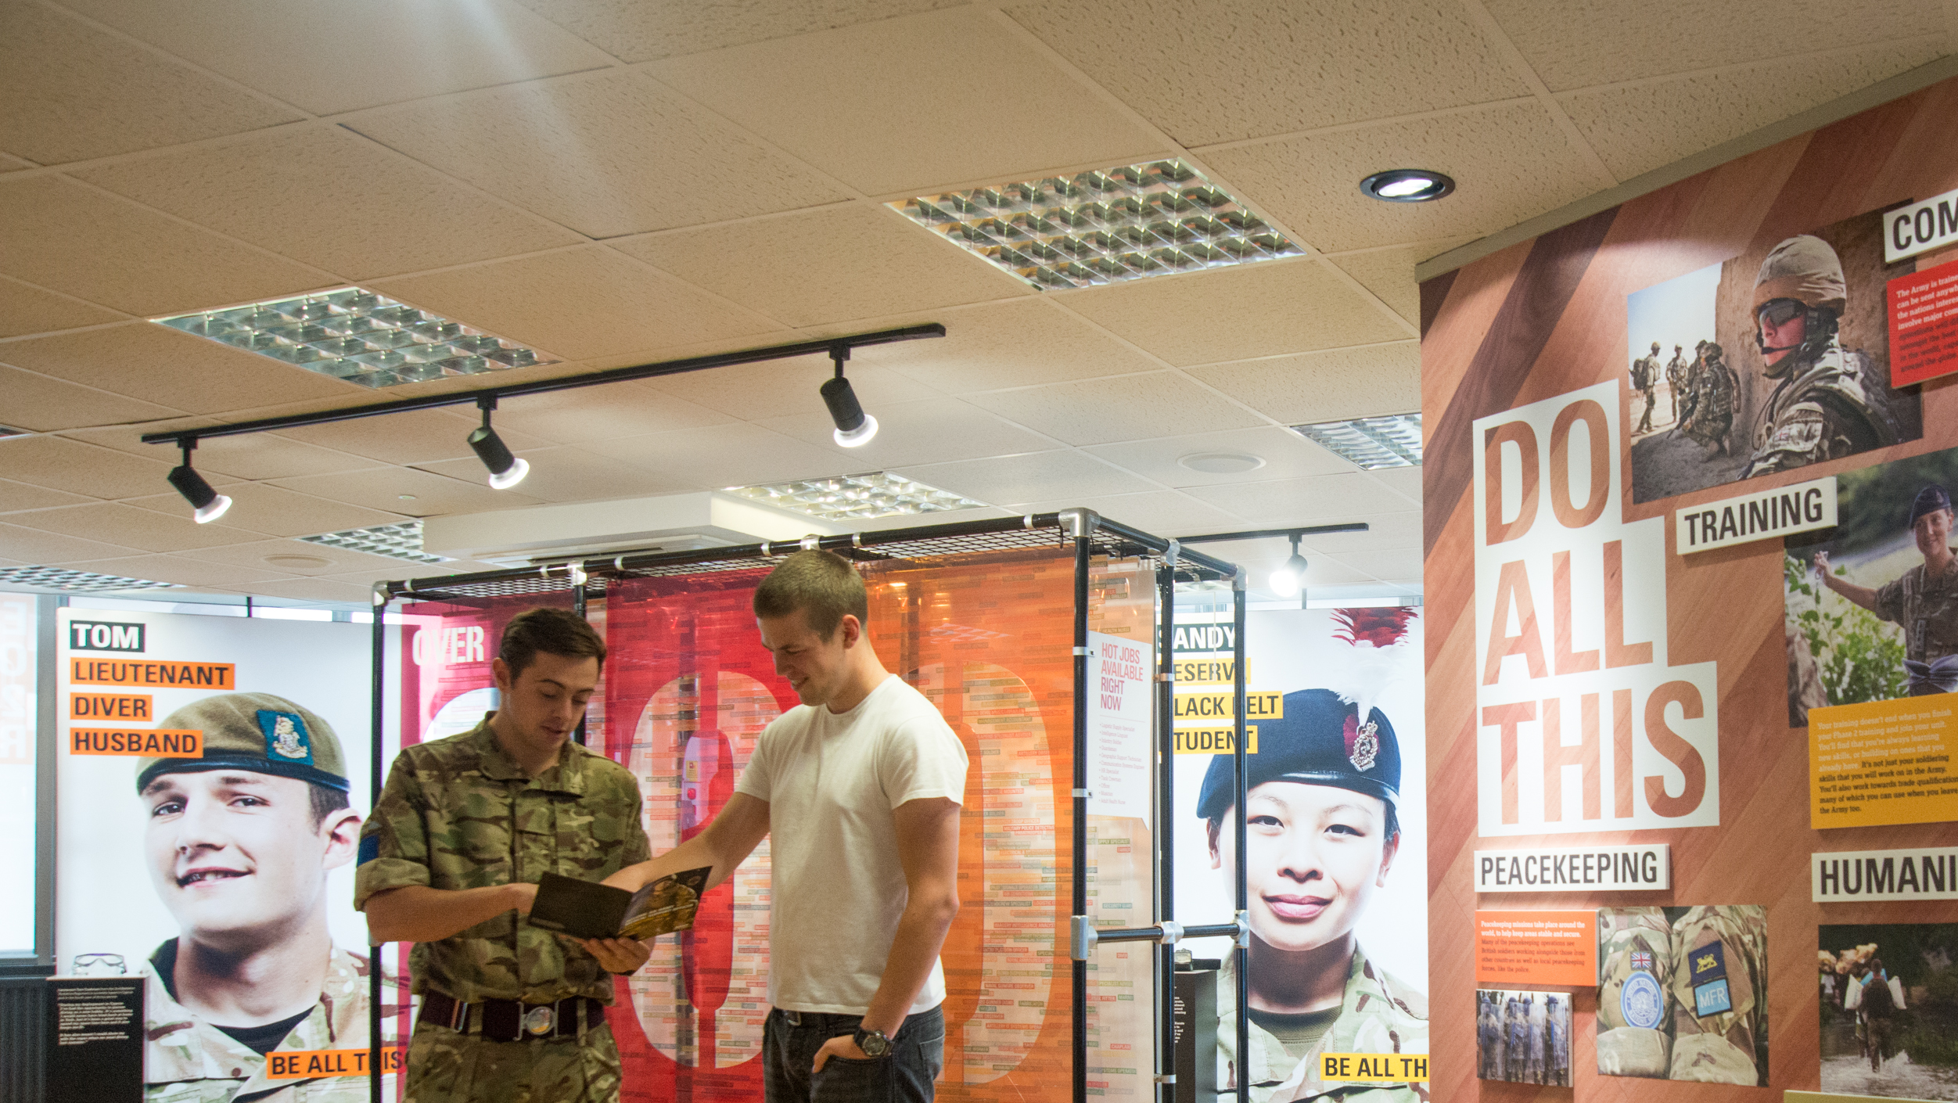

Slide 2


Slide 3
AGE: 11-14, 14-16
TIME: 45-60 minutes
LEARNING OUTCOMES
STUDENTS CAN:
List and describe some key steps in the application
process for employment.
Critically appraise a simple job application, justifying
their opinions.
Apply the STAR (situation, task, action, result) method
to describe how they demonstrate one skill or quality
RESOURCES
Skills and qualities glossary sheet (from Module 1): (1 per student)
Character application pack (1 per group of 3-4)
Job ads (from Module 1): Army Operator Technical Intelligence,
AI Engineer and Online Retail Customer Service Representative
Application Form extract (1 per student - OPTIONAL)
From Module 1 (if completed): action plans and lists of strong/weak skills and qualities.
PREPARATION
Review the slides and video
Adapt to suit your students and time available
Print copies of the resources. Print any optional slides to use as additional templates.
GATSBY BENCHMARK LINKS
2 Learning from career and labour market information
3 Addressing the needs of each pupil
4 Linking curriculum learning to careers
8 Personal guidance
PSHEA GUIDELINES LINKS
11-14
H1, H2, H3
L2, L7, L9, L10, L12, L13, L14, L15
14-16
H1, H2
L1, L10, L11, L12, L13, L14, L15, L17, L19

Slide 4
How you’ll find out about jobs
How you can develop your skills and personal qualities
What experiences can make you more attractive to employers
NOW
How you can find jobs that are right
for you
People who can help you find the right job
SUCCESS!
Notes:
Tailor your delivery of this activity depending on whether you have delivered Module 1.
Review the steps that ‘bridge the gap’ to success. Each one represents a skill that students can apply:
Knowing how to find out about jobs available to them
Being able to assess their skills and match these to jobs
Being able to network with people who could help
Identifying and acting on opportunities to develop skills and qualities employers value
Getting the experience employers seek or value
If students completed Module 1, briefly share examples they can recall from their Action Plans.
Ask students to form groups of 3-5 and come up with one example for each step/skill. Share ideas.
Highlight that the range of ideas shows that there are many possible routes to the right job, so the more options students can identify at each step, the more opportunities they will create for themselves to get all the way to success – the job they want.
Highlight or remind students that taking these steps demonstrates a ‘growth mindset’: someone with a growth mindset believes that they can learn and improve: they can get better at something if they work hard at it. Therefore someone with a growth mindset believes that effort and hard work will pay off, leading to better achievements.
Outline the learning outcomes for the lesson. Students will be able to:
List and describe some key steps in the application process for employment.
Critically appraise a simple job application, justifying their opinions.
Apply the STAR (situation, task, action, result) method to describe how they demonstrate one skill or quality
Differentiation
Support: Divide the class into groups of 3-5. Each group generates and shares ideas for one step. For a hands-on approach, ask groups to write each idea on one sheet of A4 paper. Groups can combine ideas to create complete sets of steps to place on the table, floor or wall and read out to share.
Challenge: Students generate ideas relevant to their real career ambitions. Students generate more than one idea per step and identify different combinations that can each get them to where they would like to be. As an example, if students think of just three ideas per step, this creates over 3,000 different possible combinations that could lead them to success!

Slide 5
1
2
3
4
5
6
Advert
Application
Shortlisting
Interview
Offer
Acceptance
Read carefully
to find out the requirements.
Show how your skills, qualities and experience match the requirements.
The employer chooses the
best applications to invite to interview.
Impress the employer face
to face with the right attitude
and answers.
The employer offers the job to the person they think is the best match and who most impressed them.
Agree to the terms of the job, like the hours and the rate of pay or salary.
Notes:
Don’t show this slide straight away.
Ask students to form pairs and discuss the steps involved in applying for and getting a job (this can be a Think-Pair-Share activity). Share ideas.
Show the steps on the slide. Ask students to suggest the most important thing at each stage:
Read the advert carefully to understand the job and its requirements.
Take care in your application to demonstrate that you are right for the job and would be a good employee, so you are shortlisted for interview.
At interview, answer their questions well but also impress them with your overall attitude and demeanour, and the questions you ask about the job and the employer.
Make sure you are clear about the terms of the job, like your hours, holiday, pay etc.
Differentiation
Support: Print each step, for students to place in the correct order. Students can then match the explanation to the step.
Challenge: Ask students to share their ideas about the most important thing at each stage, in a role-play as a pair. One advises the other, who then can build on their ideas as they swap roles.

Slide 6
Personal information
Name, address, age, contact details
Education
Where you studied, your subjects
and grades
Employment
Past positions and perhaps salary
and reasons for leaving
Experience/Evidence
Why you are the right person for the job
Personal statement
You may be asked to write a general statement about yourself
Specific questions
Some applications may include specific questions about your skills, qualities, qualifications or experience
References
People who can vouch for your character
Signature
By signing you promise that you have told the truth
Notes:
If students completed Module 1, they will have already met Ellie, Hasan and Rae.
Explain that three young people have applied for jobs. You’d like students to spend a few minutes reviewing parts of their application to decide whether it’s good enough to get them to interview stage.
Hand out one character application pack to each group of 3-5 along with the relevant job ad from Module 1. Ask groups to follow the instructions on the slide and come to a decision. Give groups a few minutes to review the materials and come to a decision.
Share groups’ decisions and their justifications, making sure they base their opinions on the evidence in the job advert and application extract.
Discuss why students think an employer might want to research some of the character’s social media activity. The answer is that most employers will seek to find and explore applicants’ social media accounts as another way to find out about their personality and character. How do students feel about this (given that social media accounts are generally public)?
Review how each character’s social media might influence an employer’s decision. Would each group’s decision change with vs. without seeing this content? (In module 1 for example, one of Hasan’s qualities was that he was ‘respectful’. Does his social media reflect that?)
Differentiation
Support: Students can use the skills and qualities glossary to help them. Students use a ‘What went well’ and ‘Even better if’ approach to help identify the strengths and weak areas of what they read.
The skills and qualities glossary is also on the following two (hidden) slides, should you wish to show the glossary on screen and reduce printing. To make the slides visible, right click on the slide’s icon in the sidebar and uncheck the ‘Hide’ option.
Challenge: Students imagine they are an adult friend helping the character to apply. They role-play (or speak to the class) how they would provide feedback on the strengths of the application and the areas they think the character needs to improve.

Slide 7
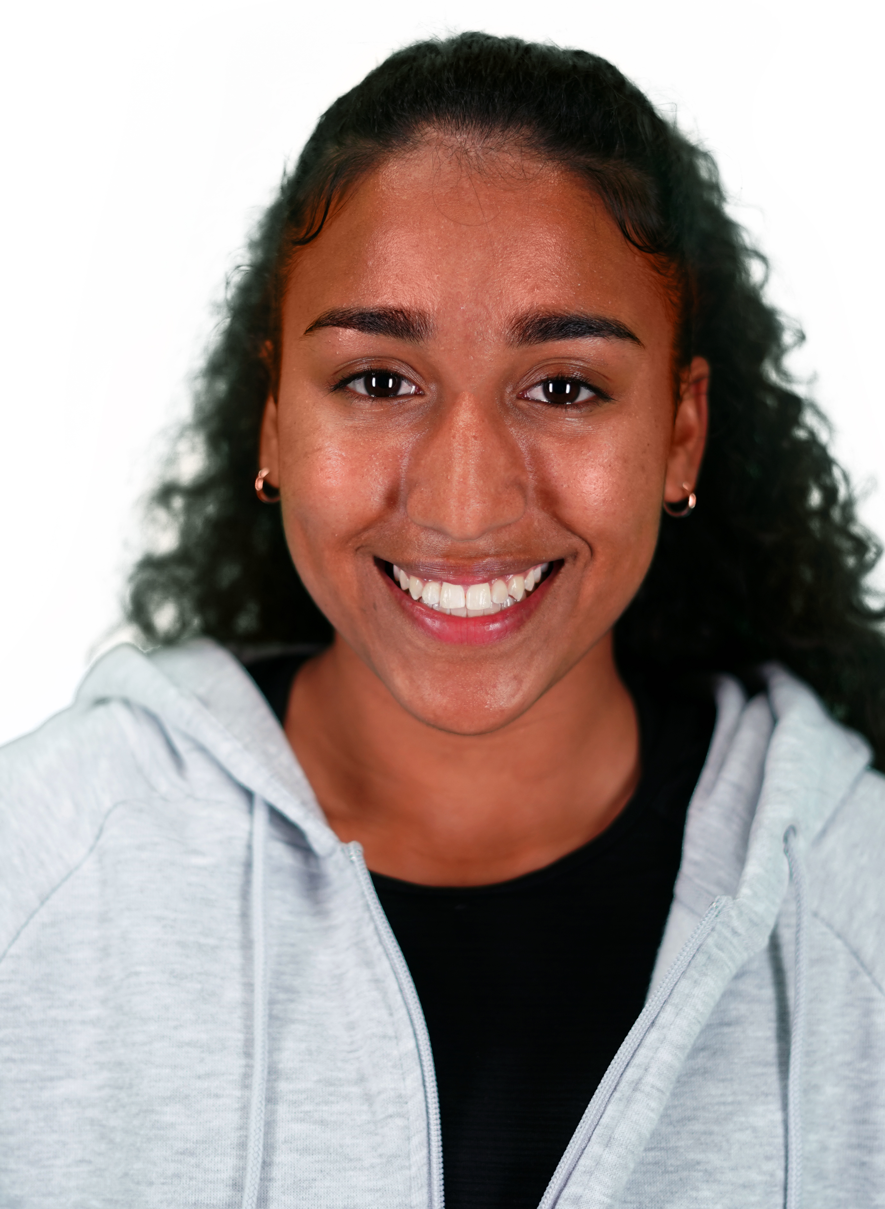

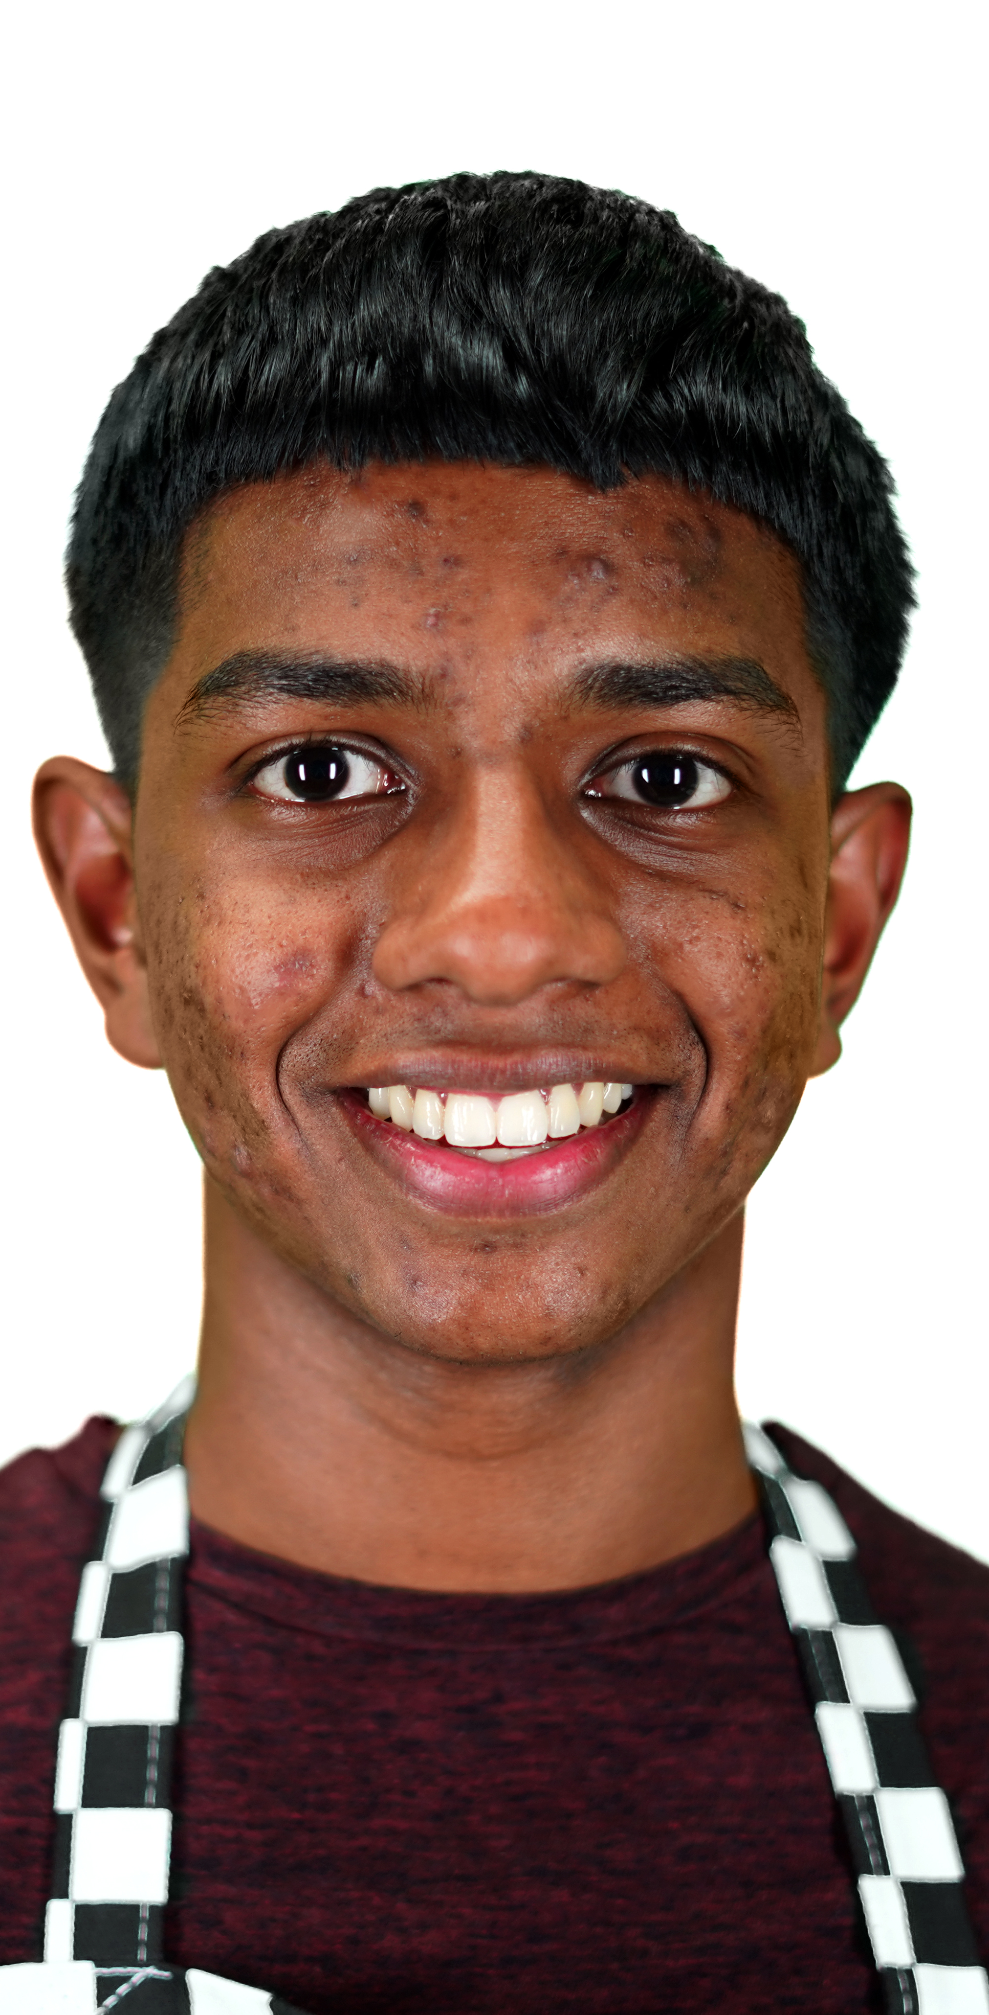
Ellie, Hasan and Rae have applied for jobs,
but how strong are their applications?
Imagine you are the employer.
Carefully read the job advert, application
extract and social media posts.
In your groups, discuss and decide:
  How well has each character ‘sold’
  their best skills and personal qualities?
  Are they a good match for the job?
  What impression have they made
  on you?
  Would you invite them to interview?
ELLIE
RAE
HASAN
Notes:
Review the learning outcomes for the lesson. How well do students feel they are able to:
List and describe some key steps in the application process for employment?
Critically appraise a simple job application, justifying their opinions?
Apply the STAR (situation, task, action, result) method to describe how they demonstrate one skill or quality?
Use hands, emojis, a 1-5 scale, RAG rating or your preferred approach.
Use ‘What went well’ and ‘Even better if’ to help students to reflect on their successes during the lesson and to identify areas they would like to do better (relate this to having a growth mindset).
Finish by asking students to choose 3 skills or personal qualities to develop. (If students completed Module 1 they can choose from those they identified as being weakest, otherwise students can choose from those listed on the skills and qualities glossary.) Students identify activities at school or in their personal lives that would enable them to develop each one they identify, and describe what they would do differently to develop this. Share ideas. Reinforce that students won’t develop unless they actually put their ideas into action. Students can write down their ideas if they wish.
Differentiation
Support: Discuss ideas for developing selected skills or qualities. Students can share ideas in small groups to help one another.
Challenge: Students create SMART goals for improvement. (Specific, Measurable, Achievable, Realistic, Timed). Students can write down their SMART goals.
Optional Homework
Using the information on slide 5, ask the students to put together the information they might include in their own CV or resume (there’s no need to include specific questions, as this should be a general CV, not one for a specific application). They should focus on their education history, work experience, personal statement, references and personal details.
Challenge: Encourage students to find CV templates online (or create their own) and format their information into a CV. Their CV must be no longer than one side of A4.

Slide 8
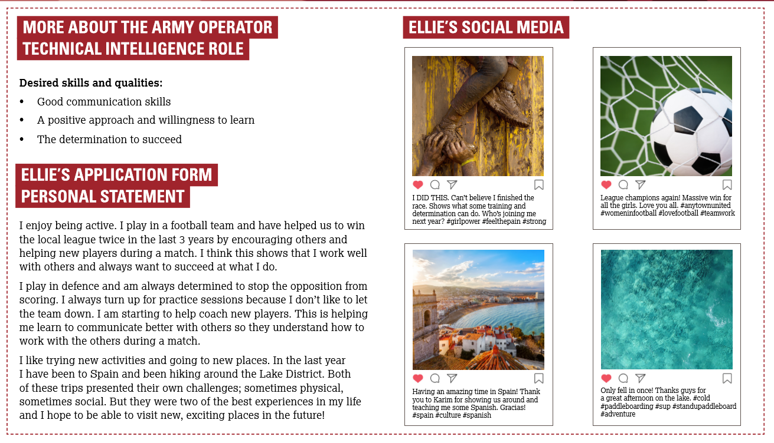

Slide 9
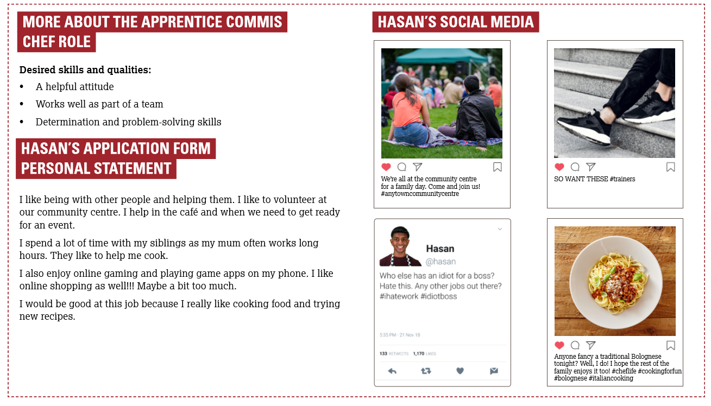

Slide 10
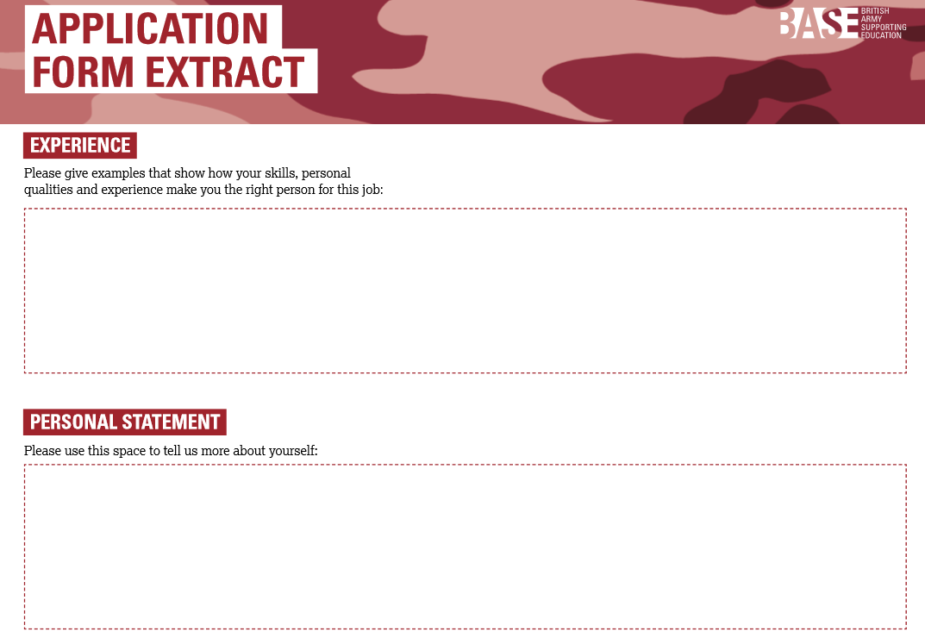

Slide 11
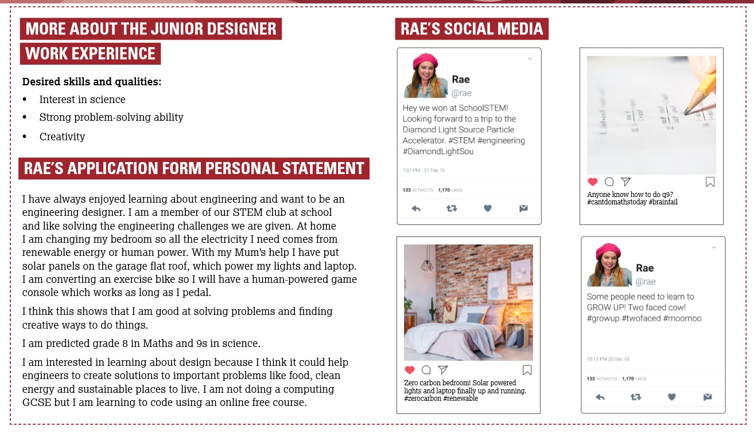

Slide 12
Skills are what you can do:
Communicate | Share information and understanding with others, clearly and accurately.
Analyse information | Examine information carefully to identify what’s most relevant or important.
Solve problems | Find solutions to difficult or complicated issues.
Manage money | Make calculations involving money and manage costs and budgets.
Plan work | Set goals to manage your time, tasks and yourself and complete all tasks.
Numeracy | Understand, work with and solve problems involving numbers.
Literacy | Read, write, speak and listen well, to understand and communicate.
Use IT | Use computers and other electronic devices to complete tasks and solve problems.
Make decisions | Examine different alternatives to identify the best choice.

Slide 13
Personal qualities are what you are like:
Conscientious | Completes tasks properly and thoroughly.
Team worker | Works well with others and shares the work, to complete tasks together.
Determined | Chooses not to give up when completing a task.
Positive | Has an optimistic, constructive and helpful approach to work and life.
Creative | Uses imagination and ideas to think of solutions and solve problems.
Respectful | Recognises the abilities, qualities, feelings and rights of others.
Disciplined | Controls their behaviour; does things in a careful and helpful way.
Loyal | Shows firm and constant support for those around them.
Reliable | Can be trusted; is consistently good at what they do.

Slide 14
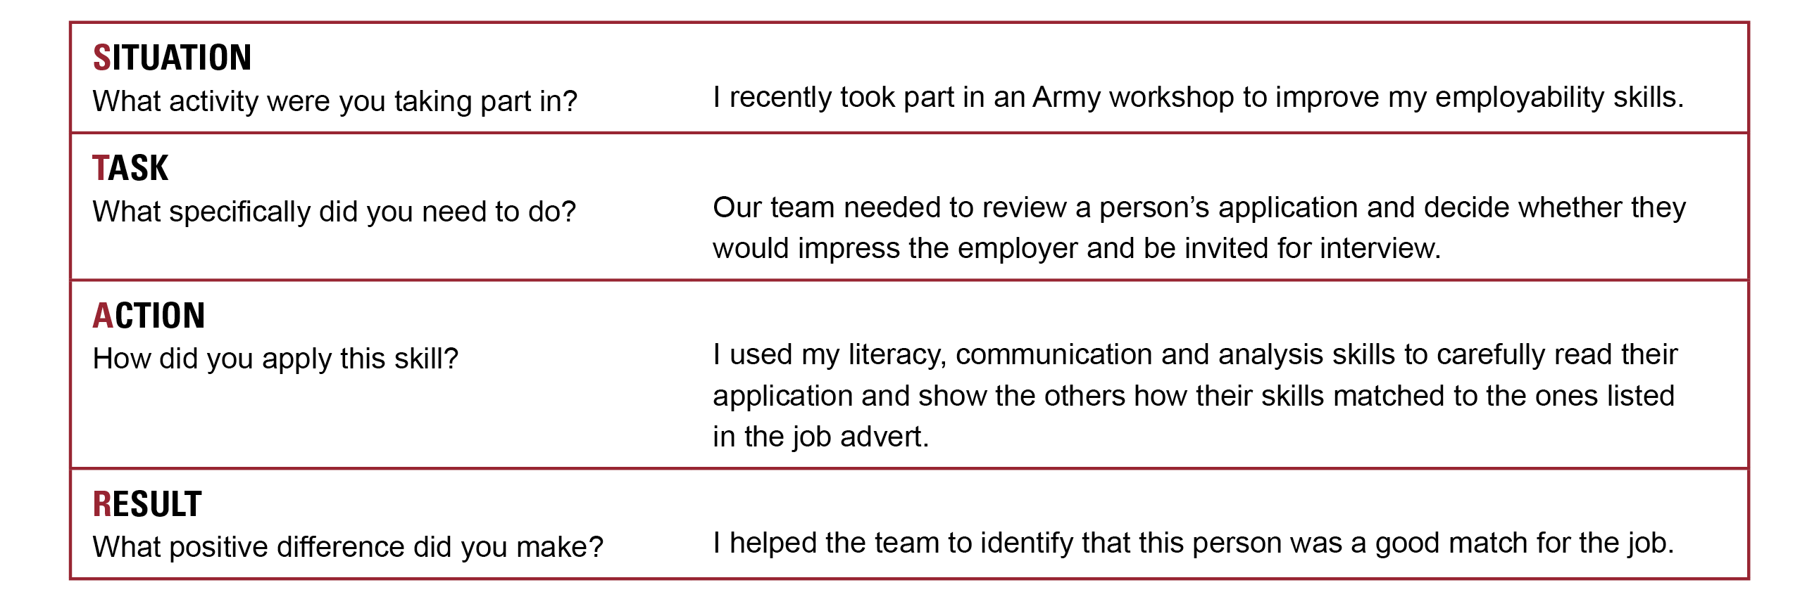
The STAR model is a great way to impress your interviewer and describe how you have shown an important skill or quality.
There are four parts to a STAR answer:
Notes:
See if students can recall that a personal statement can form an important part of any job (or course) application. It is the part of the application in which students bring their application – and themselves – to life and can demonstrate why their skills and qualities make them a good match for the needs of the job.
If students completed Module 1, for this activity they can use one their strongest skill and / or personal qualities they identified. Alternatively, students can select one from those listed in the skills and qualities glossary, or see the differentiation options below.
Review the STAR method using the example on the slide. Explain that students are applying for one of the jobs the character’s applied for (students can choose which one). As part of their application they must complete a personal statement explaining why their skills and qualities are a good match for the job. Students must use the STAR method to do this.
Give students time to develop one STAR example they could use in an application or interview. If appropriate, students can use peer coaching to improve their responses. Invite a few students to share their examples.
Differentiation
Support: Model further examples using the slide. Students develop one STAR explanation and can use peer coaching to identify a suitable example.
Challenge: Ask students to review how the characters used STAR in their applications in the previous activity / slide. Assign 1-2 skills and 1-2 qualities at random for each student to use STAR to demonstrate. OPTIONAL: students use STAR to help them to fill in the application form extract (or can do this independently after the lesson). (Students could alternatively complete a full application using your own choice of template form.)

Slide 15
WWW: What went well?
EBI: What could you do better next time?
Identify 3 skills or personal qualities
you would like to develop as part of
a ‘growth mindset’.
Complete the ‘Me at my Best’ part of
your Action Plan.
Don’t forget to put your plans into action!
Notes:
Review the learning outcomes for the lesson. How well do students feel they are able to:
List and describe some key steps in the application process for employment?
Critically appraise a simple job application, justifying their opinions?
Apply the STAR (situation, task, action, result) method to describe how they demonstrate one skill or quality?
Use hands, emojis, a 1-5 scale, RAG rating or your preferred approach.
Use ‘What went well’ and ‘Even better if’ to help students to reflect on their successes during the lesson and to identify areas they would like to do better (relate this to having a growth mindset).
Finish by asking students to choose 3 skills or personal qualities to develop. (If students completed Module 1 they can choose from those they identified as being weakest, otherwise students can choose from those listed on the skills and qualities glossary.) Students identify activities at school or in their personal lives that would enable them to develop each one they identify, and describe what they would do differently to develop this. Share ideas. Reinforce that students won’t develop unless they actually put their ideas into action. Students can write down their ideas if they wish.
Differentiation
Support: Discuss ideas for developing selected skills or qualities. Students can share ideas in small groups to help one another.
Challenge: Students create SMART goals for improvement. (Specific, Measurable, Achievable, Realistic, Timed). Students can write down their SMART goals.
Optional Homework
Using the information on slide 5, ask the students to put together the information they might include in their own CV or resume (there’s no need to include specific questions, as this should be a general CV, not one for a specific application). They should focus on their education history, work experience, personal statement, references and personal details.
Challenge: Encourage students to find CV templates online (or create their own) and format their information into a CV. Their CV must be no longer than one side of A4.

