Slide 1
COMPUTING
CSI
MISSING LINK

Slide 2

POSITIVE
AND NEGATIVES
What positives are there about increased use of the internet?
What are the negatives?

Slide 3

STAYING
SAFE ONLINE
1 IN 8
16%
62%
1 in 10
…of teens have their Facebook account set to private
…who use social media claim to have been a victim of a cyber attack
…parents allowed their children to use the internet from the age of two
…of teens have email or social media accounts their parents are unaware of
30%
7%
56%
100 million
…of identity theft victims are scammed by family
and close friends
…of those aged 16 or older were victims of identity theft in 2012
…of all online identity theft begins with a phishing email
…hours were spent by identity fraud victims trying to solve their issue

Slide 4
TYPES OF
ONLINE CRIME
TOP
IDENTITY THEFT
GROOMING
BUYING OR SELLING STOLEN GOODS
FRAUD
BULLYING / HARASSMENT
FIVE

Slide 5

DON’T LET
THEM IN
What opens the doors to most cyber criminals is poor control over personal data
There are many ways cyber criminals can harm you
The majority of cases end with financial and emotional damage

Slide 6
COMMON
ENTRY ROUTES
Paperwork or
bills left unattended
Phishing or
scam emails
Unsecure websites
Poor password habits
Inadequate social media safeguards
No firewalls
in place
Failure to
update software

Slide 7
WHAT DATA
IS IMPORTANT?
PERSONAL
DATA
Racial or ethnic origin
Name(s)
Political opinions
Is about living individuals.
Address
Religion
Date of birth
Membership of a trade union
SENSITIVE
Health
DATA
Banking details
Sexuality
Criminal activity
Is also about living people, but it includes details of one or more data subjects.

Slide 8

DATA SECURITY:
KNOWING YOUR RIGHTS

Slide 9
THE GDPR (General data protection regulation)
How the GDPR works
The GDPR was developed to strengthen pre-existing laws based on giving protection and laying down rules about how data about people can be used.
The New Regulation covers information or data stored on a computer or an organised paper filing system about living people.
The basic way it works is by:
Setting up rules that people have to follow
Having an Information Commissioner to enforce the rules
It does not stop companies storing information about people.
It does makes them follow rules:
The roles of those involved
The Information Commissioner is the person (and his/her office) who has powers to
enforce the Regulation.
A data controller is a person or company that collects and keeps data about people.
A data processor is a person or company that processes the data on behalf of the data controller.
A data subject is someone who has data about them stored somewhere, outside of their direct control. For example, a bank stores its customers' names, addresses and phone numbers. This makes us all data subjects as there can be few people in the UK who do not feature in computer records somewhere.
The Six Data Protection Principles
For the personal data that controllers store and process:
Lawfulness, fairness and transparency
Tell the subject what data processing will be done. What is processed must match up with how it has been described.
Purpose limitations
Personal data can only be obtained for “specified, explicit and legitimate purposes”. Data can only be used for a specific processing purpose that the subject has been made aware of and no other, without further consent.
Data minimisation
Data collected on a subject should be “adequate, relevant and limited to what is necessary in relation to the purposes for which they are processed”. In other words, no more than the minimum amount of data should be kept for specific processing.
Accuracy
Data must be “accurate and where necessary kept up to date”. Baselining ensures good protection and protection against identity theft. Data holders should build rectification processes into data management / archiving activities for subject data.
Storage limitations
Regulator expects personal data is “kept in a form which permits identification of data subjects for no longer than necessary”. In summary, data no longer required should
be removed.
Integrity and confidentiality
Requires processors to handle data “in a manner [ensuring] appropriate security of the personal data including protection against unlawful processing or accidental loss, destruction or damage.”

Slide 10

PHYSICAL
SECURITY
Physical data security is
often overlooked
However, even in the digital age, millions of letters, statements and bills are sent physically every day
Criminals often piece together personal information offline for
use illegally online

Slide 11
DIGITAL
SECURITY
Despite online security being better known than physical, many still don’t keep themselves safe
67%
30%
11%
71%
…of people never invest in safety
tools / firewalls
…use the same password for
all websites
…only update their software when forced to
…share their password with friends or family

Slide 12
ENTER
THE HACKER

Slide 13

7th June 2020
THE ATOM SMASHER
Well-known cyber criminal known as
the Atom Smasher is on the run. He’s
using his knowledge of the country’s
nuclear power plants to wreak havoc
on the power grid. You are a member
of the Royal Military Police, tasked with
tracking him down before he can cause
more damage. He’s a wily character,
but not perfect. His digital security is on-point but his physical
data security is rubbish. Or more accurately, in the rubbish…

Slide 14


Slide 15


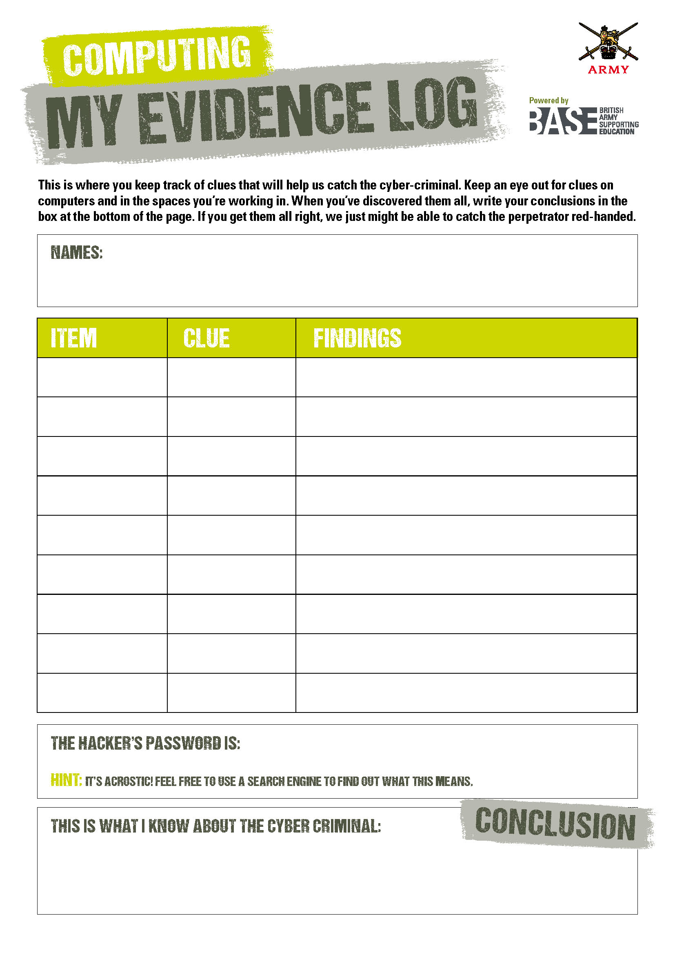


MISSION BRIEFING
OPERATION ATOM SMASHER
Word has it, The Atom Smasher has left the country and is planning his next cyber attack from a new country. To stop him, you need to find out:
Who he is
Their date of birth
Their email address
Their home address
Their job
Their work address
Answering these questions may help us hack into his laptop and foil his next attack…
ACTIVITY
Around the room are some commonly thrown away but useful
bits of paper
Each will have a clue to the Atom Smasher’s whereabouts
Collect each clue, sorting the real answers from the fake
Once you have all clues in your evidence log
REMEMBER: The Atom Smasher is very clever. He may have hidden some information. Think, talk and work out what’s real and what’s fake. You will need to use your investigative skills
to succeed...
GOOD LUCK

Slide 16
DATA IN
THE DUSTBIN
HINT: An ‘acrostic’ is the first letter of each word…
Notes:
TEACHERS: LEAVE THIS SLIDE UP UNTIL THE TEAMS HAVED WORKED OUT WHERE THE ATOM SMASHER’S NEXT TARGET IS

Slide 17

HACKER
PROFILE
NAME:
DR ALEX W. COOMBE
EMAIL:
ALEXTHEATOM@GMAIL.COM
D.O.B:
09/02/1987
ADDRESS:
BATTLE HOUSE, READING, RG3 2BG
NEXT ATTACK:
ICELAND,
JOB:
NUCLEAR ENGINEER
WORK ADDRESS:
SPRINGFIELD POWER PLANT, SPRINGFIELD, BERKSHIRE
REYKJAVIC

Slide 18
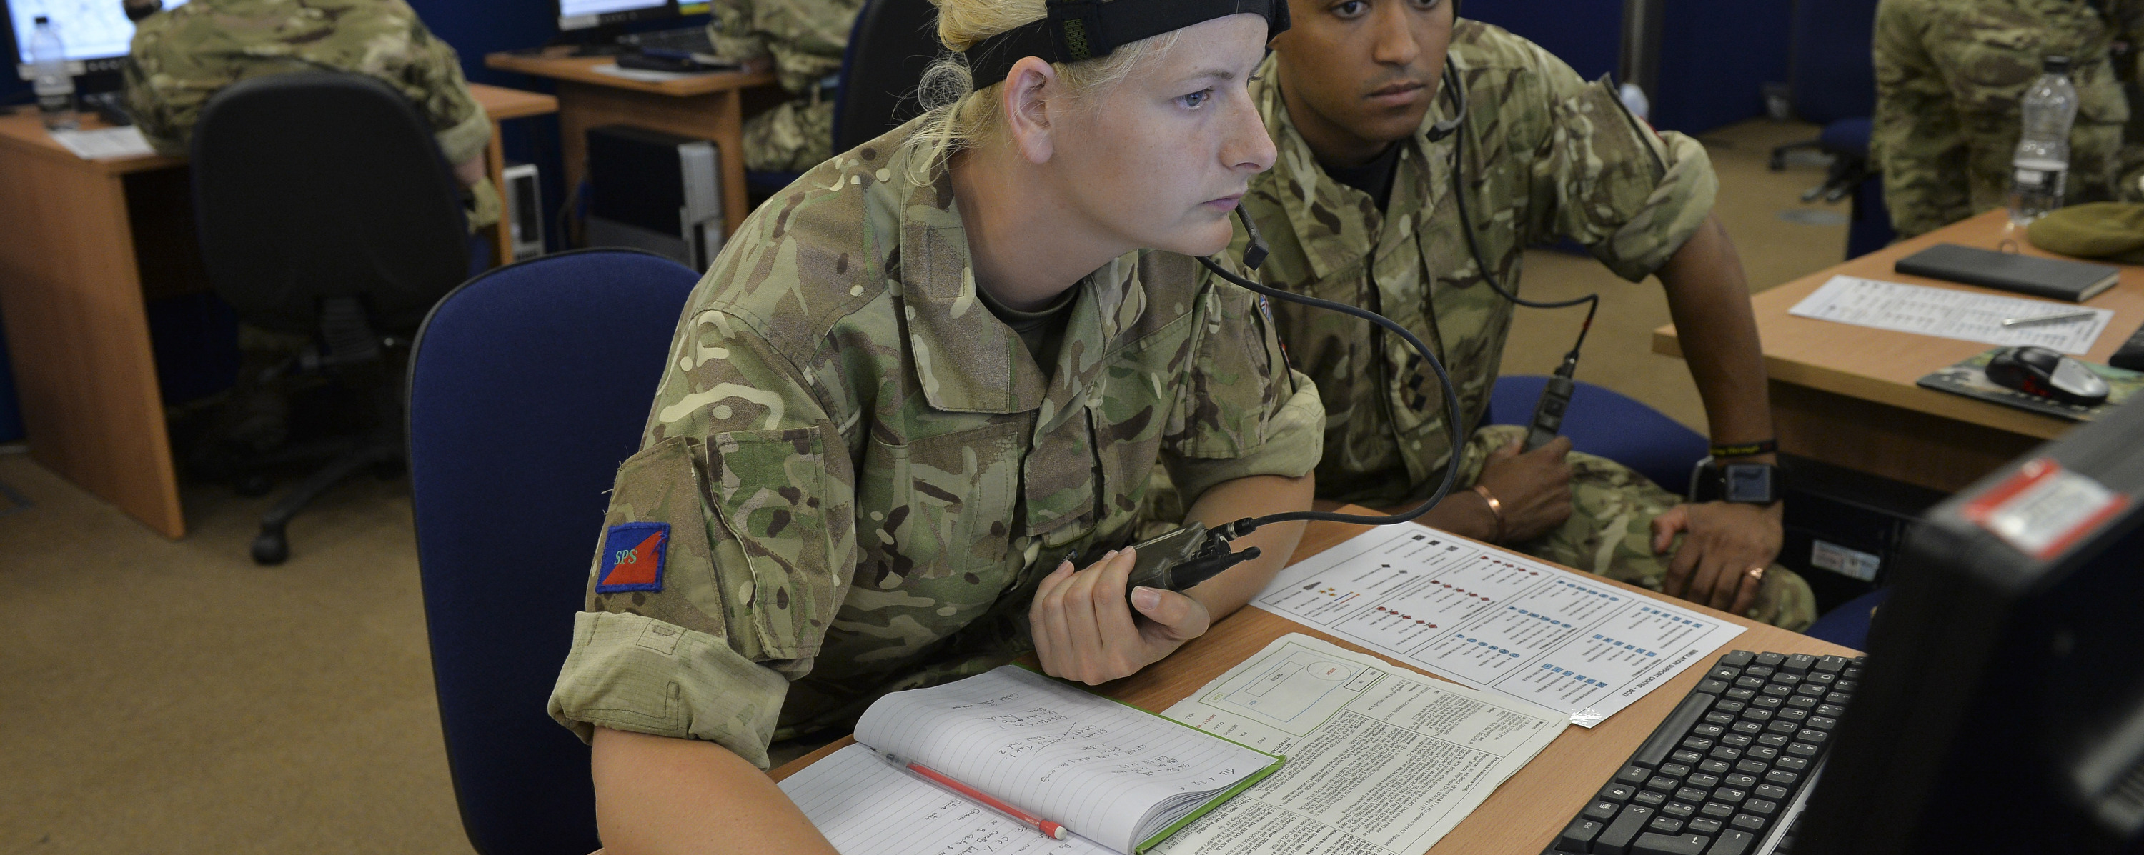
THE
DEBRIEF
Do you know how important physical data security is?
Is it easier than you thought to collect personal information?
Do you know how to keep yourself safe from hackers?
What could Dr. Alex W. Coombe have done to hide his tracks?

Slide 19
COMPUTING
CSI
MISSING LINK

