Slide 1
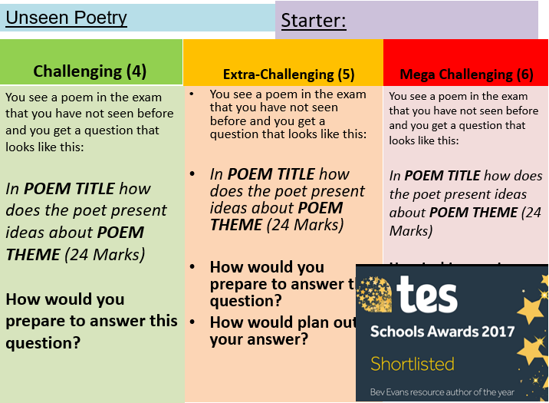
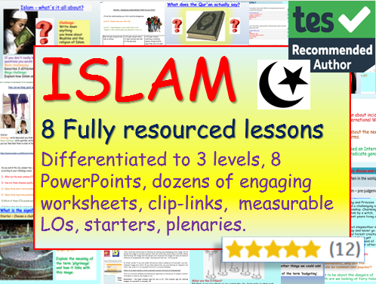
Email:
info@ecpublishing.co.uk
Website:
www.ecpublishing.co.uk
This product, or any part of it, is not to be distributed, or resold under any circumstances, including through any websites, groups or organisations, without written permission from the author. Group and whole school licenses are available at the publisher’s request.
Thanks for choosing EC Resources
©EC Publishing Ltd 2019
©Lead Practitioner English 2019
Top TES PSHE + Citizenship provider, with 2 million free downloads so far.
Check out our website, for free resources.
English
PSHE
History
Citizenship
RE
Whole School
Follow us on twitter: @ec_publishing or facebook

