Slide 1
Key stage 3 Art Projects and tasks

Slide 2
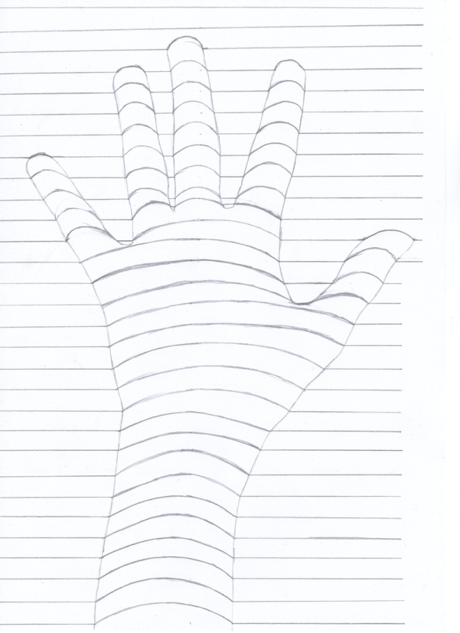
3d HAND LIFTS
Lightly draw around your hand, then using horizontal lines, give your hand a 3d lift.
Try using colours to make your work more interesting .
Try adding extra SHADING to show tonal values.

Slide 3
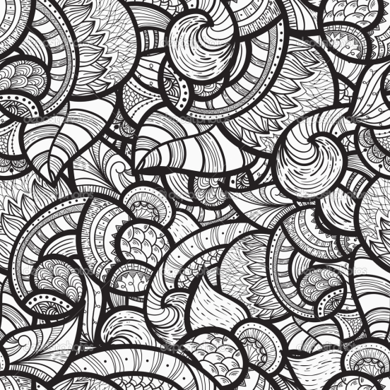
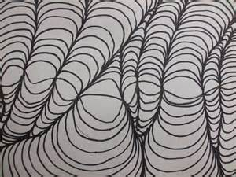
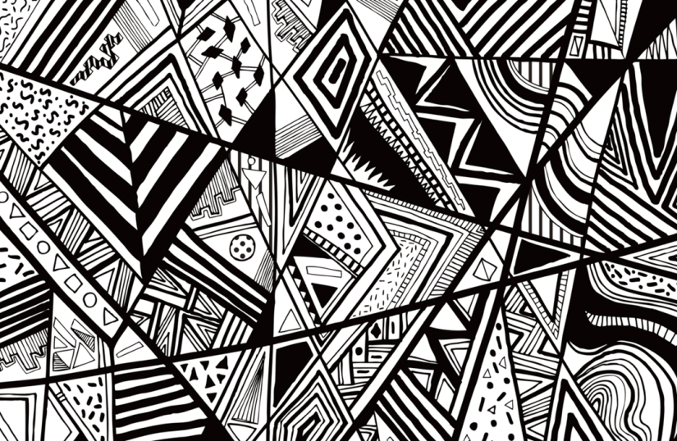
Reconstruct the images provided, choose one of them to recreate half of the image.
This will help develop your line drawing skills.

Slide 4
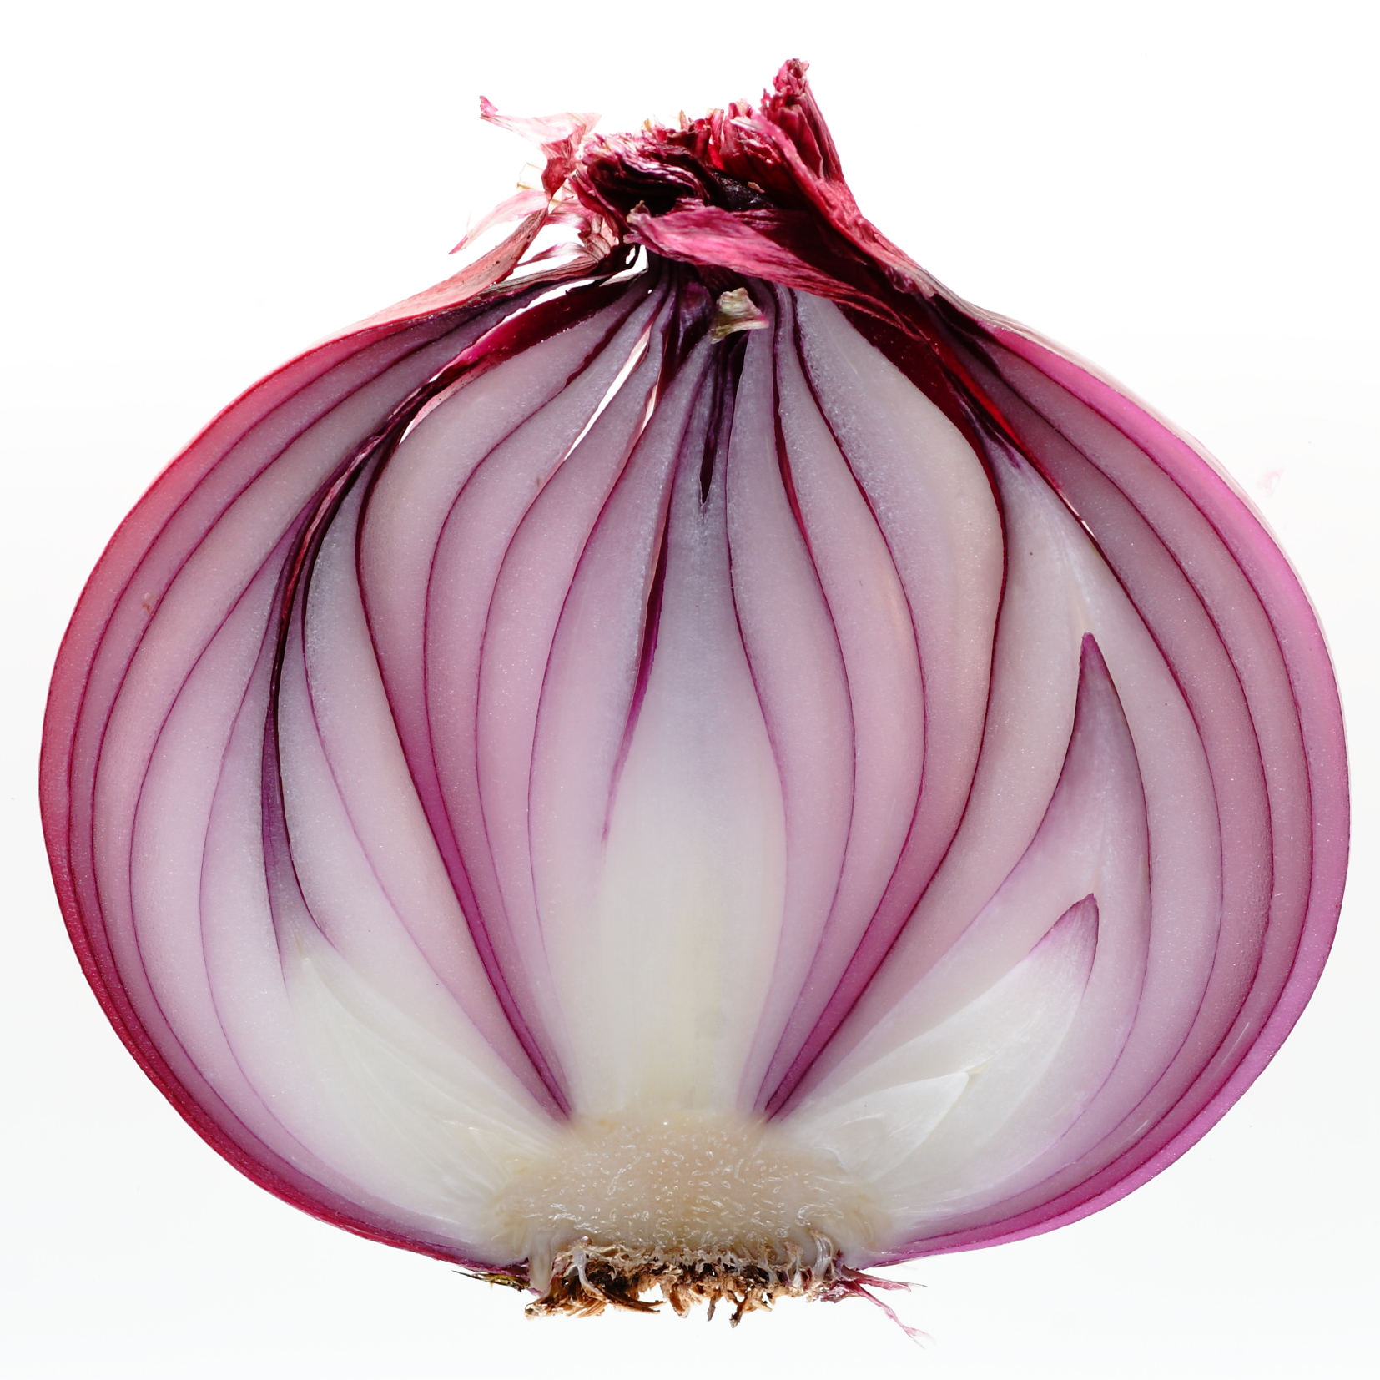
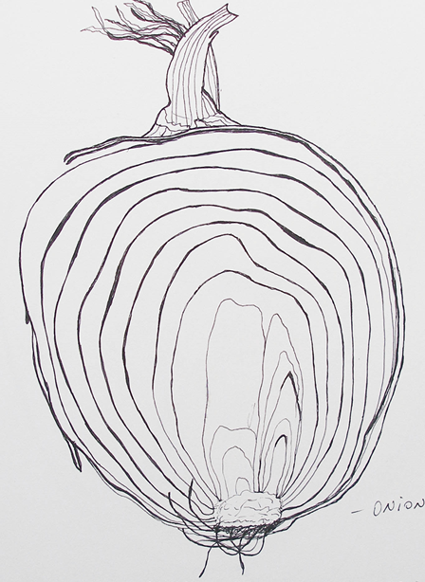
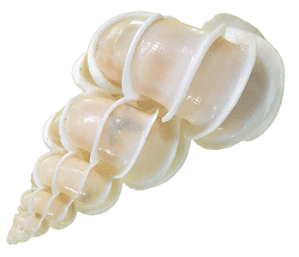
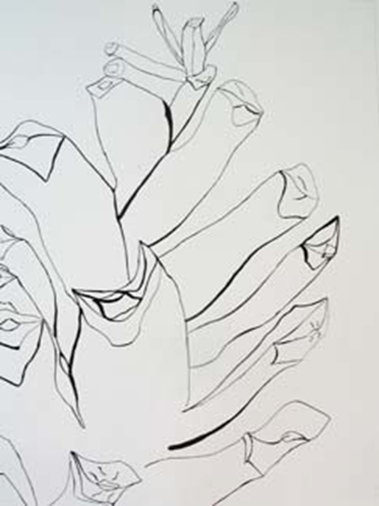
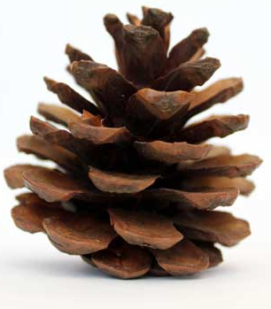
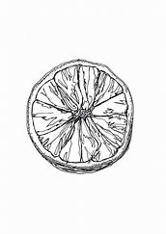
Create a continuous line drawing of one of these objects. A continuous line drawing means you CANNOT take your pencil off the paper.

Slide 5
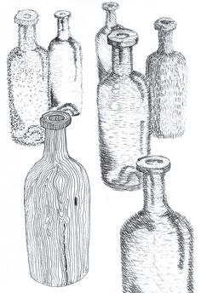
Task: Mark making
Add line or mark making techniques to the shape of a bottle in order to make it appear 3D. You are not allowed to use conventional shading but must use line and mark-making.
Challenge yourself further by drawing the shape of the bottle first.

Slide 6
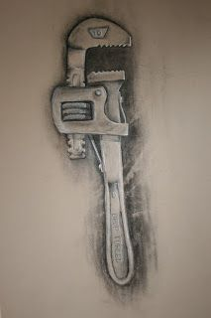
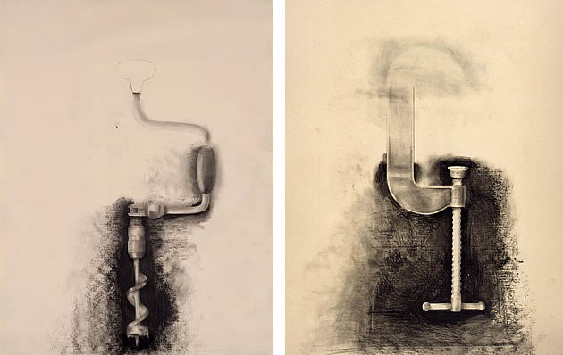
Jim Dine
Jim Dine uses basic tones in order to create objects with form. He concentrates on rendering the highlights and shadows and uses coloured paper as the mid-tone.
Task: Practise and develop your drawing skills by drawing household utensils such as cutlery, tools, pots and pans.

Slide 7
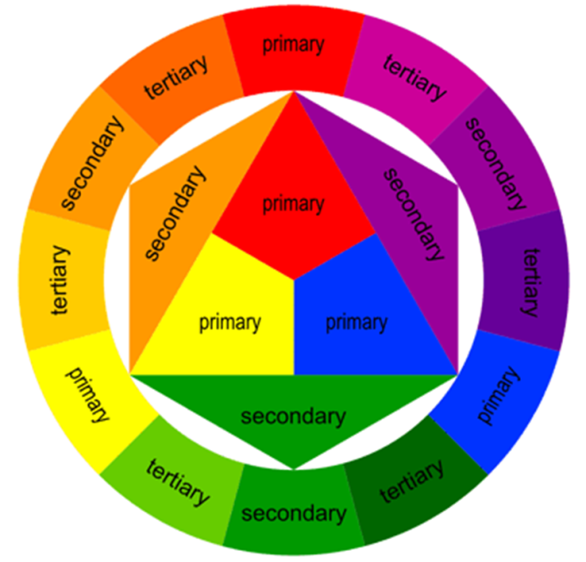
Colour Wheel
Use paints or pencil to try and recreate the secondary and tertiary colours.
Primary Colour
+
Secondary colour
=
Tertiary Colour

Slide 8
Colour quiz
DRAW A SQUARE AROUND THE SECONDARY COLOURS
IN THE CENTRE OF THE CIRCLE DRAW HALF A SQUARE
IF YOU MIX BLUE AND GREEN WHAT COLOUR DO YOU GET?
NEXT TO THE COLOUR CIRCLE DRAW TWO HALF CIRCLES IN THE COMPLEMENTARY COLOURS
5. DRAW A CIRCLE AROUND THE PRIMARY COLOURS

