Slide 1
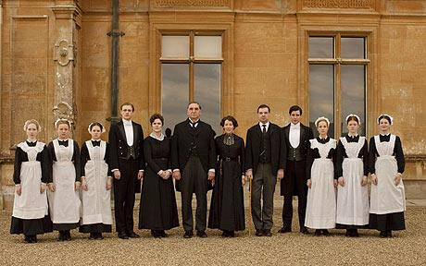
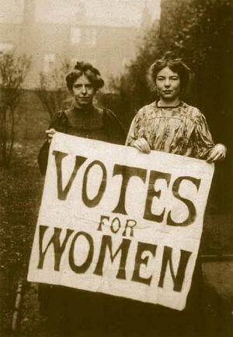
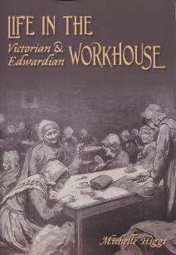
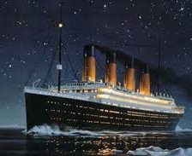
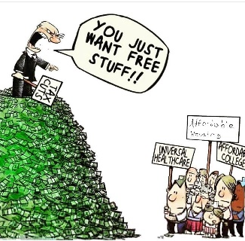
Knowledge Organiser – An Inspector Calls
Who is JB Priestly?
Born in Bradford, 1894
In WW1, he immediately joined the British army. After being wounded and affected by a gas attack, he was withdrawn from active service.
Priestley wrote An Inspector Calls after the First World War and contains controversial, politically charged messages.
He was concerned about the social inequality in Britain during the 1930’s.
set up a new political party, the Common Wealth Party, which argued for public ownership of land, greater democracy, and a new 'morality' in politics.
Context – Edwardian England 1912 (two years before World War One)
An Inspector calls was set in 1912 |  | An Inspector calls was written in 1945
The First World War would start in two years. Birling's optimistic view that there would not be a war is completely wrong. There were strong distinctions between the upper and lower classes. 87% of all the money in England belonged to only 5% of the population. Women were subservient to men. They had fewer rights than men: couldn’t vote; stayed at home to look after children; lower class women seen as cheap labour; higher class simply expected to get married; men were expected to be the breadwinners The ruling classes saw no need to change the status quo. With the Capitalists in control, England had NO welfare system i.e. no dole if you were unemployed. For those lucky enough to be employed, there were no unions or laws that helped and protected people at work. Employers could basically treat their workers as they wanted and there was no minimum wage. The Titanic – the ‘unsinkable ship’ took its first voyage and sunk after hitting an iceberg. The ship had been a symbol of progress and hope in engineering term but many lives were lost as it sank to the bottom of the sea. The boat’s layout made the class system very visible – all the lowest class passengers were left to die. |  | The Second World War ended in Europe on 8 May 1945. People were recovering from nearly six years of warfare, danger and uncertainty. Class distinctions had been greatly reduced as a result of two world wars. Women had earned a more valued place in society due to their hard work during the wars (plus the work of the suffragettes and suffragists) There was a great desire for social change. Immediately after The Second World War, Clement Attlee's Labour Party won a landslide victory over Winston Churchill and the Conservatives. Priestley wanted to make the most of these changes. Through this play, he encourages people to seize the opportunity the end of the war had given them to build a better, more caring society. This play has a moral message (like a fable, with a lesson to be learned at the end); that we should think of others and work together to ensure that we are all offered a chance to be treated equally, This idea is known as socialism. This meant: Everyone should think of others, not just themselves. Everyone should work together for the greater good. Everyone should be offered the chance to be treated equally i.e. no class system for example.
Questions to consider:
Does everyone deserve to have the same?
Is it fair that our opportunities are determined by our class/ social status?
Who should take responsibility for the fact that there is still extreme poverty?
Are you a capitalist or a socialist? Why?
Is gender discrimination still a problem?
How can we ensure that class and gender discrimination is not an issue in modern society?
GSCE LINK:
AO3 – Relate texts to their social, cultural and historical contexts; explain how texts have been influential and significant to self and other readers in different contexts and at different times.
Key Words | Definitions
Subservient Breadwinner Socialism Capitalism Dole Suffragettes Suffragists | prepared to obey others unquestioningly a person who earns money to support their family, typically the sole one. Thinking of the collective, rather than just the individual The idea that a few individuals or private companies own industry. Benefits a woman seeking the right to vote through organized, militant protest. a woman seeking the right to vote through organized, moderate protest.
Capitalism- The idea that a few individuals or private companies own industry. Therefore there is a hierarchy of wealth. The people at the bottom work for the people at the top. They don’t have as much money and it can lead to exploitation.
Socialism- The belief that we all have to look after each other. The rich should help the poor. Services should be provided by the government and therefore communities get a say in how services (like NHS) are run and it is more fair.

Slide 2
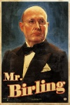
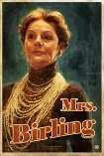
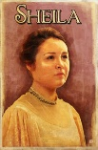
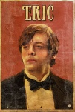
Key Characters: | Information:
Arthur Birling | "heavy-looking, rather portentous man in his middle fifties” He has worked his way up in the world and is proud of his achievements. He boasts about having been Mayor and tries (and fails) to impress the Inspector with his local standing and his influential friends. He is extremely selfish: He wants to protect himself and his family. He believes that socialist ideas that stress the importance of the community are "nonsense" and that "a man has to make his own way."
Sybil Birling | "about fifty, a rather cold woman and her husband's social superior.“ She is a snob, very aware of the differences between social classes – ‘a girl of that class’ She sees Sheila and Eric still as "children" and speaks patronisingly to them. She tries to deny things that she doesn't want to believe: Eric's drinking, Gerald's affair with Eva, and the fact that a working class girl would refuse money even if it was stolen
Shelia Birling | "a pretty girl in her early twenties, very pleased with life and rather excited.“ she shows her compassion immediately she hears of her father's treatment of Eva Smith: "But these girls aren't cheap labour - they're people." – Priestly is trying to show a new attitude of lower class to educate a new generation.
Eric Birling | "in his early twenties, not quite at ease, half shy, half assertive.“ Eric seems embarrassed and awkward right from the start. It soon becomes clear to us that he is a hardened drinker. He feels guilt and frustration with himself
Gerald Croft | "an attractive chap about thirty, rather too manly to be a dandy but very much the easy well-bred man-about-town.“ He is an aristocrat - the son of Lord and Lady Croft. He is not as willing as Sheila to admit his part in the girl's death
Eva Smith (Daisy) | "very pretty - soft brown hair and big dark eyes.“ Her parents were dead. She came from outside Brumley: Mr Birling speaks of her being "country-bred." She was working class.
The Inspector | "an impression of massiveness, solidity and purposefulness. He is a man in his fifties, dressed in a plain darkish suit. He speaks carefully, weightily, and has a disconcerting habit of looking hard at the person he addresses before actually speaking. “ He works very systematically
Career Paths:
By studying An Inspector Calls you may be interested in a career path of…
Playwright
Role within the Government
Political Activist
Actor/Actress
Key Theme | Information:
Social Responsibility | The words responsible and responsibility are used by most characters in the play at some point. Each member of the family has a different attitude to responsibility. Make sure that you know how each of them felt about their responsibility in the case of Eva Smith. The Inspector wanted each member of the family to share the responsibility of Eva's death: he tells them, "each of you helped to kill her." However, his final speech is aimed not only at the characters on stage, but at the audience too.
Social Class | Apart from Edna the maid, the cast of the play does not include any lower class characters. We see only the rich, upwardly mobile Birlings and the upper class Gerald Croft. Yet we learn a lot about the lower class as we hear of each stage in Eva's life and we see the attitude the Birling's had for them.
Age | Age is an important theme in An Inspector Calls. Priestley uses it to show how he believed that there was hope in the younger generation's ability to learn and change. The older characters' opinions and behaviours are stubbornly fixed. Mr Birling refuses to learn and Mrs Birling cannot see the obvious about herself and her children. Eric and Sheila however are younger - they accept their mistakes and offer the chance for a brighter future.
Guilt | Arthur, Sybil, Sheila, Eric and Gerald must come to terms with their guilt, leading to Eva/Daisy’s demise. The Inspector wants the family to accept the pain it has caused Eva/Daisy. In this way, guilt plays an important role in the Inspector’s politics. Although he does not describe his politics explicitly, he appears to be a socialist, and for him, socialism demands that human beings look out for one another, do their absolute best to avoid harming each other. When people do wrong, they must then explain, to themselves and others, the wrongness of their actions.
Sex | Because Eva was a woman - in the days before women were valued by society and had not yet been awarded the right to vote - she was in an even worse position than a lower class man. Even upper class women had few choices. For most, the best they could hope for was to impress a rich man and marry well - which could explain why Sheila spent so long in Milwards. For working class women, a job was crucial. There was no social security at that time, so without a job they had no money. There were very few options open to women in that situation: many saw no alternative but to turn to prostitution.

